Slide 1
Multidimensional Drug Profiling By Automated Microscopy
Zachary E. Perlman et al.
Published 2004
Joseph Martinez and Ginger Yang

Slide 2
Stages of Pharmaceutical Development
Activity on Target
Off Target Activity
Effective Concentration
Notes:
Testing millions of compounds for effectiveness against a target
Screening compounds against off target activity
Finding optimal compound concentration for activity while limiting toxicity

Slide 3
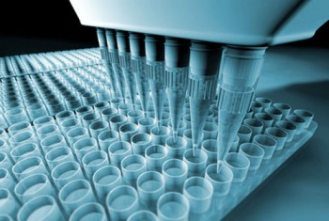
Use of Automated Microscopy
Limited throughput with current (2004) transcriptional and proteomic profiling
Automate for efficiency and cost effectiveness
Multiplex markers to screen multiple pathways and mechanisms of action
Enhanced efficiency allows concentration dose dependent analyses
Notes:
Single drug concentrations

Slide 4
Experimental Setup
100 Drugs
6 Alternate Titrations
1 Toxin (Didemnin B)
90 Known
3 Unknown
Notes:
Known Drugs: Cover common mechanisms of toxicity and therapeutic action in cancer and other diseases, many with the same target.
Blinded alternate titrations of known drugs
Micro to picomolar final concentrations of drugs
Didemin B: Immunosuppressent and extremely cytotoxic

Slide 5
Testing Scheme
HeLa Cells in 384 Wells
Treat With Drug Titrations
Image and Measure Descriptors
11 Probes
Notes:
Micromolar to picoplar concentrations
Size, Shape, Intensity descriptors
7x 10^7 individual cells were identified
from >600,000 images, yielding ~10^9 data
points.

Slide 6
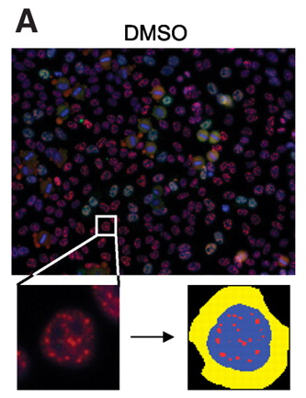
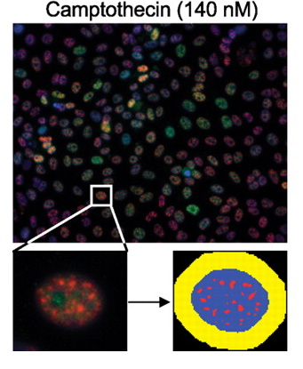
Sample Image
Perlman et al (2004)
Notes:
DMSO = control
Camptothecin: Anticancer drug: inhibits topoisomerase B. Arrests cell cycle at S phase (also at higher concentrations inhibits transcription)
Blue = DNA, Red = SC35, Green = anillin

Slide 7
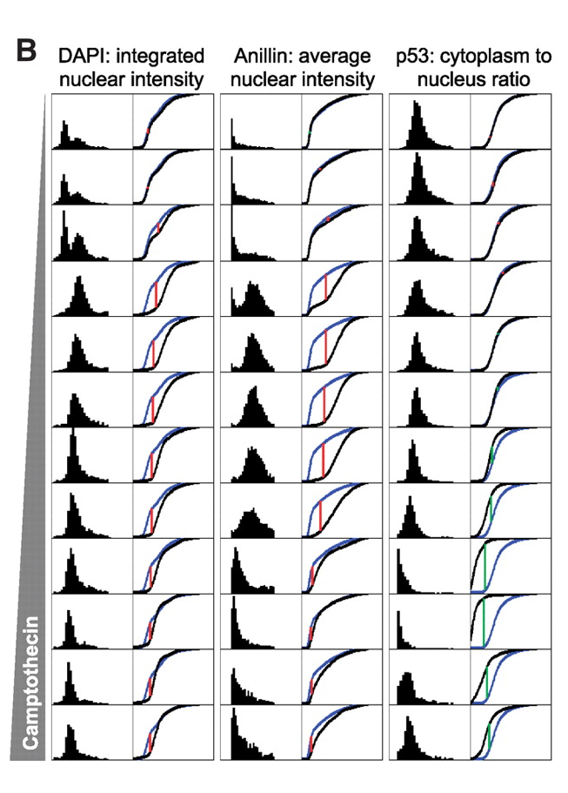
Quantification of Population Responses
Perlman et al (2004)
Notes:
DAPI: DNA Stain
Anilin: Binds Actin (Cytokinesis protein)
P53: tumor suppressor Gene cytoplasm to nucleus ratio
Generated a histogram and cdf (blue) to compare to control (Black)
Red/Green Verticle line = maximum difference (KS statistic)
Low concentrations: histogram = mix of G1, S and G2/M
Medium concentration = S/G2 Arrest
High Concentrations: Apoptosis (p53 induced)

Slide 8
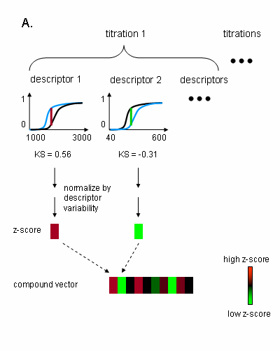
Comparison of Compound Profiles
Generate a Kolmogorov-Smirnov (KS) Statistic
Compute a z score by dividing KS statistic by a measure of variability in control populations
Create Heat Plot
Determine Primary Effective Concentration (PEC)
Notes:
Kolmogorov Smirnov statistic: controls experimentation distributions to control distributions
Heat map : z score for each KS statistic, increasing scores = red and decreasing = green (arrowheads – descriptors)
Advantage: Relationship between z score and physical measure may not be linear, amplify the changes: not discernable by eye but still significant.
x axis: increasing dose
Y axis: descriptors (amount of fluorescence)
Increasing scores = red, decreasing scores = green
Top (DNA), bottom (Actin)

Slide 9
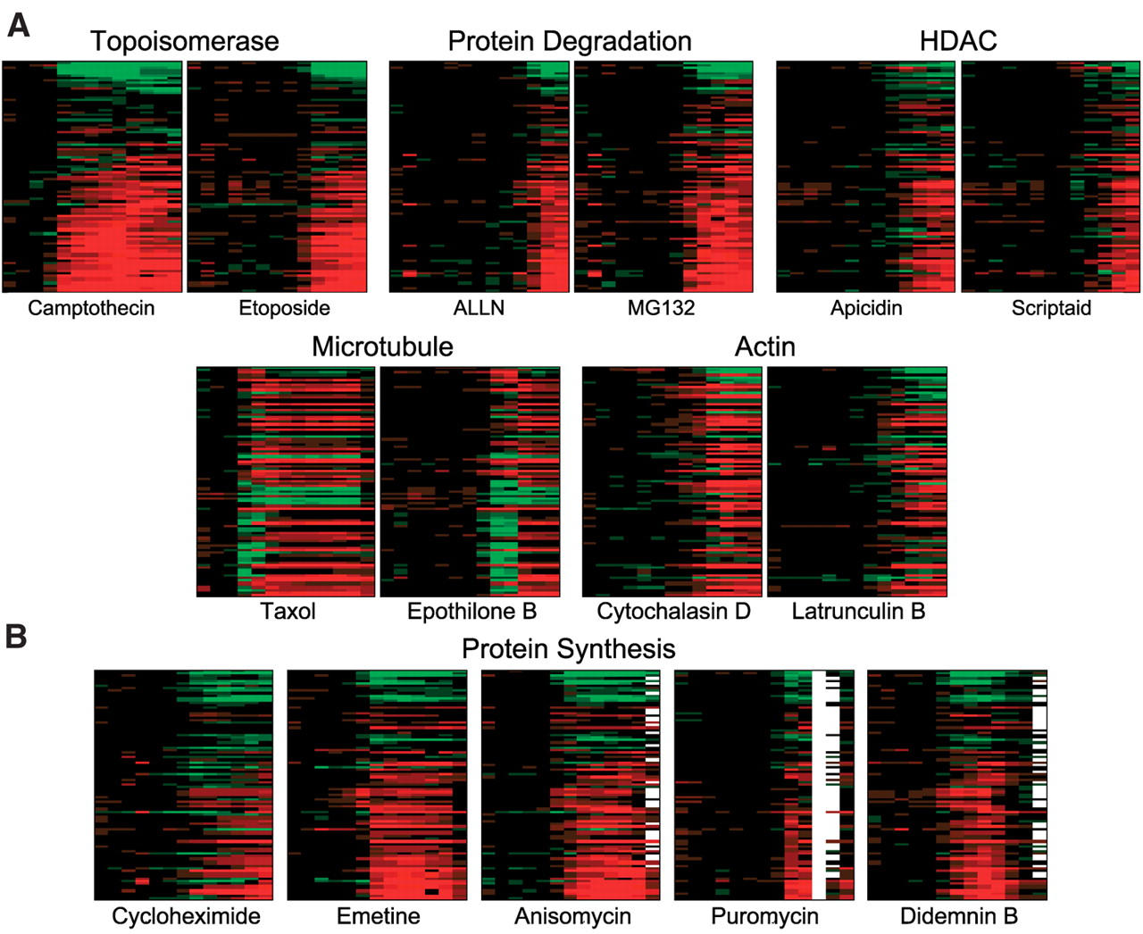
Heat Maps
Notes:
Drugs with common targets but diff chemical structures have similar profiles
Drugs with similar structures but different mechanisms: dissimilar profiles
Drugs within same family: such as protein synthesis inhibitors have different profiles
Great but how to compare?
Drugs with common targets but diff chemical structures have similar profiles
Drugs with similar structures but different mechanisms: dissimilar profiles
Drugs within same family: such as protein synthesis inhibitors have different profiles

Slide 10
Conclusion
Cytometric dose-response profiling successful at determining drug response profiles quantitatively
The method is fast, cheap, and unbiased.
Future work: has been commercialized today
Questions?

Slide 11
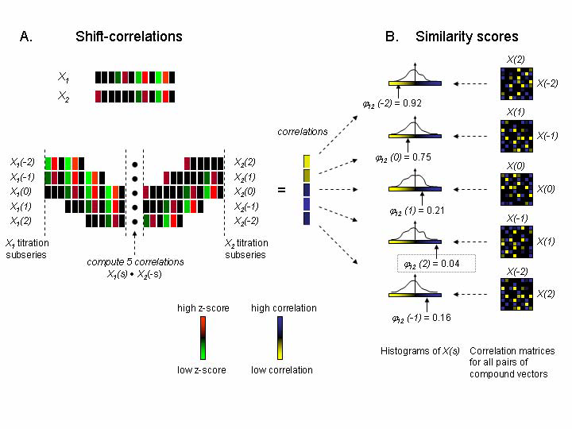
Titration-Invariant Similarity Score (TISS)
Notes:
Affinity doesn’t really matter for drug mechanisms if that’s what we’re interested in.
X1 and X2 are just examples: many more than that (13*93 or something @_@)
Shift the starting point of titration series so they match. (truncate beginning or ending)
Find correlations for each shift ϕij(s) = (# entries in X(s) ≥ (Xij(s) - 1) / 40,000.
Pick the minimum value (fraction that lies to the right of the correlation of value)
Grouped compounds of similar mechanism ( can be useful in the future for determining the mechanism of unknown or new drugs)

