Slide 1
20.020 Technical Specification Review Tackling Tartar
Divya Arcot, Megan Bumgarner
Spring 2011

Slide 2
Agenda
Background
Proposal
Devices
Parts
Testing/Debugging
Timing Diagram
Impact
Issues
Go/No Go

Slide 3
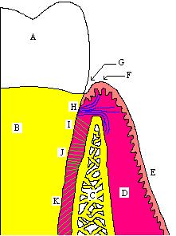
Background
Periodontitis – Set of Gum Diseases
Caused by bacteria secreting toxins near the gum line
→ Prompt an aggressive immune response
Leads to gum swelling, bleeding, and tooth decay
Bacteria move into pockets created between teeth and gum
Attachments between gum and teeth destroyed by matrix metalloproteinases (MMPs)
Toxins secreted by the bacteria continue this destructive cyclic process
MMPs drive tissue destruction
Further harms the gum, triggering great inflammation

Slide 4
Proposal
Our Goal:
To engineer bacteria to secrete anti-inflammatory agent (TIMP1) to reduce inflammation to prevent tartar- causing bacteria from expanding below the gum line
Theory Behind the Design:
Bacteria can be targeted through pH and quorum sensing
Bacteria secrete toxins which are more acidic that the average pH of the mouth
Assuming that it is easier for bacteria to bind to a certain location, our bacteria should also bind in high concentrations to the same locations
TIMP1 inhibits production of MMPs

Slide 5
Devices
Cellular Export Sequence
Quorum Sensor
AND
Gate
TIMP1
(promoter)
(MMP Inhibitor)
pH Sensor

Slide 6
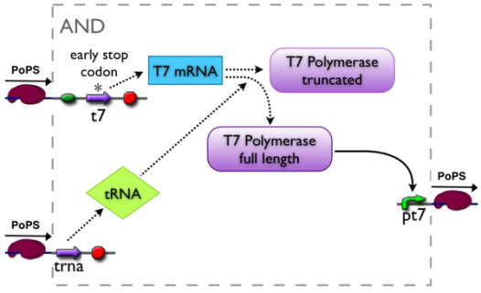
Parts
BBa_K182200
Cellular Export Sequence
Quorum Sensor
BBa_J34000.
AND
Gate
TIMP1
(promoter)
(MMP Inhibitor)
pH Sensor
Need to Know!

Slide 7
Testing/Debugging
TEST 1 – Quorum Sensor
Cellular Export Sequence
Quorum Sensor
GFP
AND
Gate
TIMP1
(promoter)
(MMP Inhibitor)
pH Sensor

Slide 8
Testing/Debugging
TEST 2 – pH Sensor
Cellular Export Sequence
Quorum Sensor
AND
Gate
TIMP1
(promoter)
(MMP Inhibitor)
pH Sensor
RFP

Slide 9
Testing/Debugging
TEST 3 – TIMP1 Expression Sensor
Cellular Export Sequence
Quorum Sensor
AND
Gate
YFP
TIMP1
(promoter)
(MMP Inhibitor)
pH Sensor

Slide 10
Timing Diagram
AND Gate
Devices
Quorum Sensor
pH Sensor
Timing

Slide 11
Impact
Will serve as a vital product in preventing further tooth decay and gum diseases (oral cancer, gingivitis, etc.)
Over all improvement in oral hygiene
Supplement to brushing, flossing, using mouthwash, etc.
Reduce dental costs
Many do not have insurance which covers dental care
Inexpensive enough to be marketed to impoverished countries

Slide 12
Issues
Will the system work in its desired location?
Will inhibition of MMPs be enough to fix an inflammation problem?
How big of a problem is this relative to other factors influencing inflammation
At what range should the pH sensor be set?
The average pH varies in mouths of different people
Will all components be compatible?

Slide 13
Go/No Go
GO
(please)

Slide 14
References
http://www.surgeryencyclopedia.com/Fi-La/Gingivectomy.html
http://www.ncbi.nlm.nih.gov/pubmed/12645936
http://www.sciencedirect.com/science?_ob=ArticleURL&_udi=B6W8H-4B0BWN15&_user=501045&_coverDate=12%2F31%2F2003&_rdoc=1&_fmt=high&_orig=gateway&_origin=gateway&_sort=d&_docanchor=&view=c&_acct=C000022659&_version=1&_urlVersion=0&_userid=501045&md5=66c4fd58b0b46b178c38c795660d0c7b&searchtype=a
http://rpi.edu/dept/bcbp/molbiochem/MBWeb/mb2/part1/protease.htm#other
http://en.wikipedia.org/wiki/Matrix_metalloproteinase
http://www.colgateprofessional.com/LeadershipUS/ProfessionalEducation/WhitePapers/Resources/pdf/profed_WP_oral-inflam-and-patient-mgmt.pdf
http://en.wikipedia.org/wiki/Chronic_periodontitis
http://www.google.com/patents?hl=en&lr=&vid=USPAT5725373&id=QaIkAAAAEBAJ&oi=fnd&dq=sensing+gum+inflammation&printsec=abstract#v=onepage&q=sensing%20gum%20inflammation&f=false

