Slide 1
Chassis introduction
Natalie Kuldell
February 14th, 2012

Slide 2
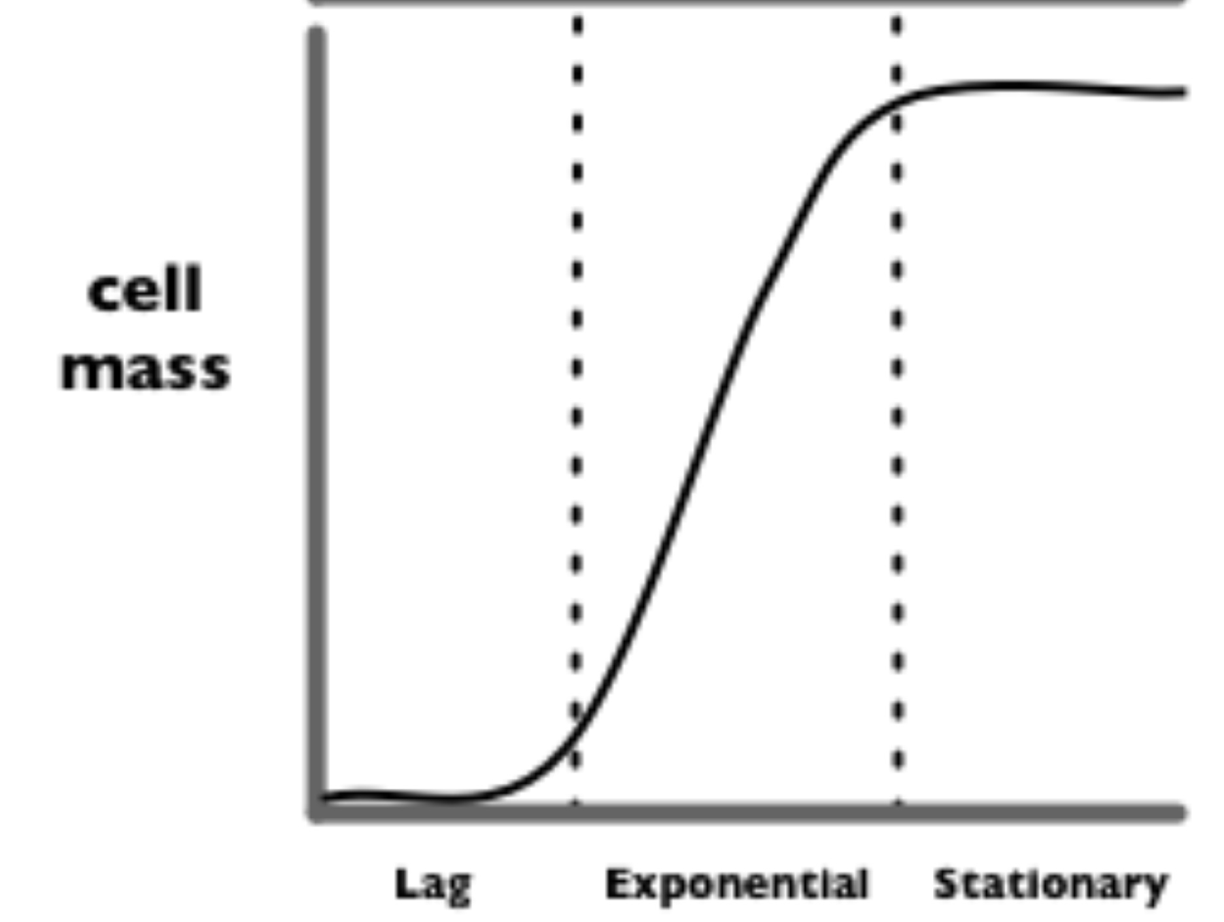
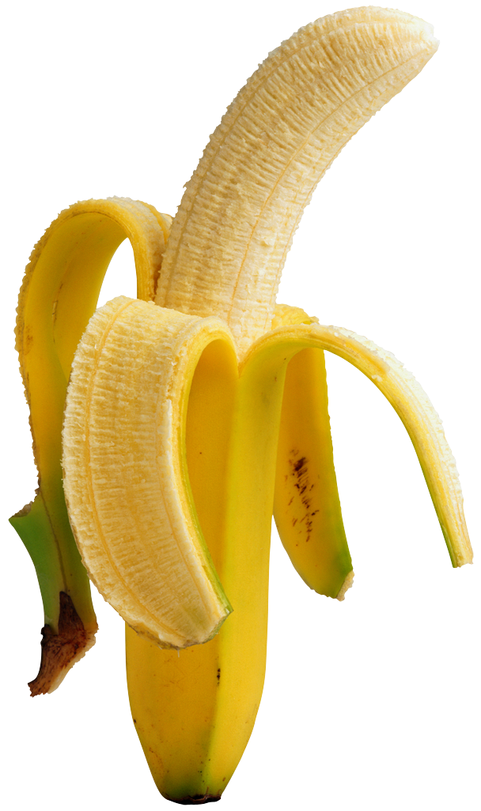
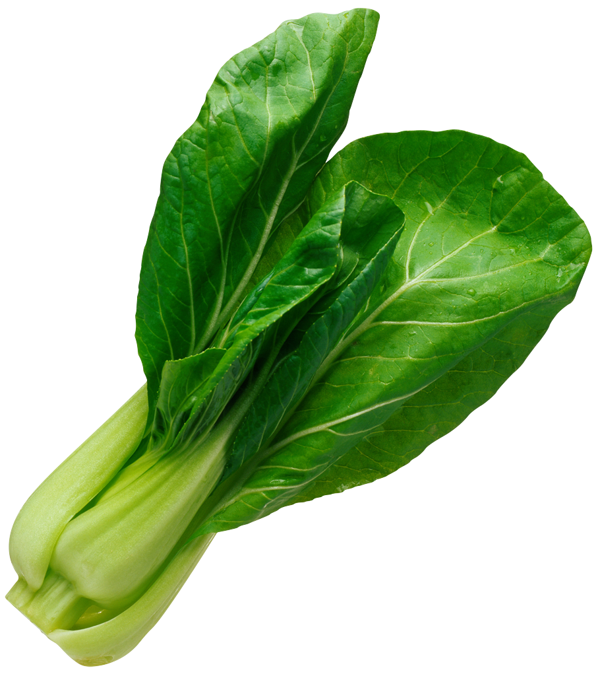
“Eau d’coli”
“stationary”
cell density
“log”
saGD
WGD
“lag”
iaGD
BGD
time
Notes:
http://parts.mit.edu/movies/iGEM2006_MIT.mov

Slide 3
Next slides from Barry Canton, Ginkgo BioWorks

Slide 13
