Slide 1
GRNmap Testing and Results
Natalie Williams
Brandon Klein
October 31, 2016

Slide 2
Last week, we tested GRNmap with our 5 database-generated Networks.
1) Input sheets were made for five database-derived networks (wt, dCIN5, dGLN3, dHAP4, dZAP1).
2) Model runs were performed for each network.
3) Preliminary results from the runs are presented here.
4) We will work towards developing an in depth analysis of these results in the coming weeks.

Slide 3
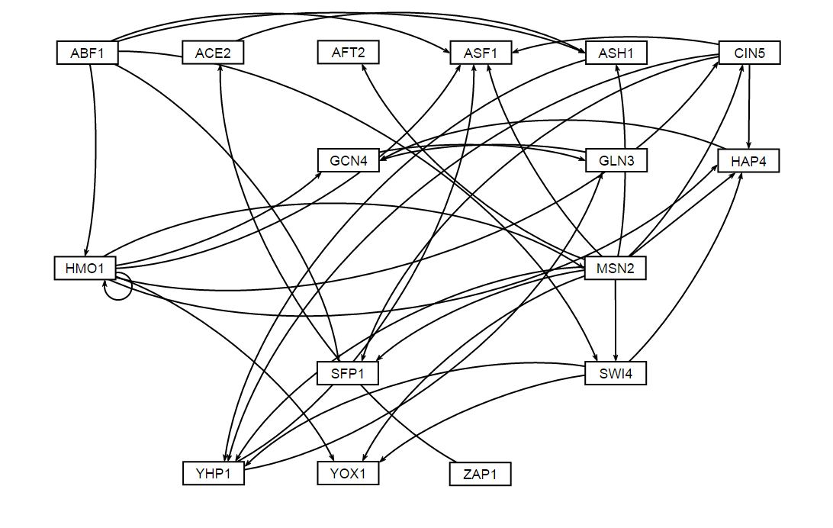
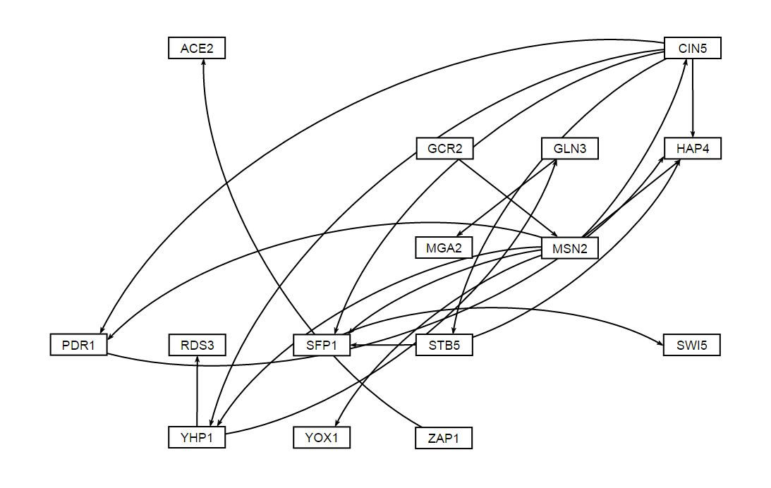
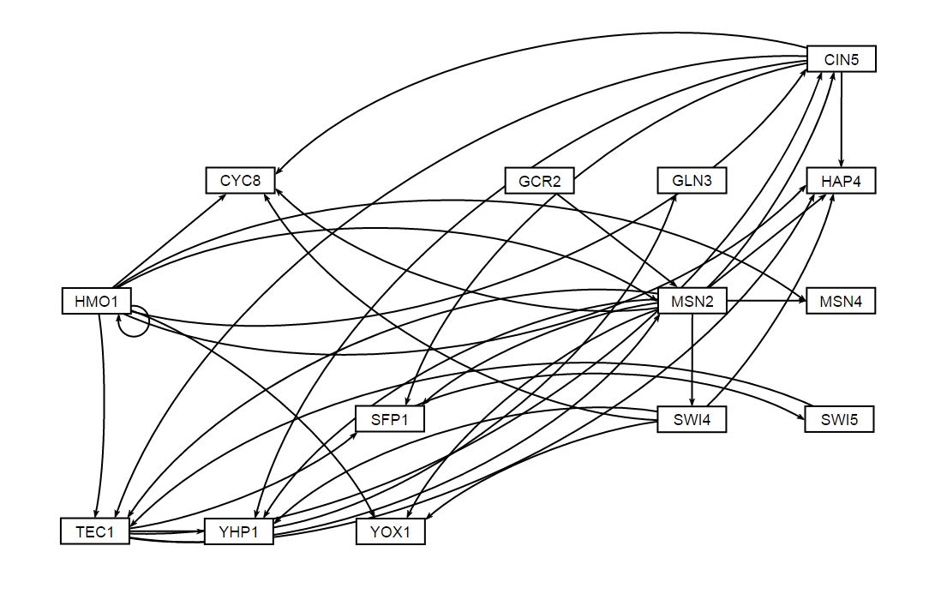
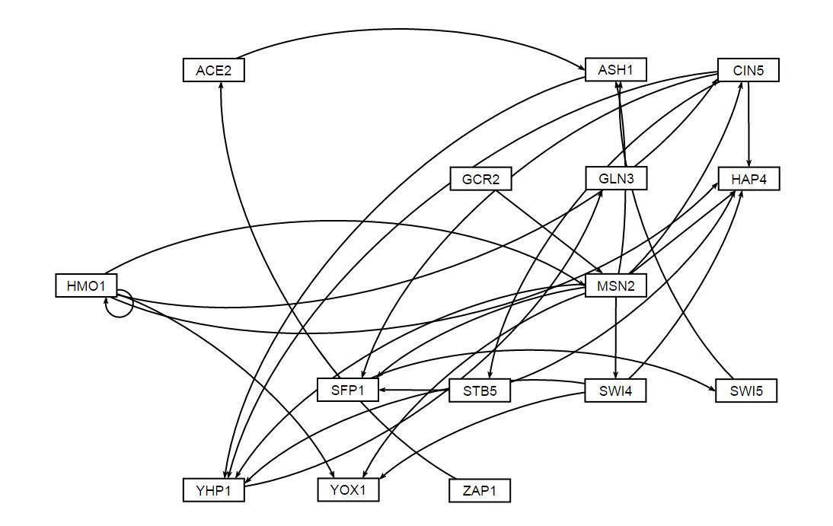
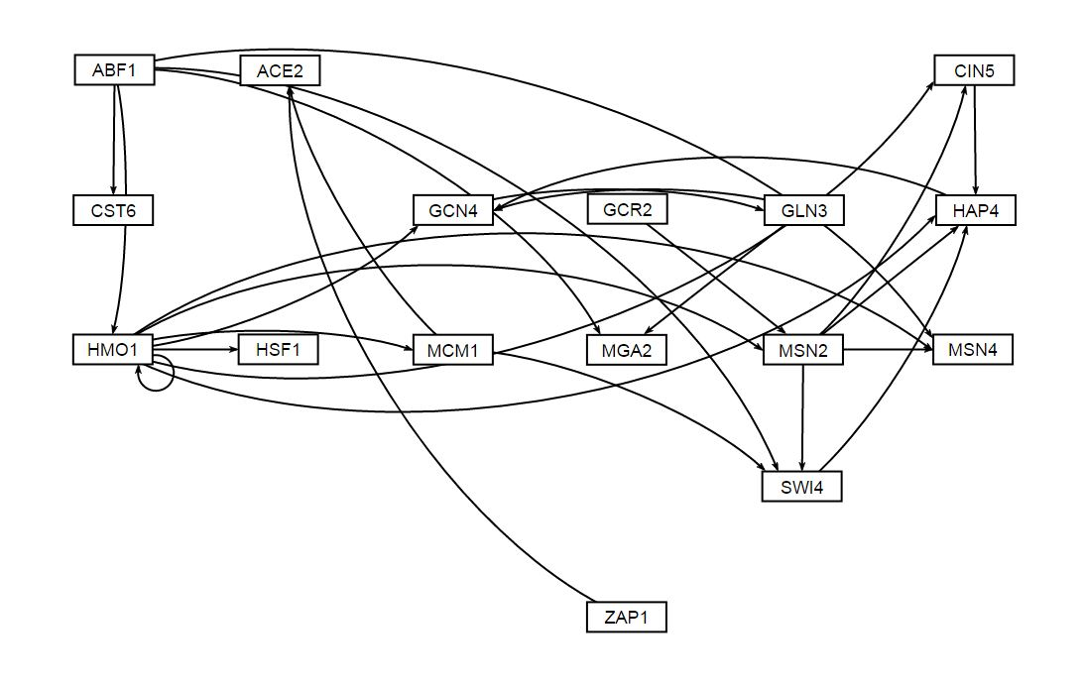
Unweighted visualization of the 5 database-generated GRNs via GRNSight
WT Unweighted Network
dCIN5 Unweighted Network
dGLN3 Unweighted Network
dZAP1 Unweighted Network
dHAP4 Unweighted Network

Slide 4
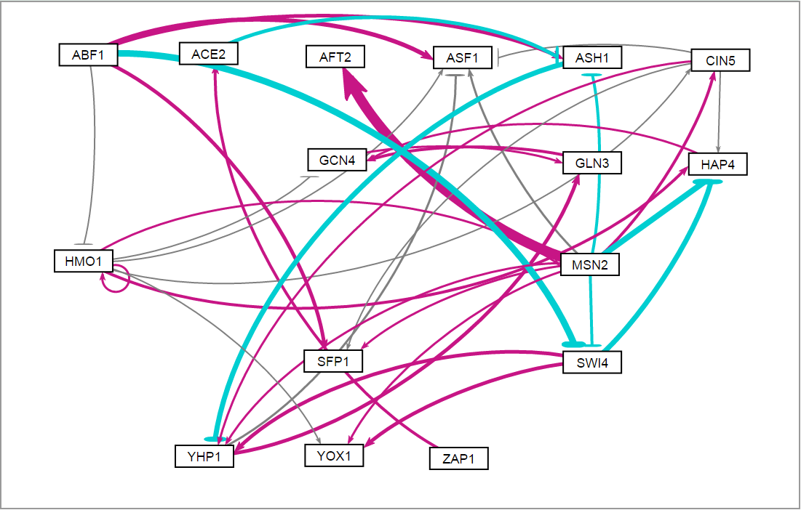
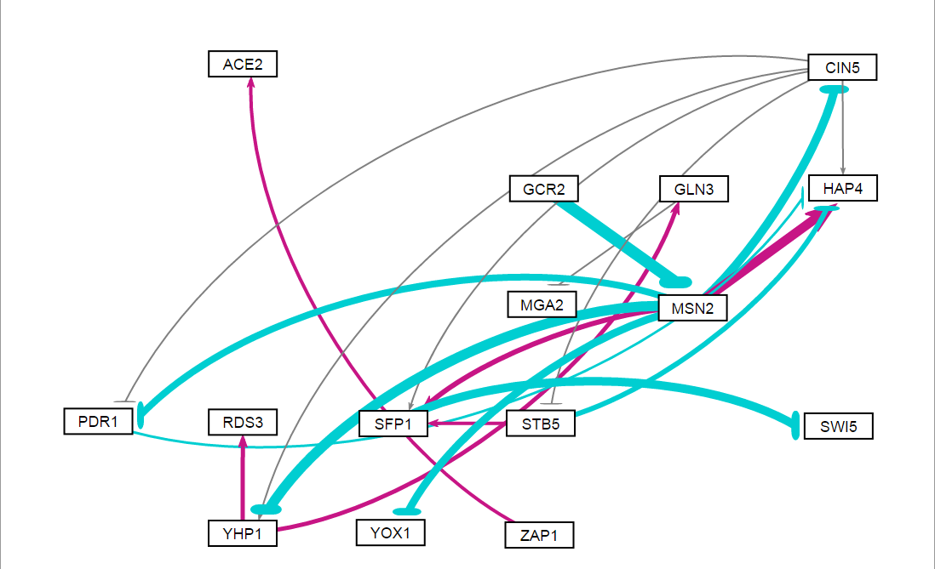
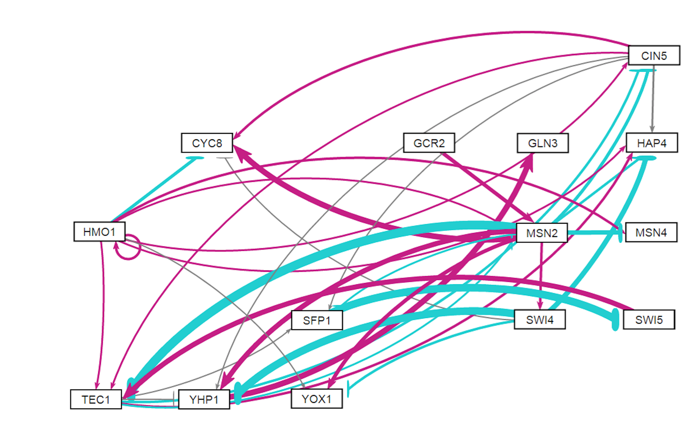
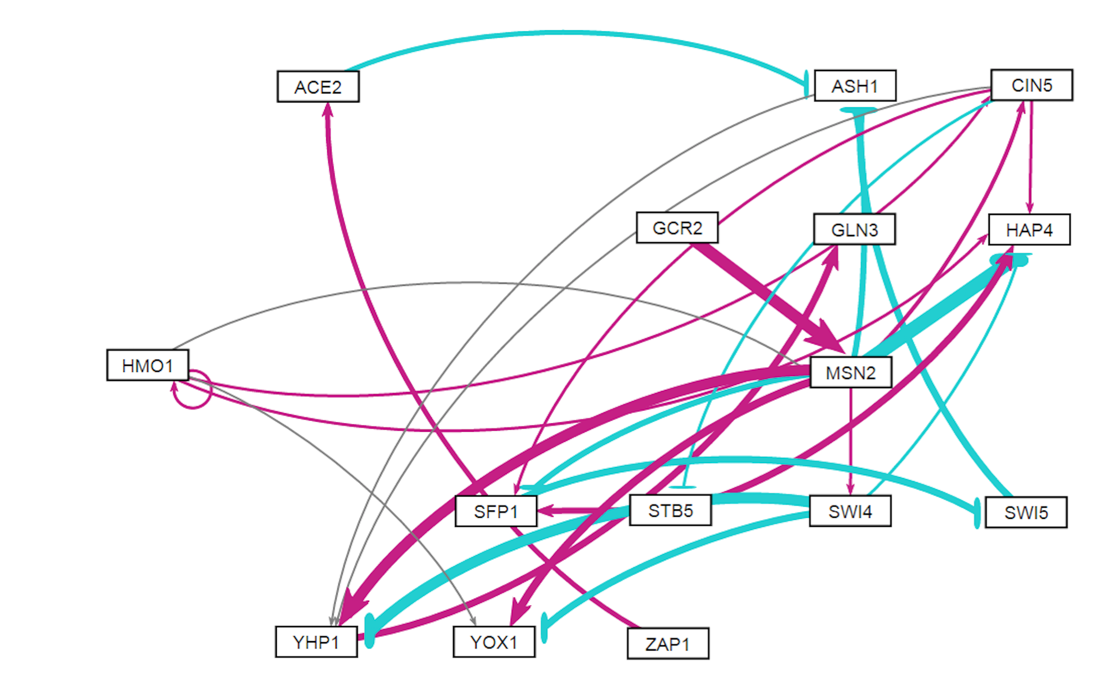
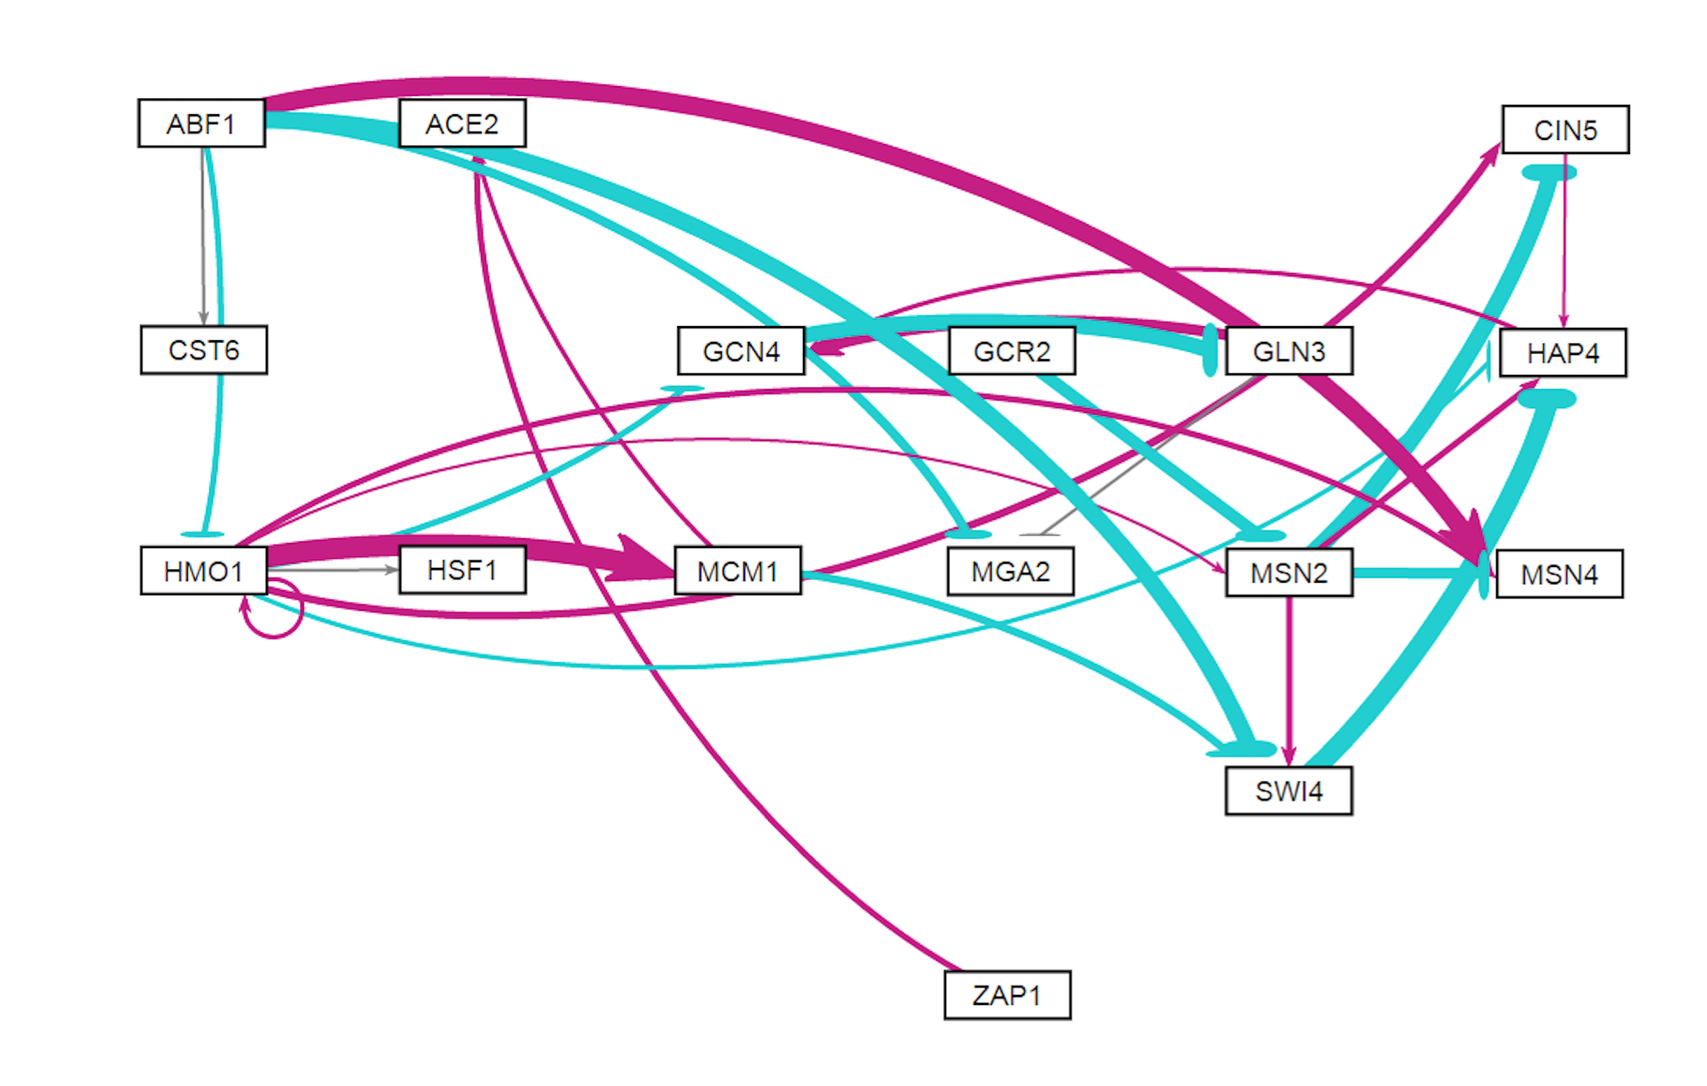
Weighted GRNSight visualizations of the database-derived GRNs from all 5 strains
WT Weighted Network
dCIN5 Weighted Network
dGLN3 Weighted Network
dHAP4 Weighted Network
dZAP1 Weighted Network

Slide 5
WT GRNmap Testing Results
As of: 2016 Oct. 30
WT Information:
16 Nodes (Genes)
36 Edges
Network composed of the following genes:
ABF1
ACE2
AFT2
ASF1
ASH1
CIN5
GCN4
GLN3
HAP4
HMO1
MSN2
SFP1
SWI4
YHP1
YOX1
ZAP1

Slide 6
Parameter Outputs - WT
Parameter | Value
Penalty Term | 2.5923
LSE | 0.8194
minLSE | 0.5768
LSE:minLSE ratio | 1.4206
Iteration Count | 109718

Slide 7
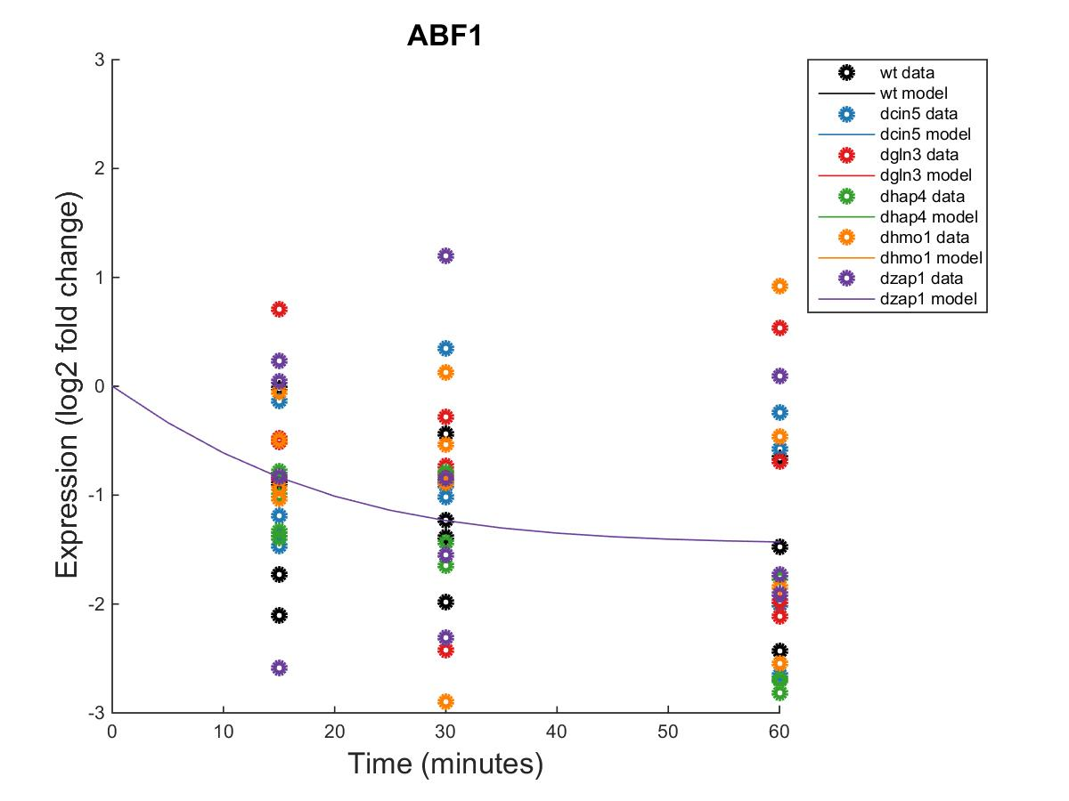
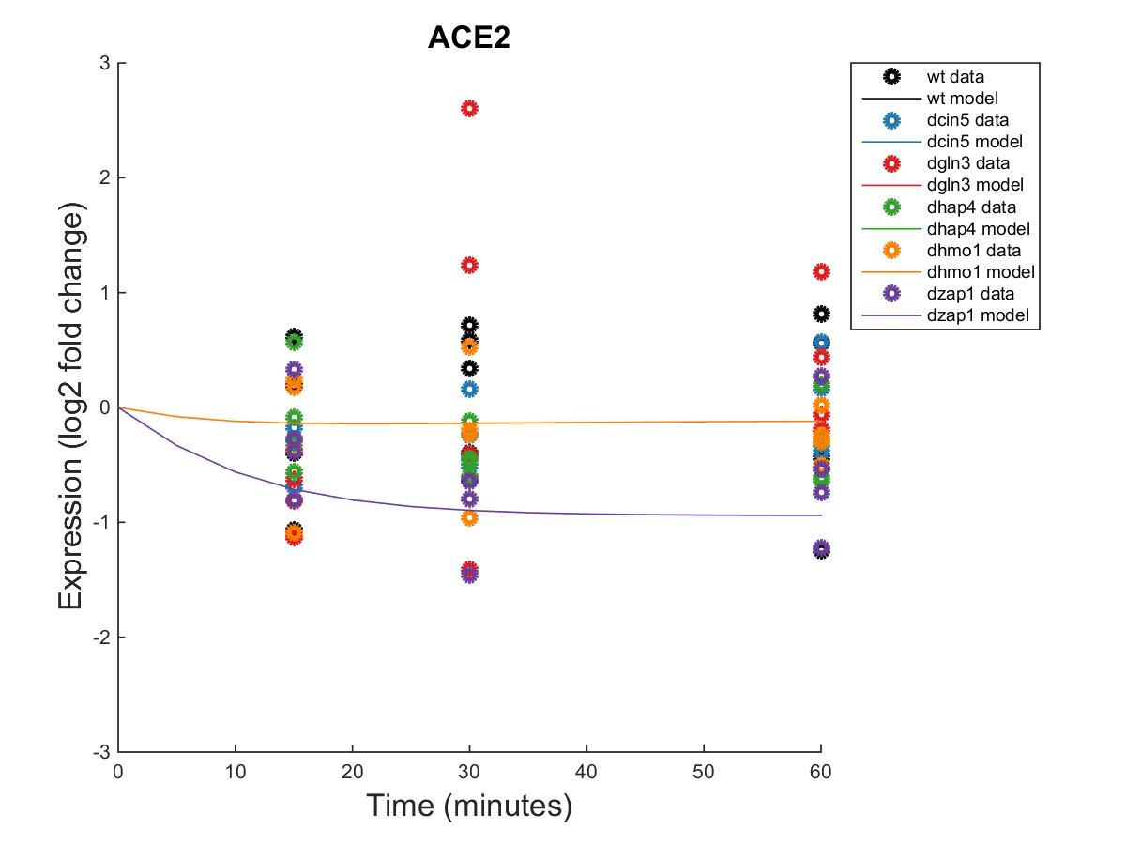
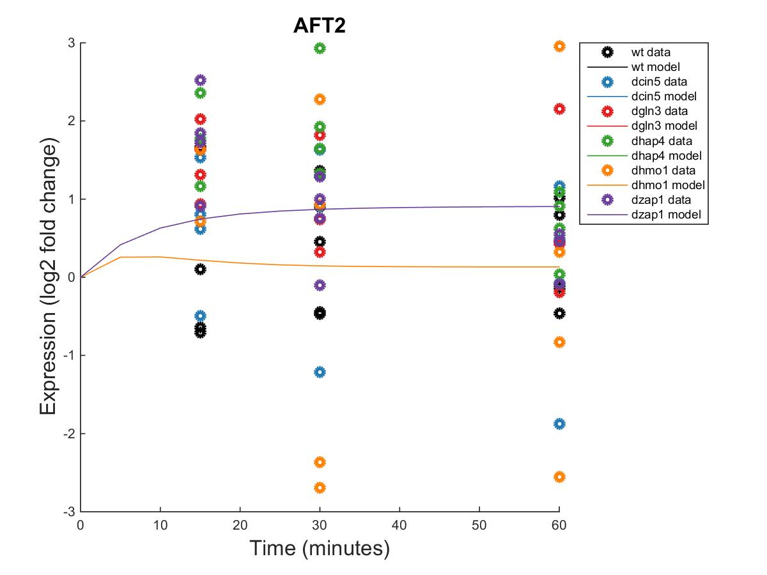
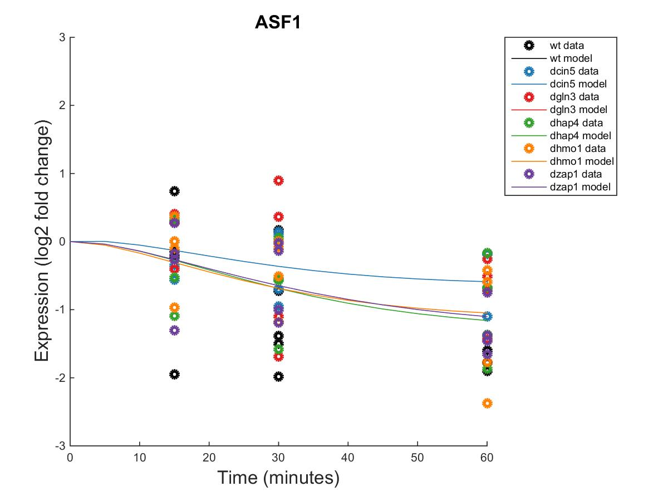
GRNmap Output Estimation of ABF1, ACE2, AFT2, AND ASF1

Slide 8
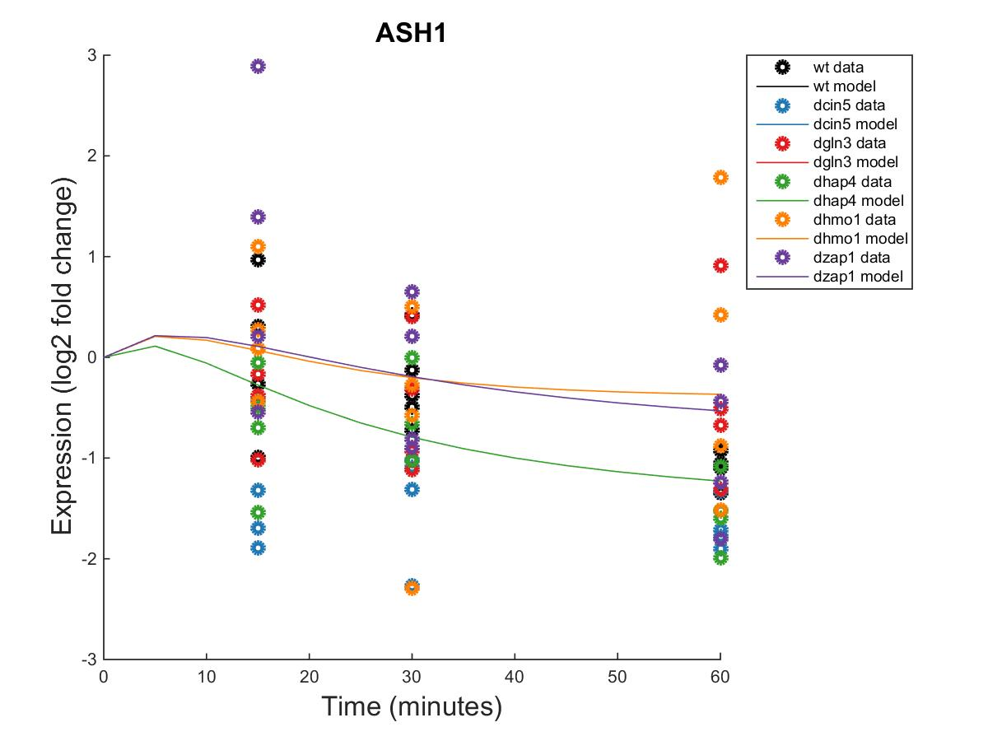
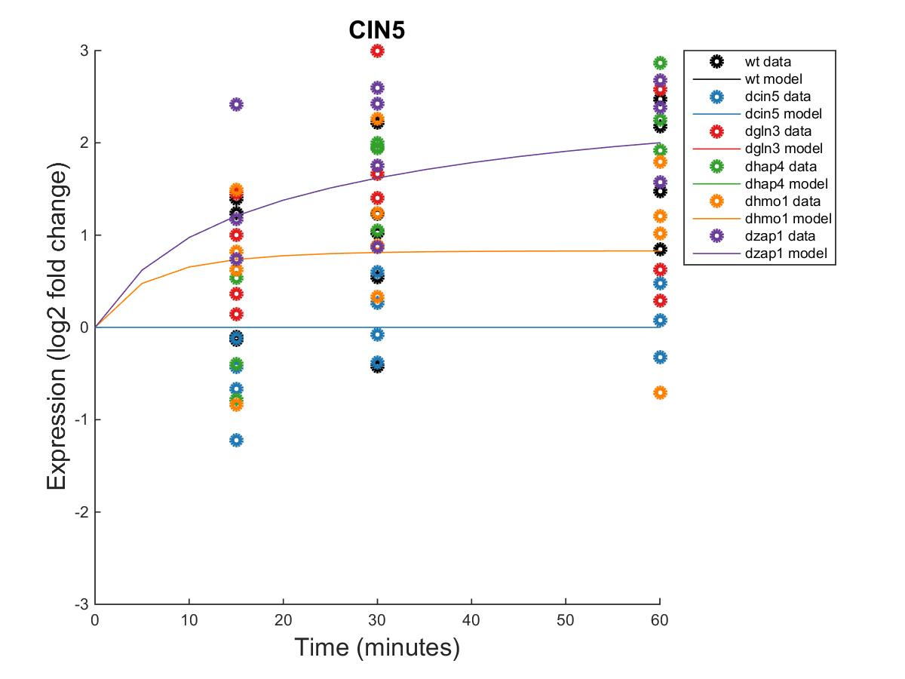
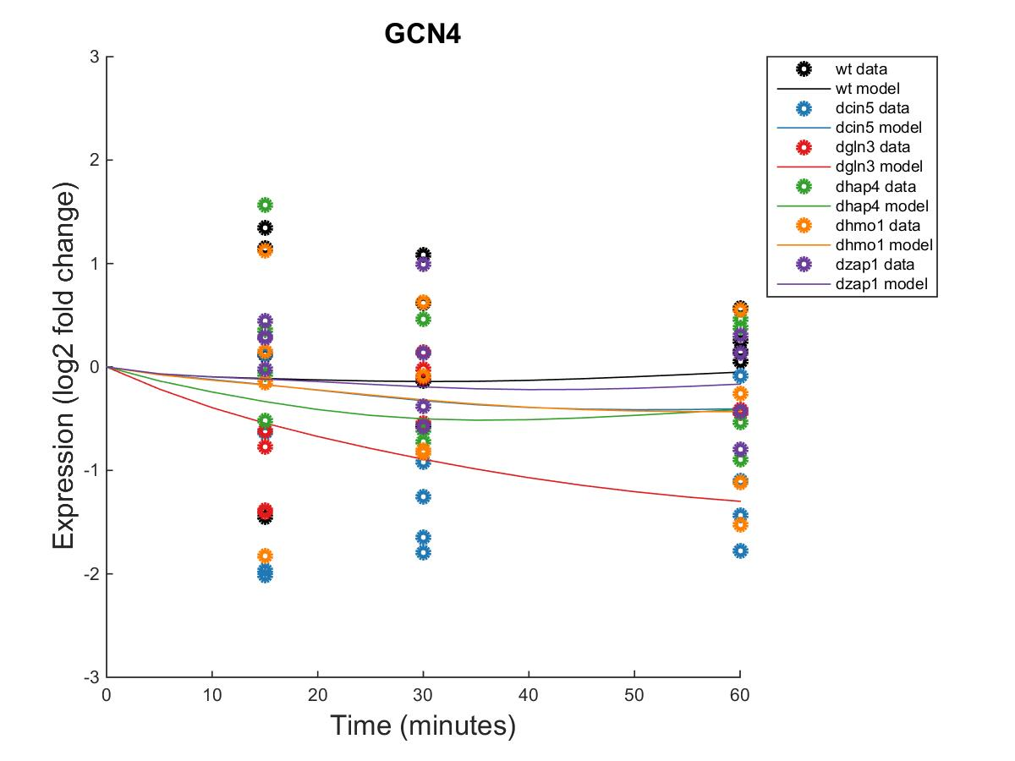
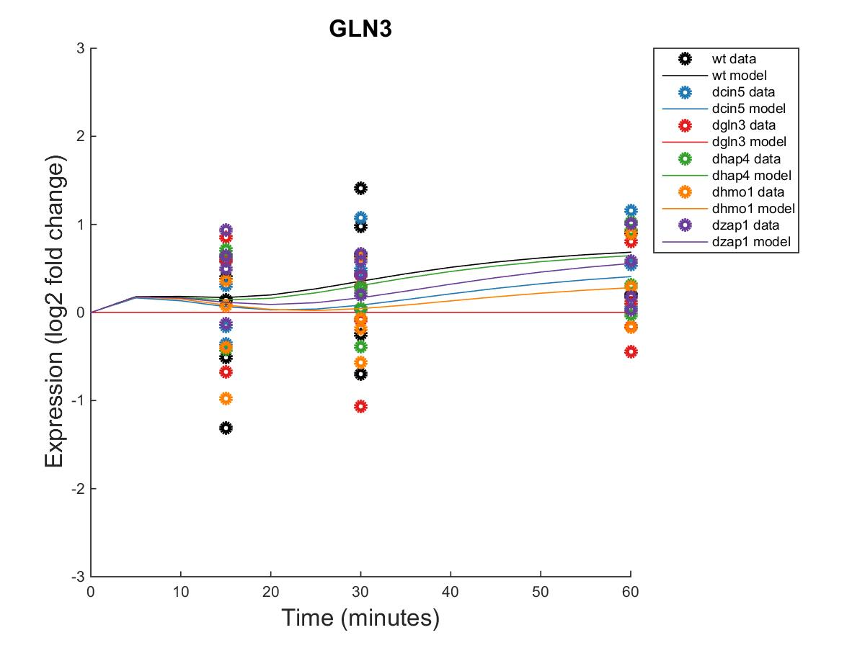
GRNmap Output Estimation of ASH1, CIN5, GCN4, AND GLN3

Slide 9
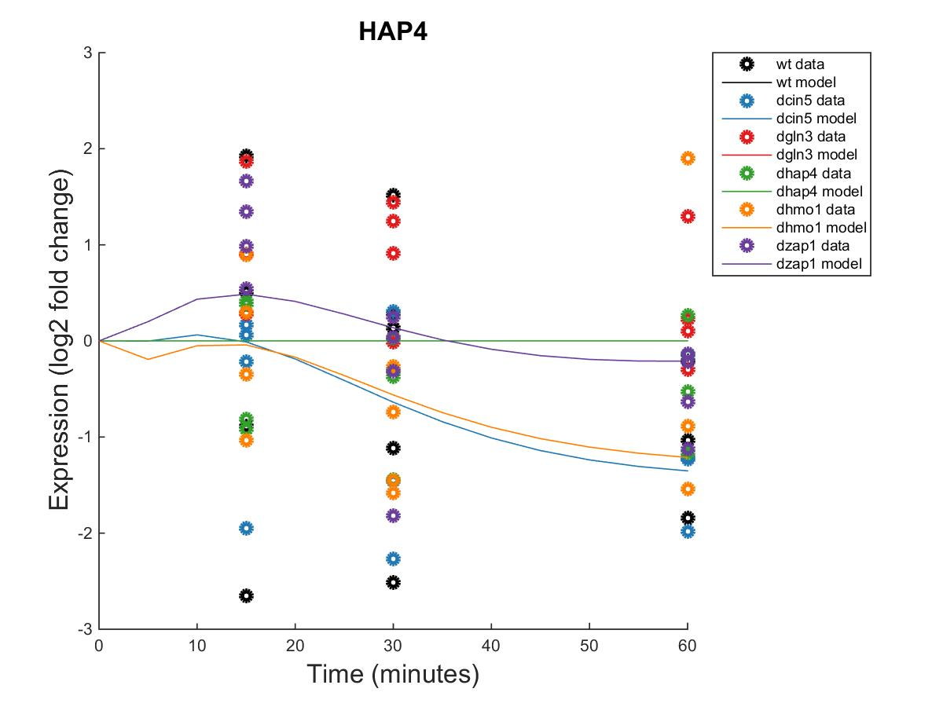
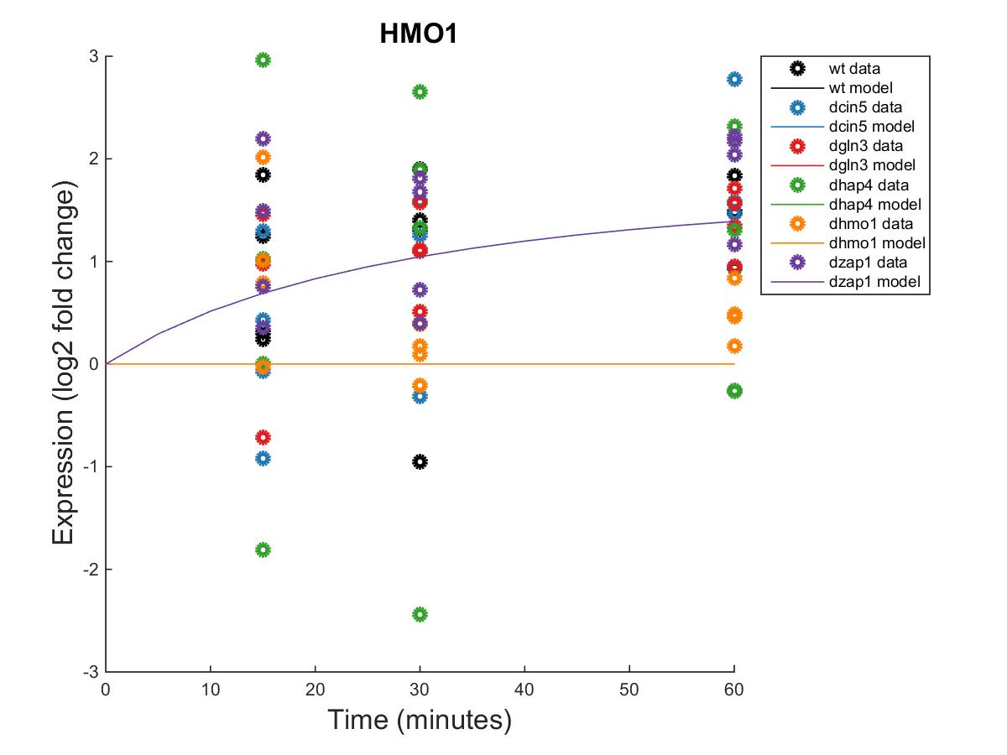
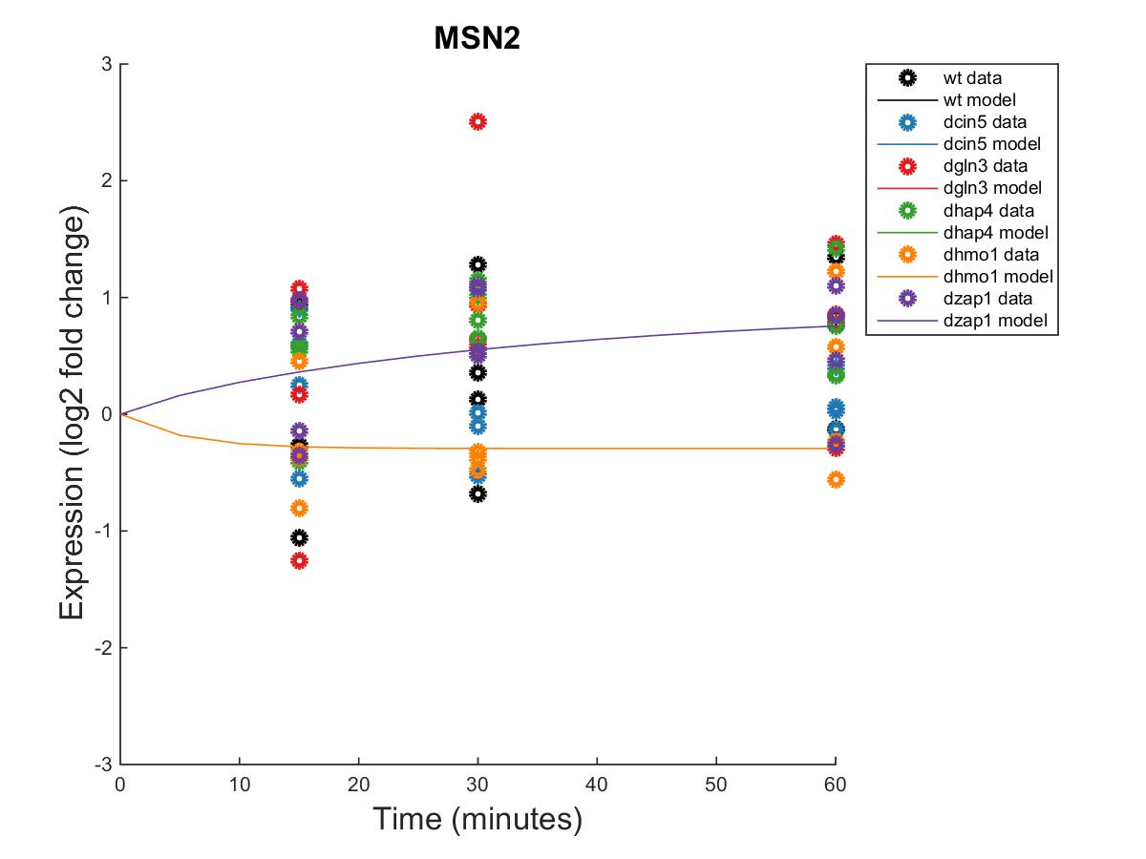
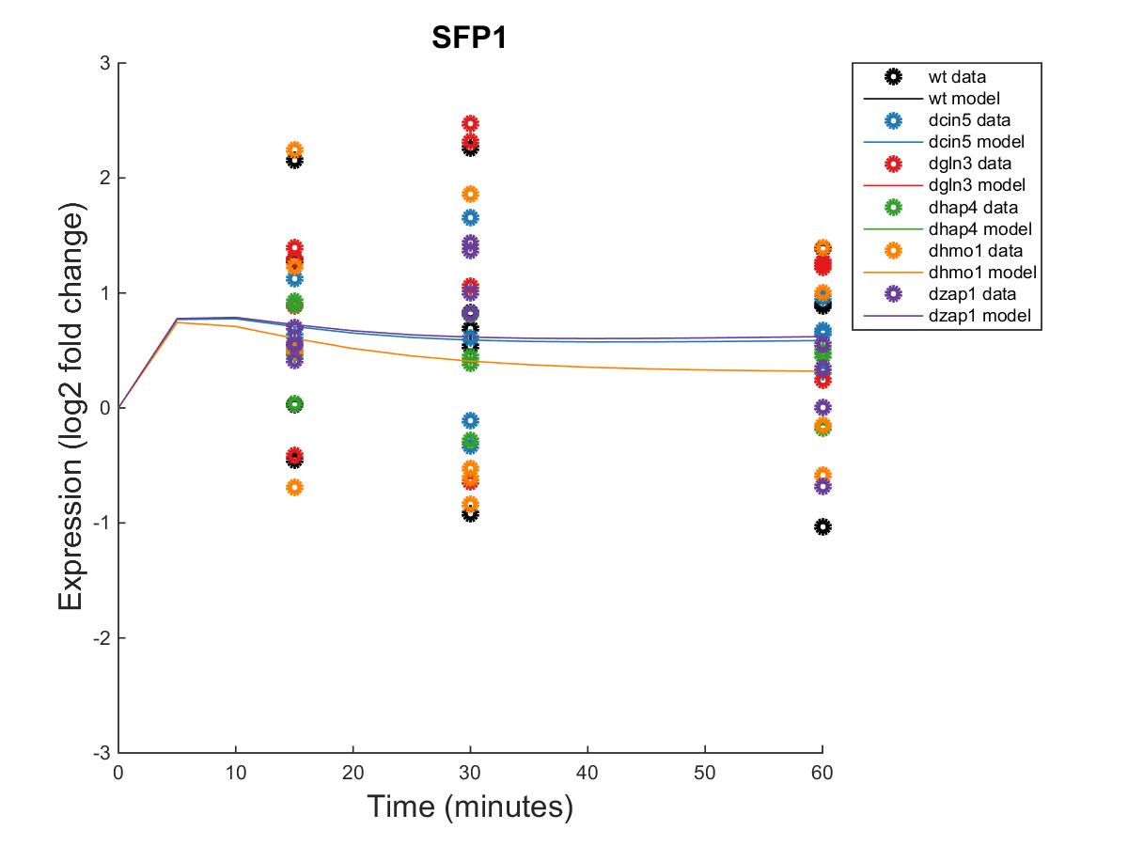
GRNmap Output Estimation of HAP4, HMO1, MSN2, AND SFP1

Slide 10
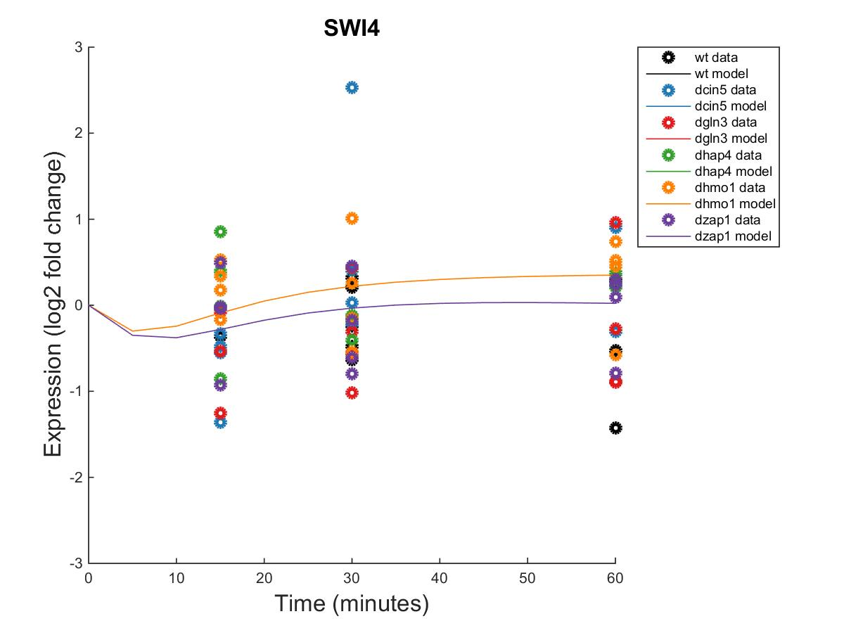
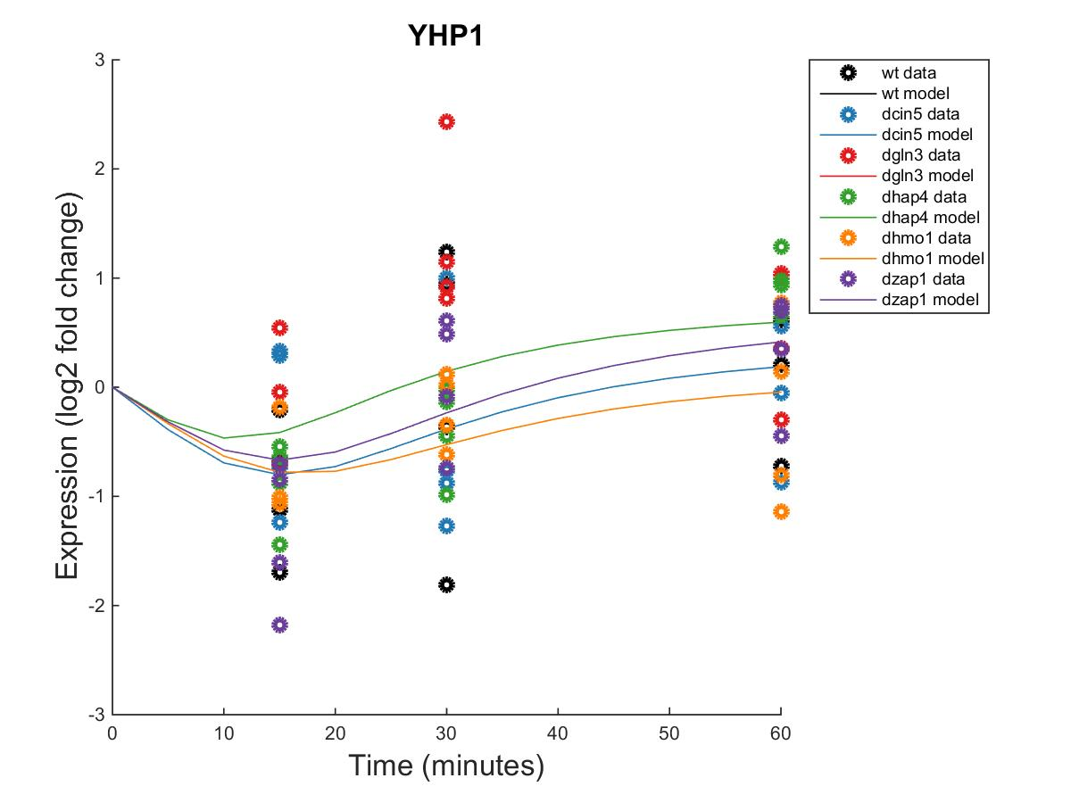
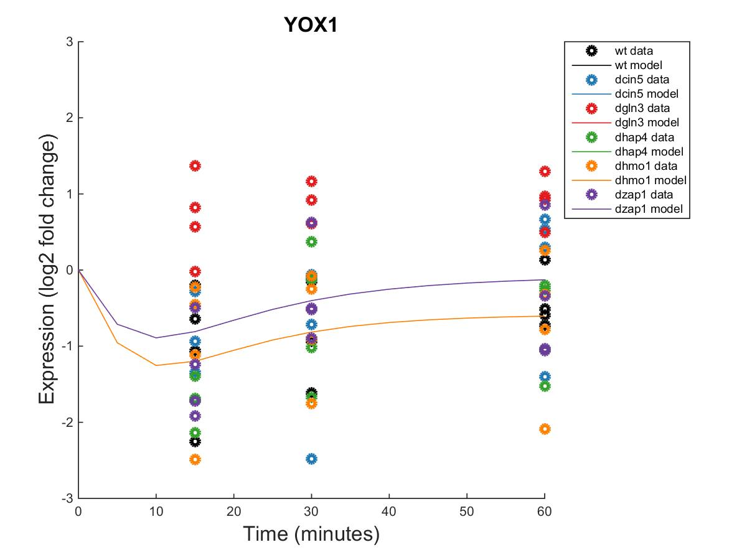
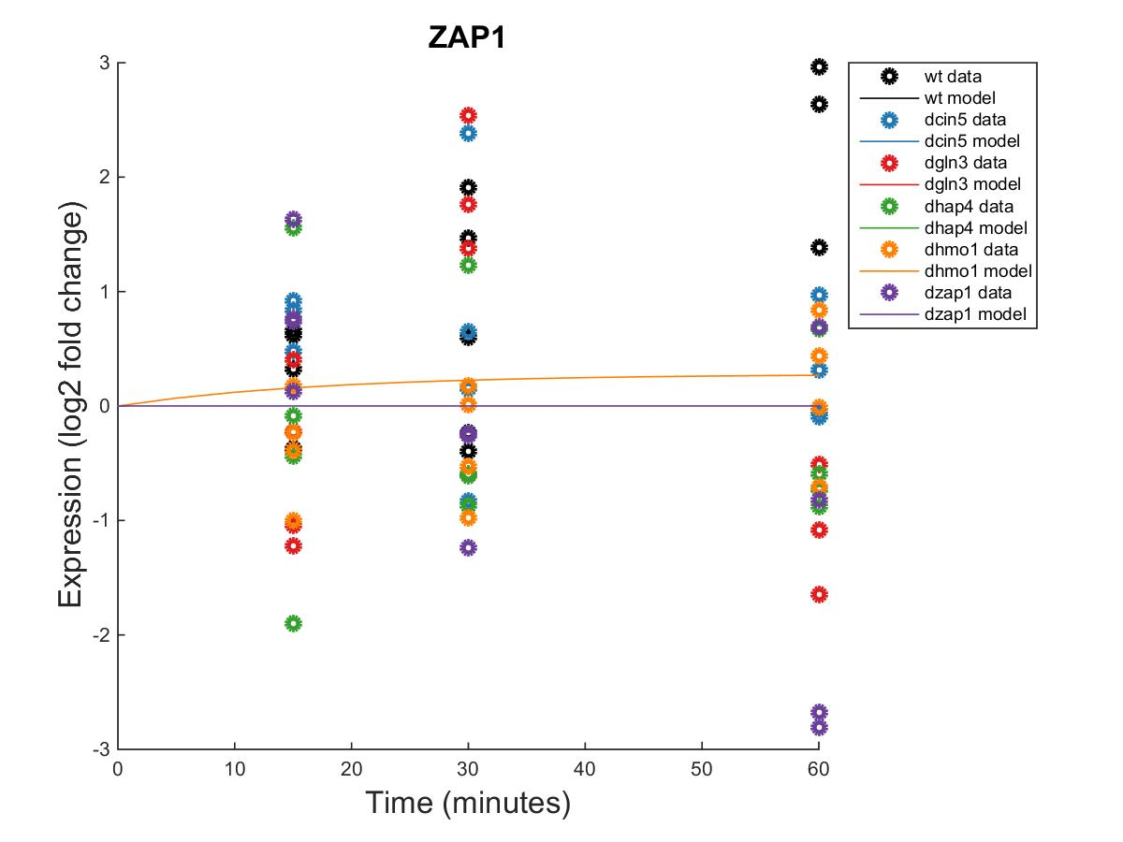
GRNmap Output Estimation of SWI4, YHP1, YOX1, AND ZAP1

Slide 11
Weighted WT Network appears to have more activation than repression of genes within the network.

Slide 13
Optimized Production Rates and Threshold B Values for wt Network
id | production_rate | threshold_b
ABF1 | 0.057591382 | 0.057591
ACE2 | 0.133860771 | 0.262124
AFT2 | 0.290004958 | 4.516856
ASF1 | 0.158179715 | 1.358124
ASH1 | 1.529886194 | 0.764114
CIN5 | 1.152815988 | 2.697564
GCN4 | 0.181216029 | 2.422825
GLN3 | 0.360109759 | 1.344126
HAP4 | 2.344771437 | -1.74514
HMO1 | 0.483290667 | 1.312883
MSN2 | 0.573852542 | 0.89613
SFP1 | 1.006631277 | 1.243381
SWI4 | 0.227818344 | -3.39406
YHP1 | 0.151302376 | 0.312824
YOX1 | 0.785593453 | 2.981617
ZAP1 | 0.12653347 | 0.126533

Slide 14
dCIN5 GRNmap Testing Results
As of: 2016 Oct. 26
dCIN5 Information:
15 Nodes (Genes)
20 Edges
Network Composed of the following genes:
ACE2
CIN5
GCR2
GLN3
HAP4
MGA2
MSN2
PDR1
RDS3
SFP1
STB5
SWI5
YHP1
YOX1
ZAP1

Slide 15
Parameter Outputs – dCIN5
Parameter | Value
Penalty Term | 1.9396
LSE | 0.7200
minLSE | 0.4883
LSE:minLSE | 1.4745
Iteration count | 32595

Slide 16
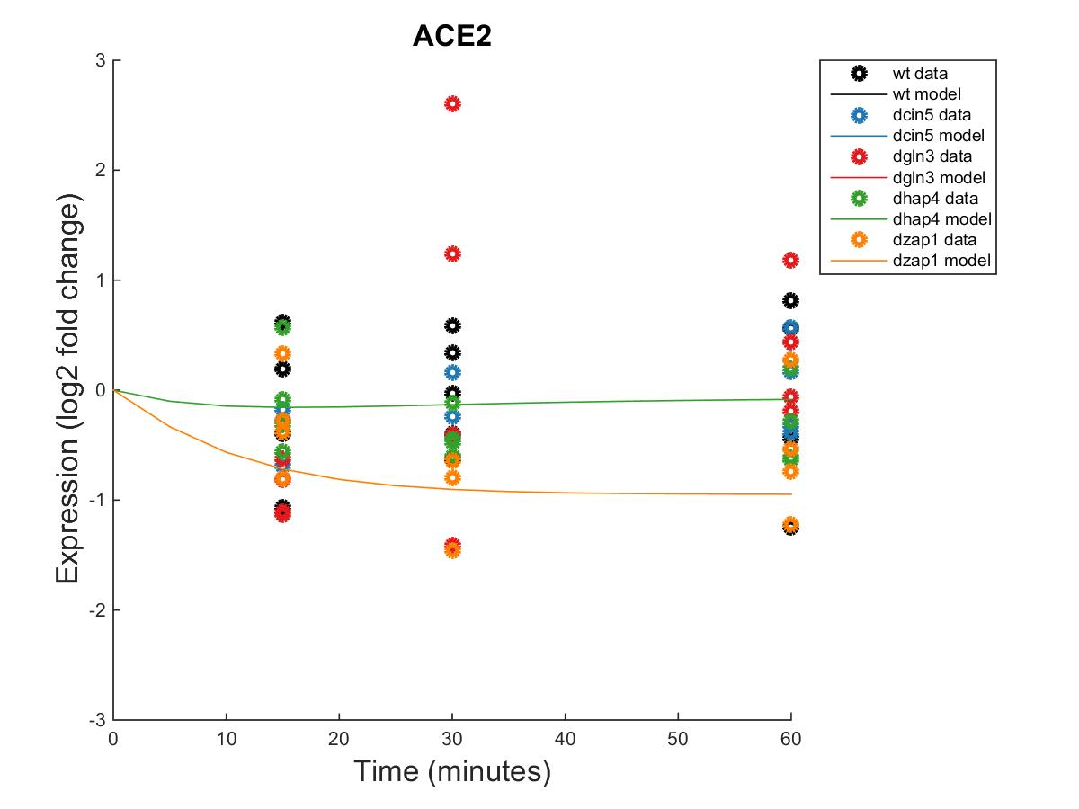
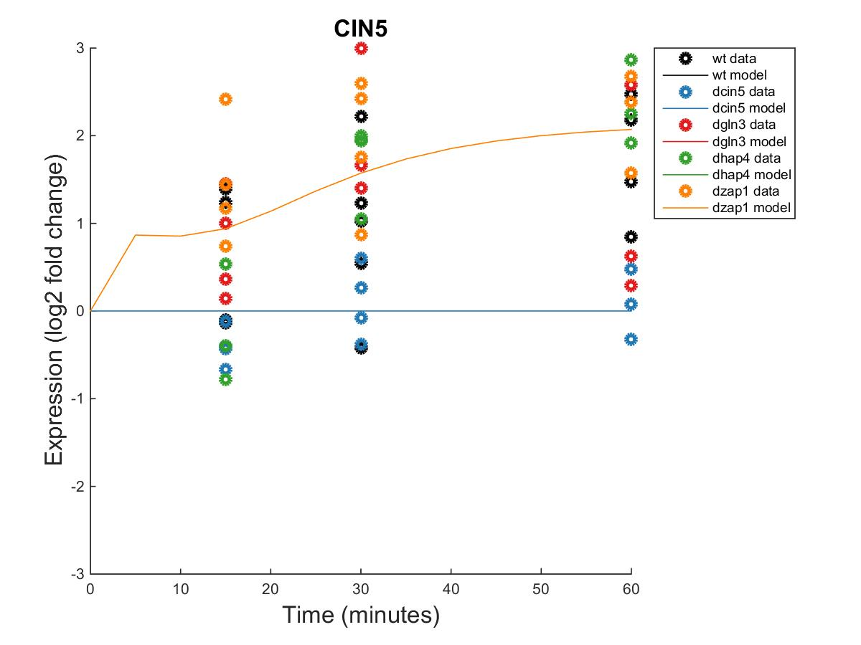
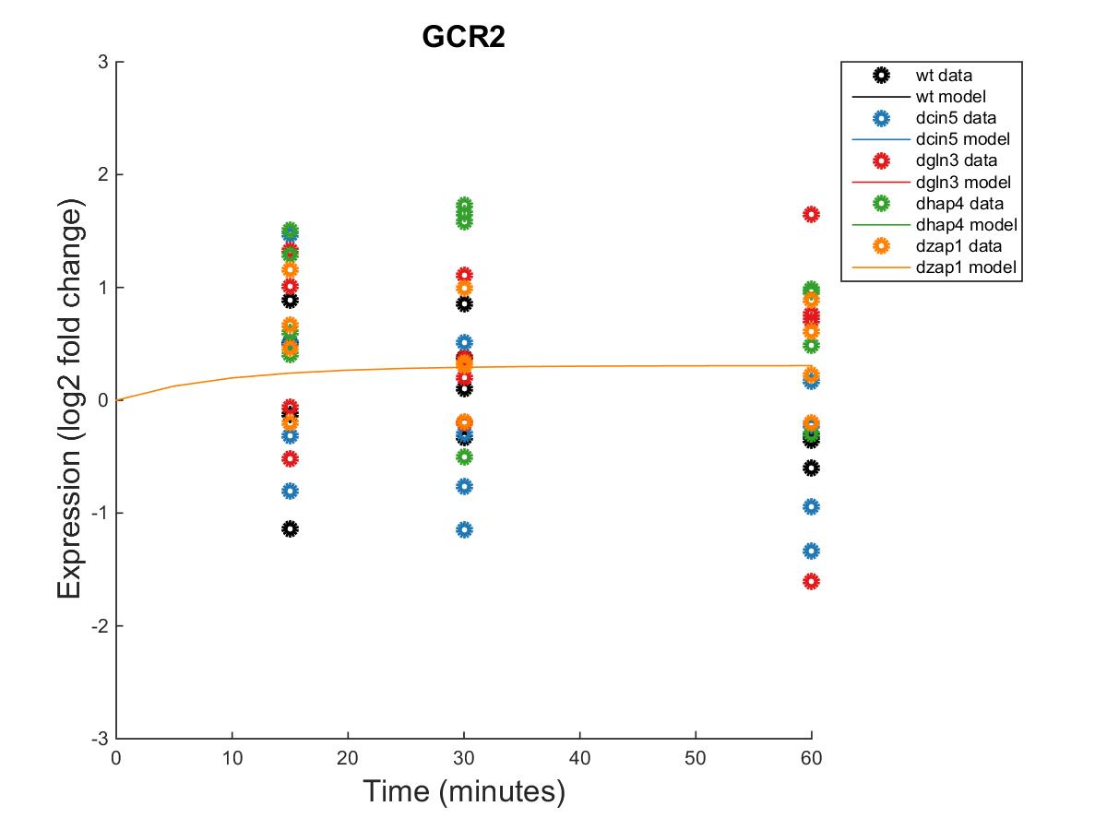
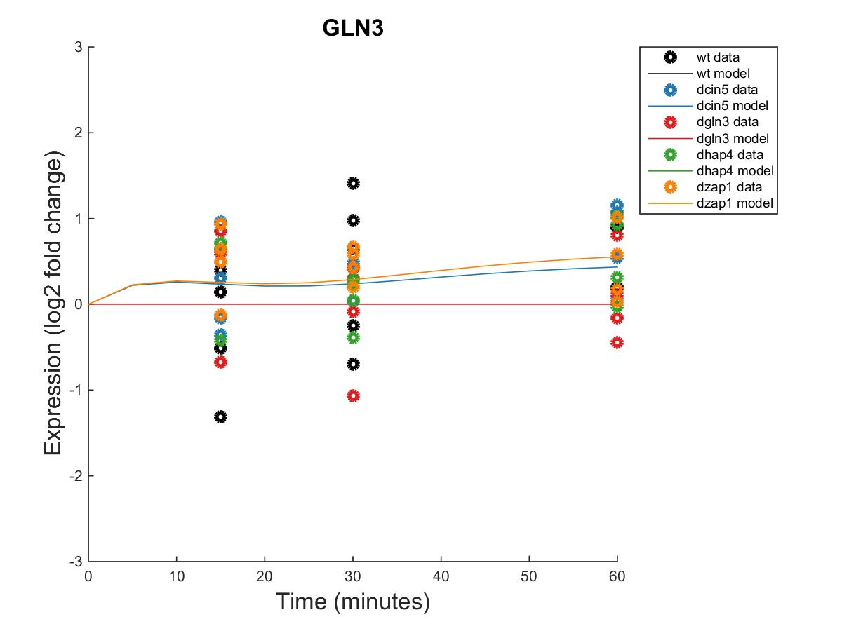
GRNmap Output Estimation of ACE2, CIN5, GCR2 AND GLN3

Slide 17
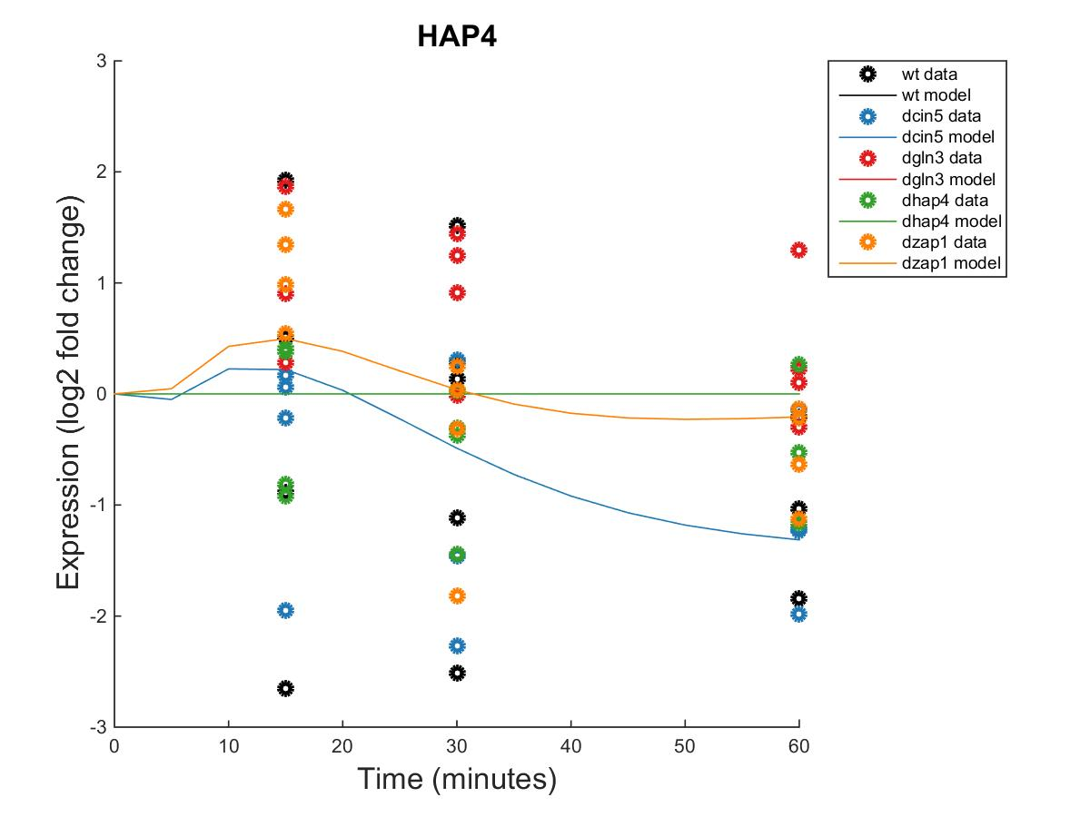
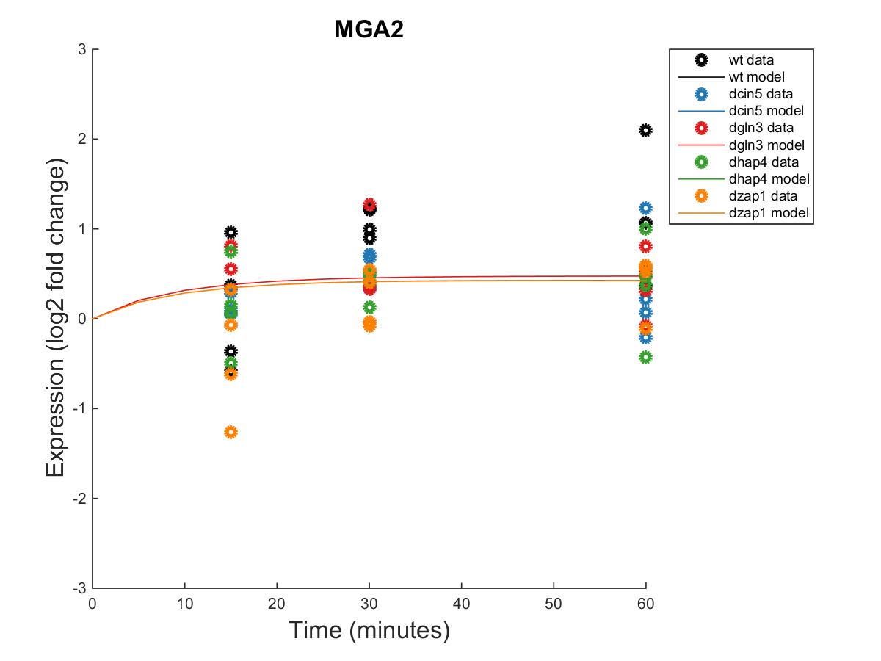
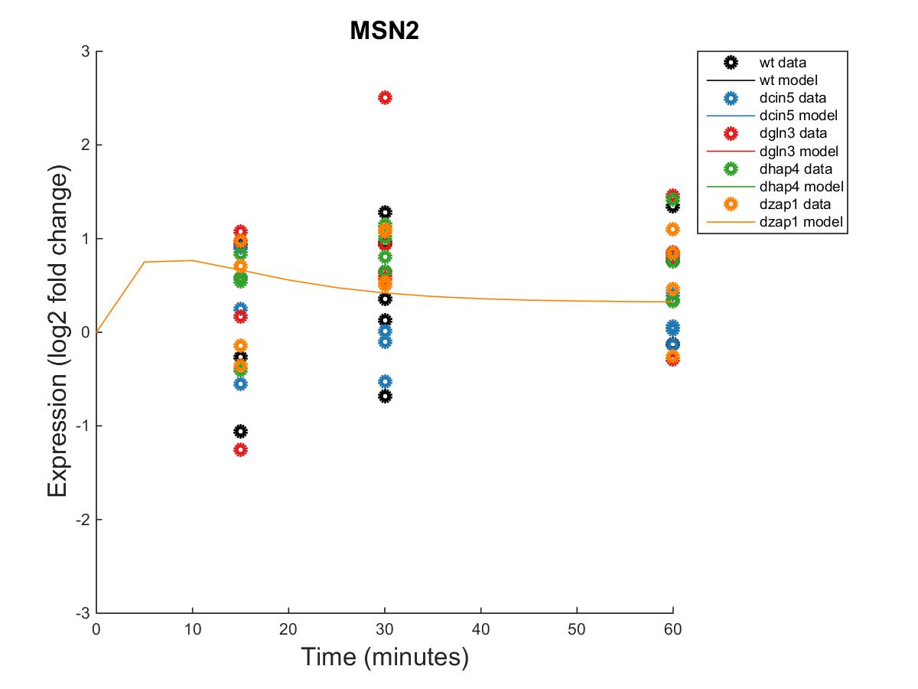
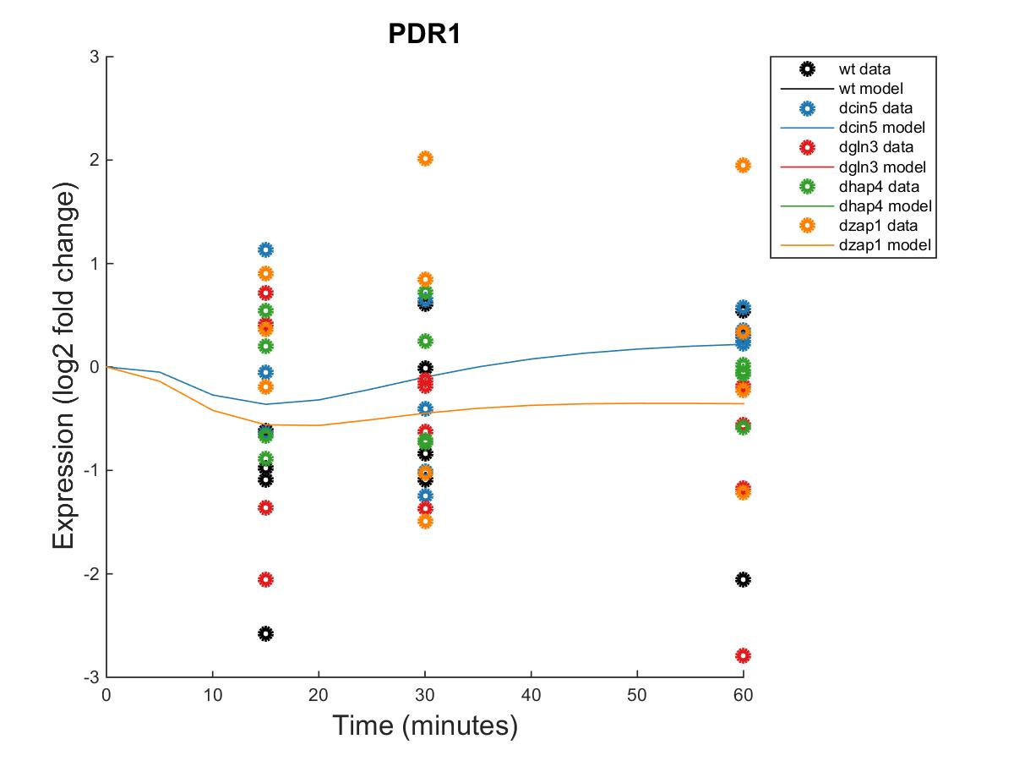
GRNmap Output Estimation of HAP4, MGA2, MSN2, AND PDR1

Slide 18
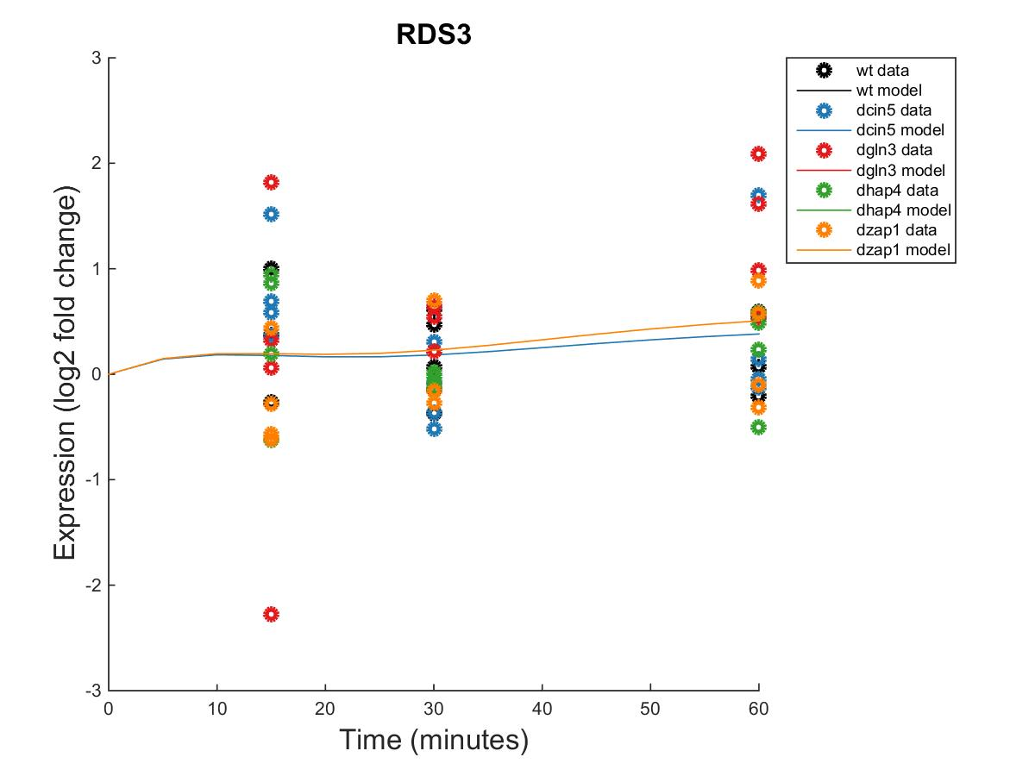
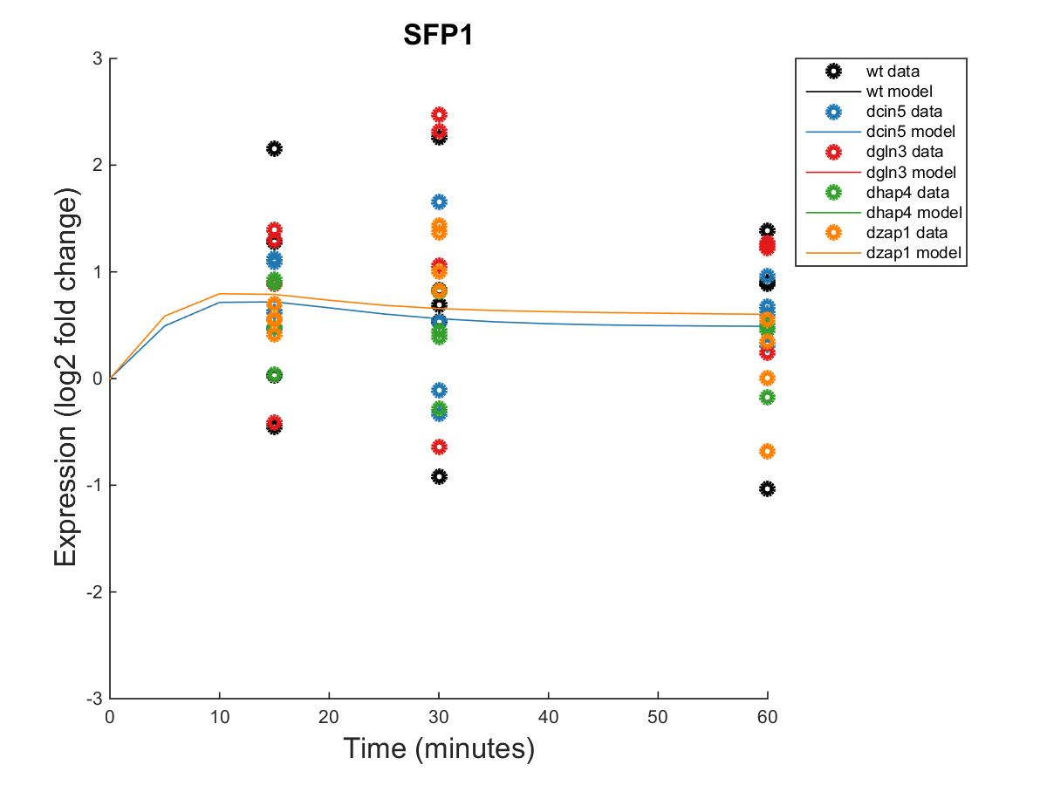
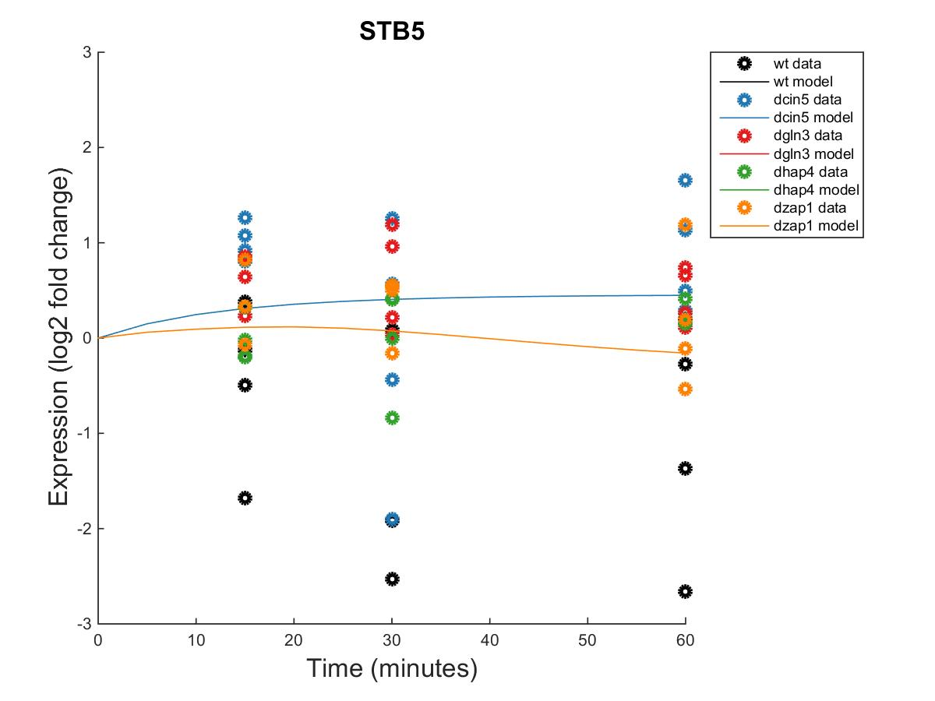
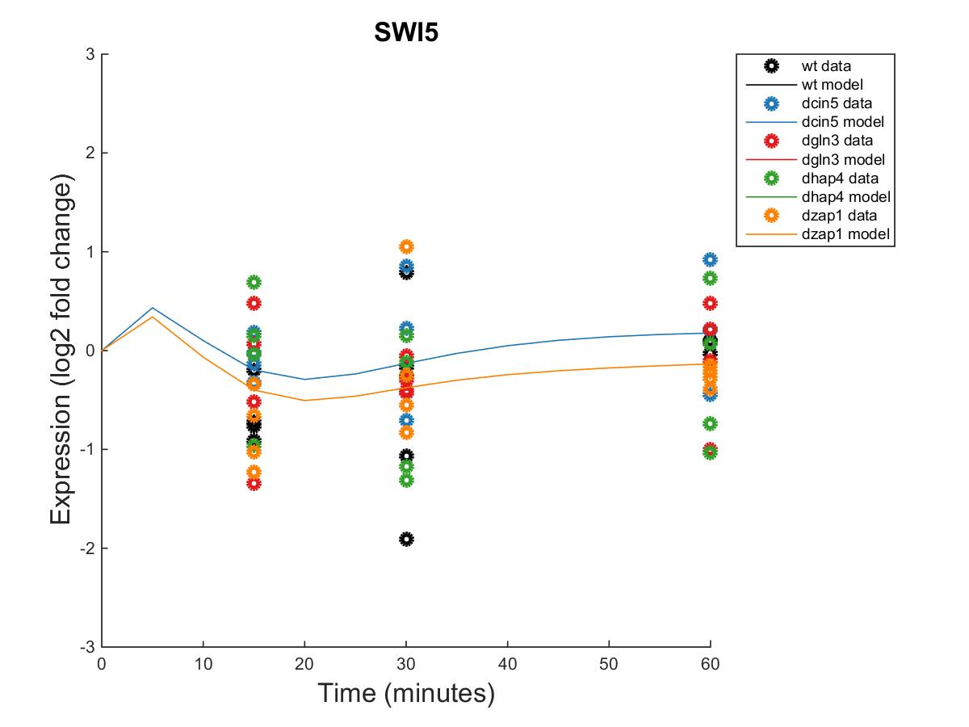
GRNmap Output Estimation of RDS3, SFP1, STB5, AND SWI5

Slide 19
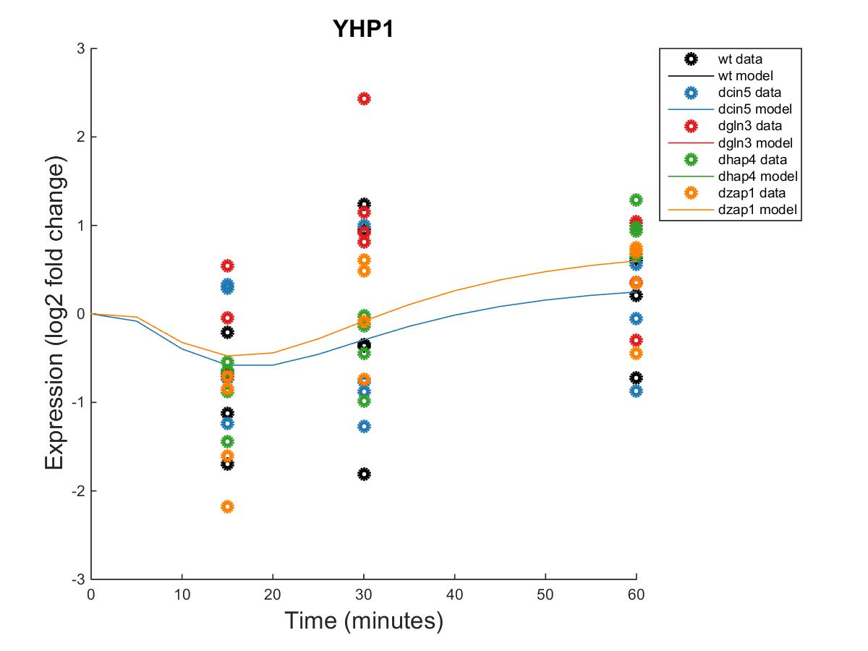
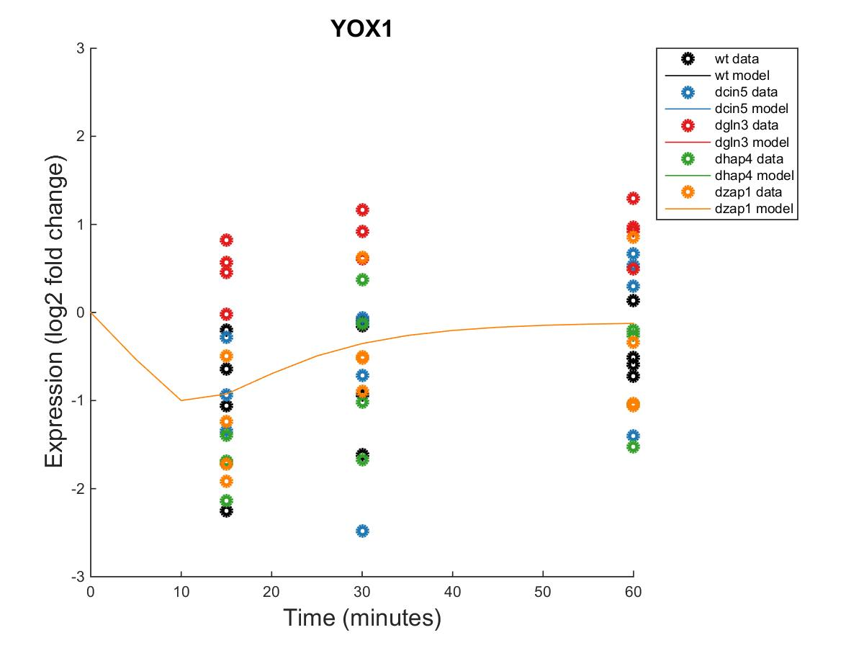
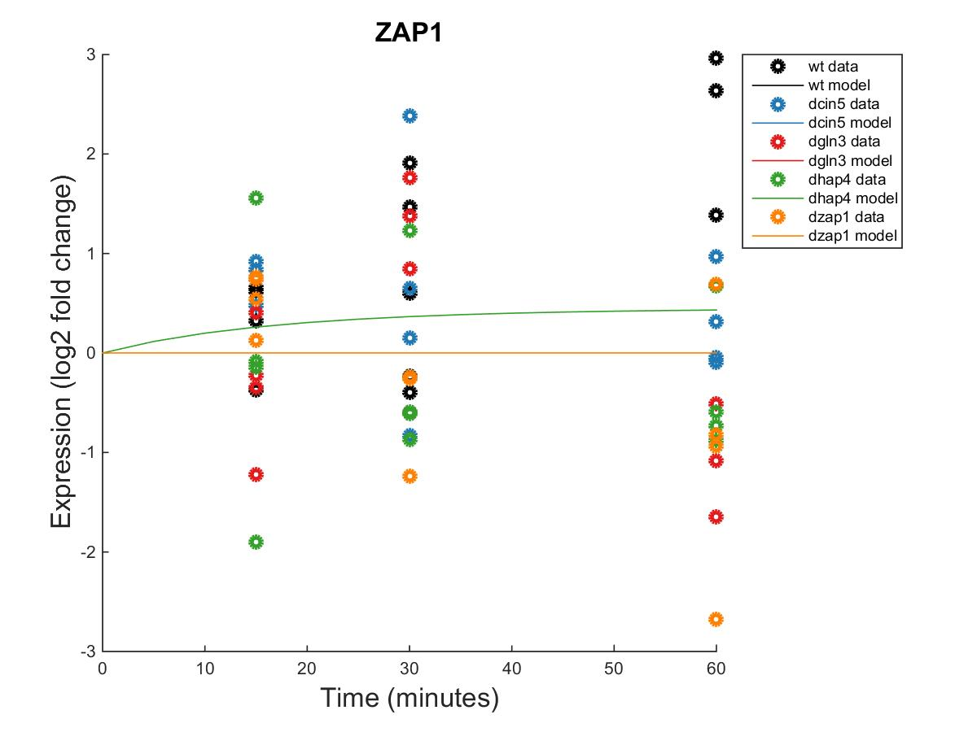
GRNmap Output Estimation of YHP1, YOX1 AND ZAP1

Slide 20
Weighted dCIN5 Network from GRNSight appears to have an equal distribution of high activation and repression.

Slide 22
Optimized Production Rates and Threshold B Values for dCIN5 Network
id | production_rate | threshold_b
ACE2 | 0.239035969 | 1.140363
CIN5 | 1.937039256 | -1.59358
GCR2 | 0.238368923 | 0.238369
GLN3 | 0.333099398 | 0.373651
HAP4 | 1.021627291 | 3.900532
MGA2 | 0.271687006 | -0.02688
MSN2 | 2.507572912 | -1.78041
PDR1 | 0.717322746 | -0.42142
RDS3 | 0.220922587 | 0.567369
SFP1 | 1.169085767 | 2.315616
STB5 | 0.321901481 | 0.857352
SWI5 | 1.386398987 | -1.10279
YHP1 | 0.858036572 | -1.26956
YOX1 | 1.494446257 | -0.97951
ZAP1 | 0.142220917 | 0.142221

Slide 23
dGLN3 GRNmap Testing Results
As of: 2016 Oct. 30
dGLN3 Information:
14 Nodes (Genes)
35 Edges
Network composed of the following genes:
CIN5
CYC8
GCR2
GLN3
HAP4
HMO1
MSN2
MSN4
SFP1
SWI4
SWI5
TEC1
YHP1
YOX1

Slide 24
Parameter Outputs – dGLN3
Parameter | Value
LSE | 0.6994
Penalty | 1.7895
min LSE | 0.5379
Iteration count | 78,124
LSE/minLSE ratio | 1.300

Slide 25
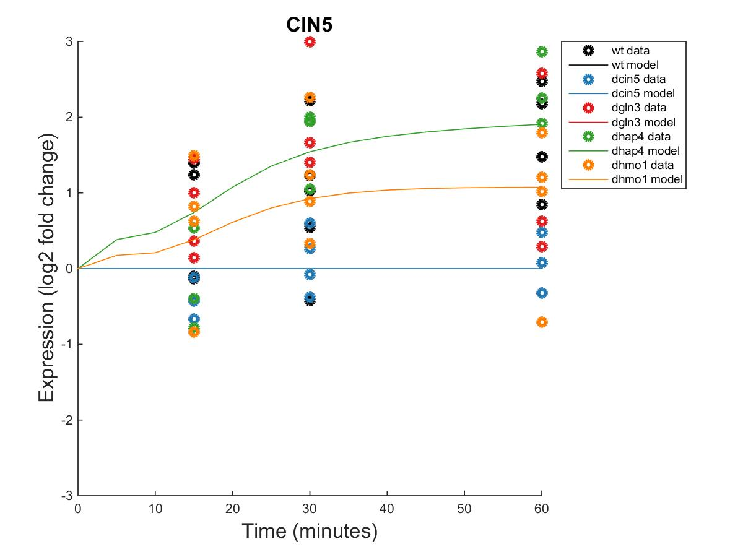
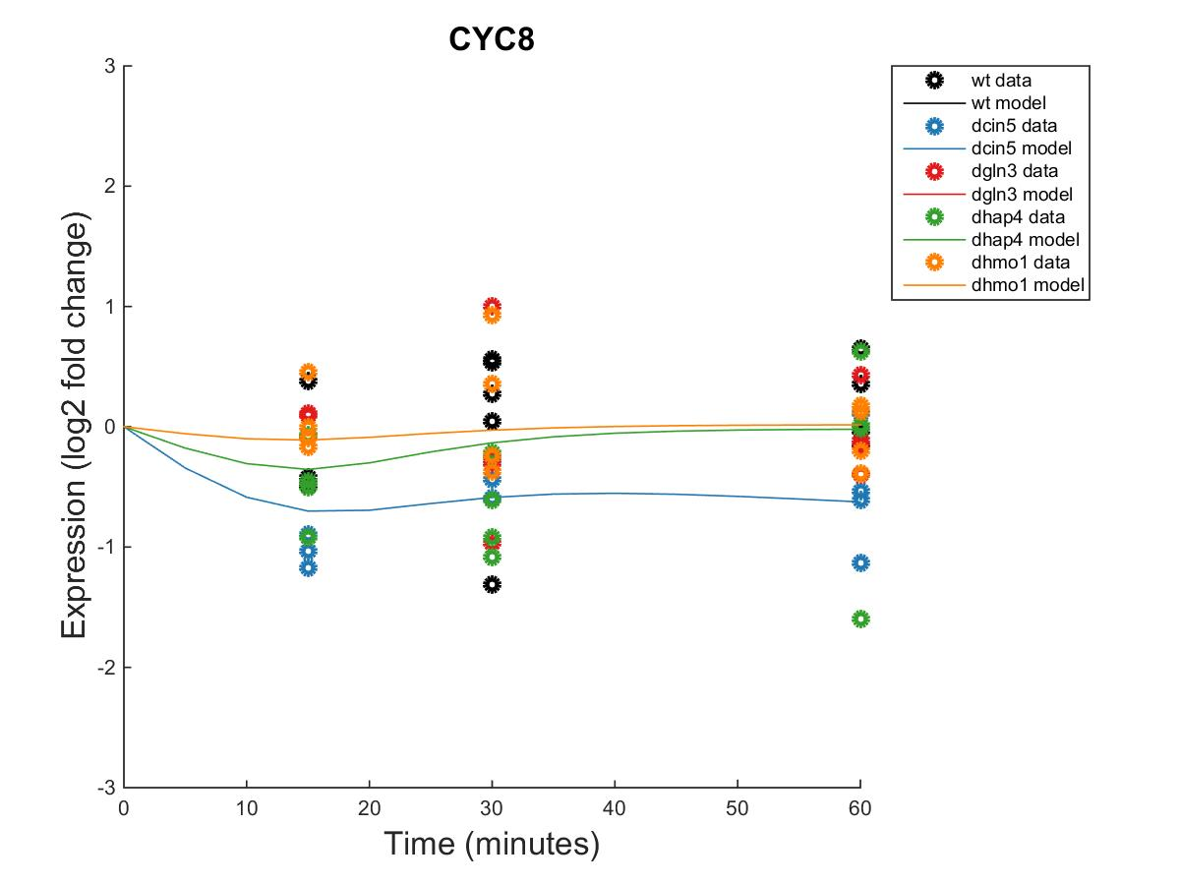
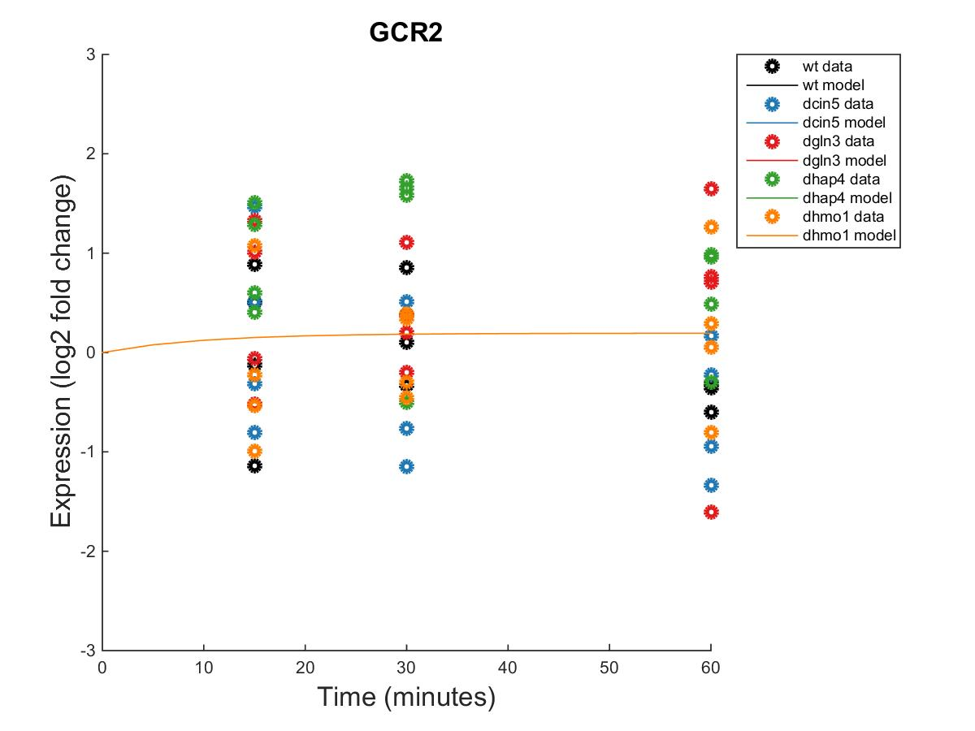
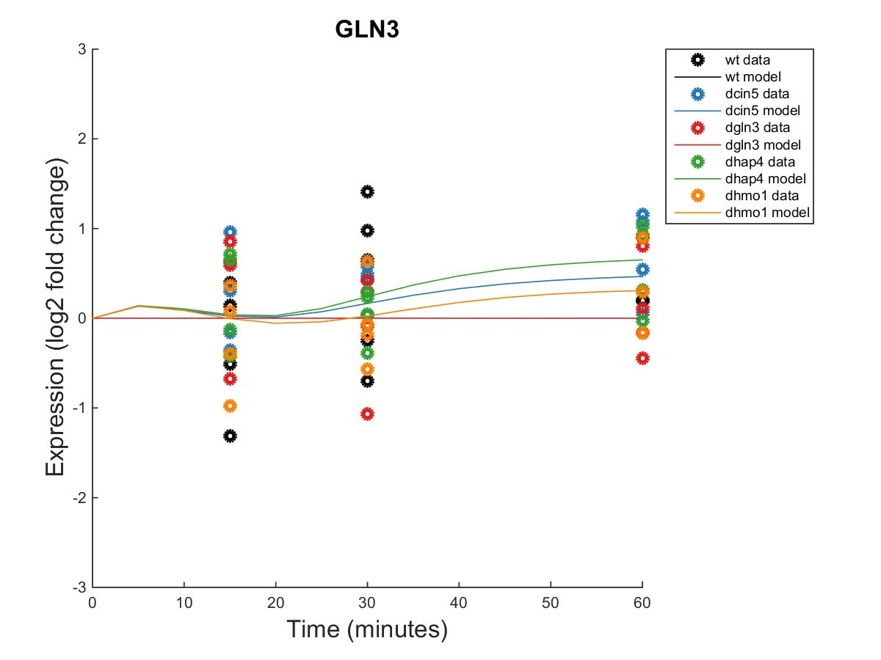
GRNmap Output Estimation of CIN5, CYC8, GCR2, and GLN3

Slide 26
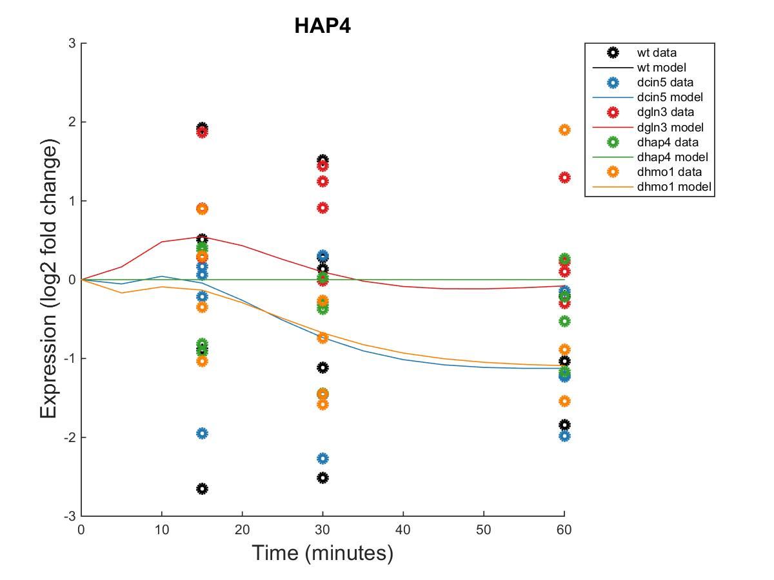
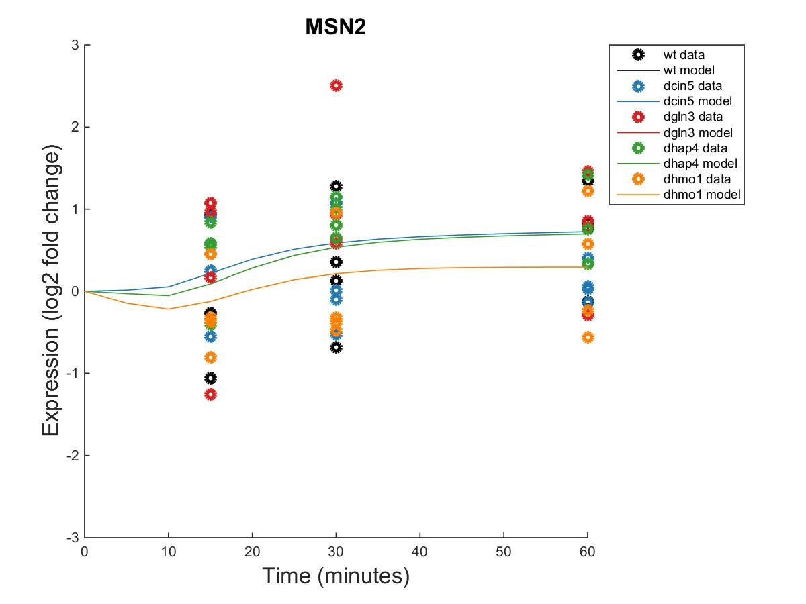
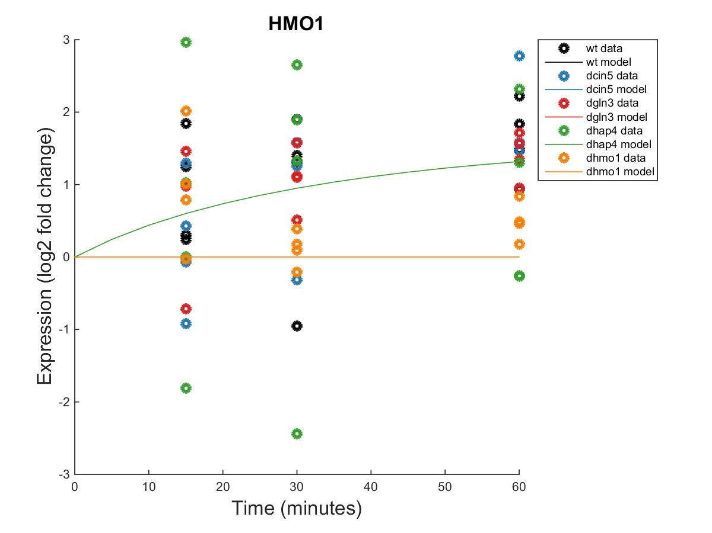
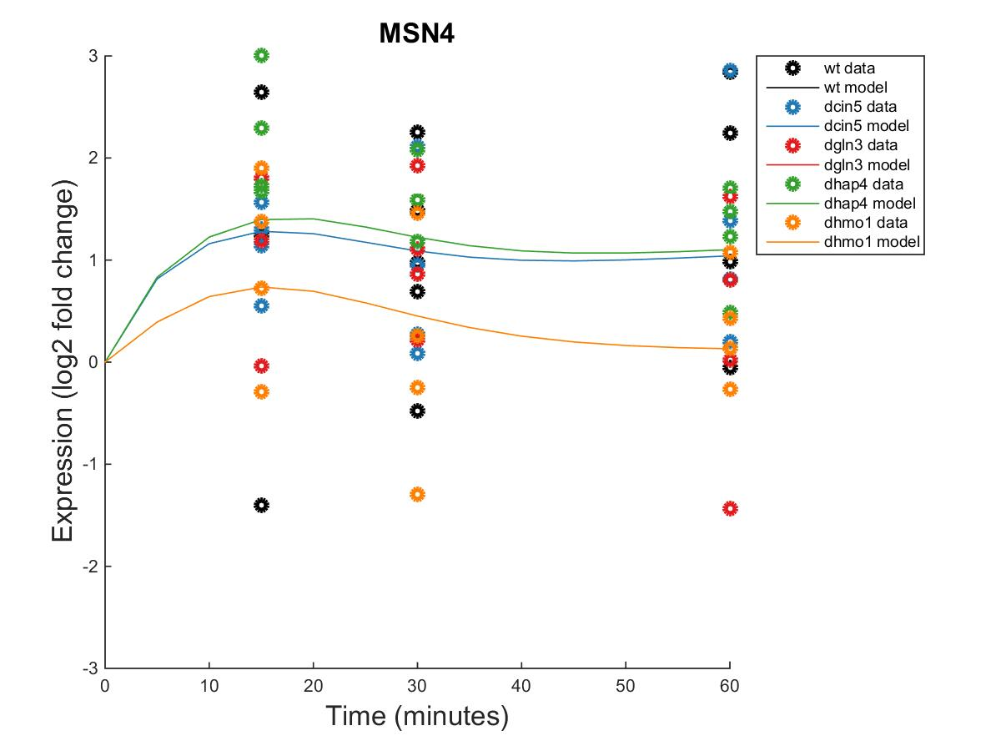
GRNmap Output Estimation of HAP4, HMO1, MSN2, and MSN4

Slide 27
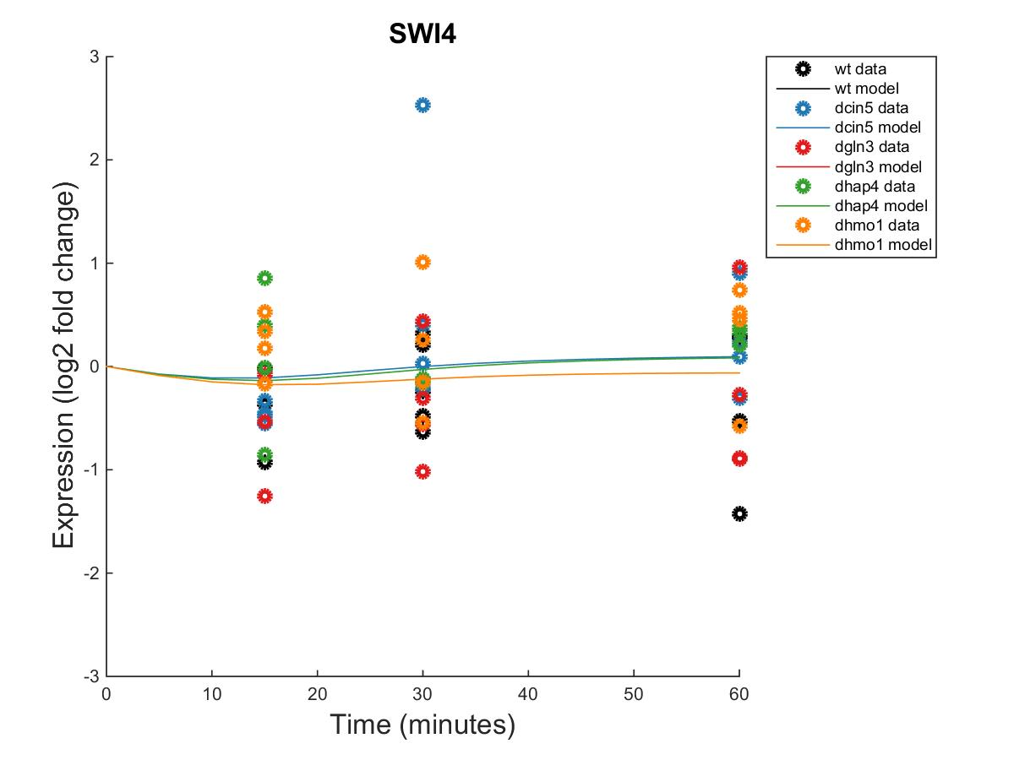
GRNmap Output Estimation of SFP1, SWI4, and SWI5

Slide 28
GRNmap Output Estimation of TEC1, YHP1, and YOX1

Slide 30
Unweighted dGLN3 Network

Slide 31
Weighted dGLN3 Network

Slide 32
Optimized Production Rates and Threshold B Values for the dGLN3 Network
id | production_rate | threshold_b
CIN5 | 1.271003641 | 0.209399466
CYC8 | 0.160845844 | 0.950363449
GCR2 | 0.220370375 | 0.220370375
GLN3 | 0.28447758 | 1.482407766
HAP4 | 1.256925872 | 0.614245955
HMO1 | 0.182926186 | 0.870922377
MSN2 | 0.520156519 | 1.661419406
MSN4 | 1.320347752 | -0.013479776
SFP1 | 1.19732936 | -0.021415072
SWI4 | 0.287798399 | 0.76607819
SWI5 | 2.305777244 | -2.553877634
TEC1 | 1.576533679 | 0.351001393
YHP1 | 0.53884153 | 1.108341513
YOX1 | 0.792511916 | 1.692328334

Slide 33
dHAP4 GRNmap Testing Results
As of: 2016 Oct. 30
dHAP4 Information:
15 Nodes (Genes)
28 Edges
Network composed of the following genes:
ACE2
ASH1
CIN5
GCR2
GLN3
HAP4
HMO1
MSN2
SFP1
STB5
SWI4
SWI5
YHP1
YOX1
ZAP1

Slide 34
Parameter Outputs – dhap4
Parameter | Value
LSE | 0.6919
Penalty | 2.3443
min LSE | 0.4851
iteration count | 62139
LSE/minLSE ratio | 1.4263

Slide 35
GRNmap Output Estimation of ACE2, ASH1, CIN5, and GCR2

Slide 36
GRNmap Output Estimation of GLN3, HAP4, HMO1, and MSN2

Slide 37
GRNmap Output Estimation of SFP1, STB5, SWI4, and SWI5

Slide 38
GRNmap Output Estimation of YHP1, YOX1, and ZAP1

Slide 40
Unweighted dHAP4 Network

Slide 41
Weighted dHAP4 Network

Slide 42
Optimized Production Rates and Threshold B Values for the dHAP4 Network
id | production_rate | threshold_b
ACE2 | 0.163234325 | 0.600247905
ASH1 | 2.026770243 | -1.788383776
CIN5 | 0.951135552 | 2.368983232
GCR2 | 0.235110128 | 0.235110128
GLN3 | 0.287841401 | 0.820555924
HAP4 | 1.672581844 | 0.726615646
HMO1 | 0.23866431 | 0.968024053
MSN2 | 0.882424058 | 4.748924118
SFP1 | 1.209396426 | 1.039919814
STB5 | 0.320388323 | 0.57712108
SWI4 | 0.241176223 | 0.326154591
SWI5 | 1.249745969 | -0.591006185
YHP1 | 0.341078303 | 2.30425228
YOX1 | 0.864626626 | 2.095374344
ZAP1 | 0.129813716 | 0.129813716

Slide 43
dZAP1 GRNmap Testing Results
As of: 2016 Oct. 30
dZAP1 Information:
16 Nodes (Genes)
27 Edges
Network composed of the following genes:
ABF1
ACE2
CIN5
CST6
GCN4
GCR2
GLN3
HAP4
HMO1
HSF1
MCM1
MGA2
MSN2
MSN4
SWI4
ZAP1

Slide 44
Parameter Outputs – dZAP1
Parameter | Value
LSE | 0.8602
Penalty | 1.8276
min LSE | 0.6156
iteration count | 76769
LSE/minLSE ratio | 1.3973

Slide 45
GRNmap Output Estimation of ABF1, ACE2, CIN5, and CST6

Slide 46
GRNmap Output Estimation of GCN4, GCR2, GLN3, AND HAP4

Slide 47
GRNmap Output Estimation of HMO1, HSF1, MCM1, and MGA2

Slide 48
GRNmap Output Estimation of MSN2, MSN4, SWI4, AND ZAP1

Slide 50
Unweighted dZAP1 Network

Slide 51
Weighted dZAP1 Network

Slide 52
Optimized Production Rates and Threshold B Values for the dZAP1 Network
id | production_rate | threshold_b
ABF1 | 0.05756589 | 0.05756589
ACE2 | 0.231454349 | 1.538999218
CIN5 | 1.915680925 | -0.536934415
CST6 | 0.291666931 | -0.023546341
GCN4 | 0.045606823 | -0.942389874
GCR2 | 0.227795509 | 0.227795509
GLN3 | 1.357203575 | -0.447653587
HAP4 | 1.704620101 | 0.170199964
HMO1 | 0.238992333 | 0.384936848
HSF1 | 0.107908965 | 0.095031078
MCM1 | 0.142935955 | 0.264279283
MGA2 | 0.307594235 | -0.039708706
MSN2 | 1.353883241 | -0.64778282
MSN4 | 1.405376368 | 1.717458691
SWI4 | 0.21276404 | -2.744608001
ZAP1 | 0.130661697 | 0.130661697

