Slide 1
Rewiring the Specificity of Two-Component Signal Transduction System
By Jeffrey M. Skerker, Barrett S. Perchuk, Albert SiryaPorn, Emma A. Lubin, Orr Ashenberg, Mark Goulian, and Michael T. Laub
Cell (2008); 133(6); 1043-1054
Presented by Jose R. Echevarria for 20.385
02-24-2010

Slide 2
Hypothesis
Could the Specificity of Histidine Kinases be determined by amino acids that exhibit a large degree of covariation.
If you vary a subset of amino acids of Histidine Kinases, could that modify the specificity of the Histidine Kinases.

Slide 3
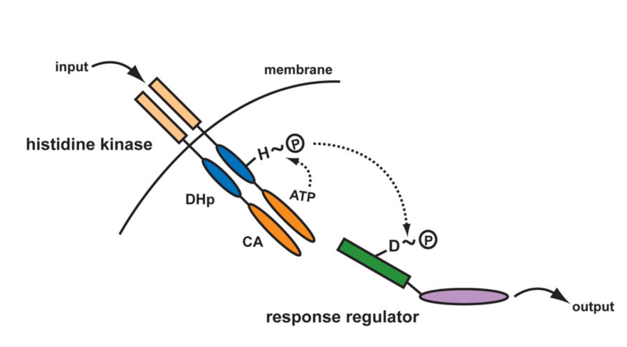
Histidine Kinase Diagram

Slide 4
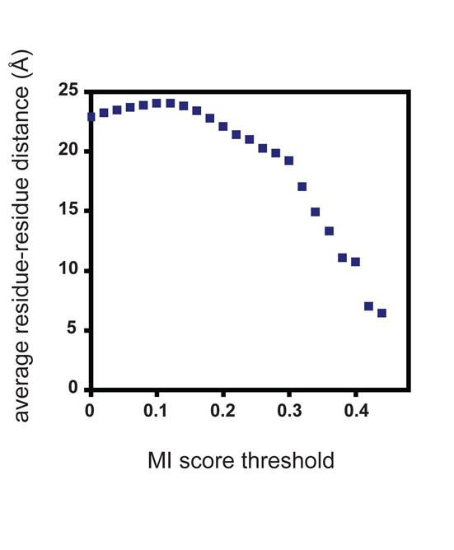
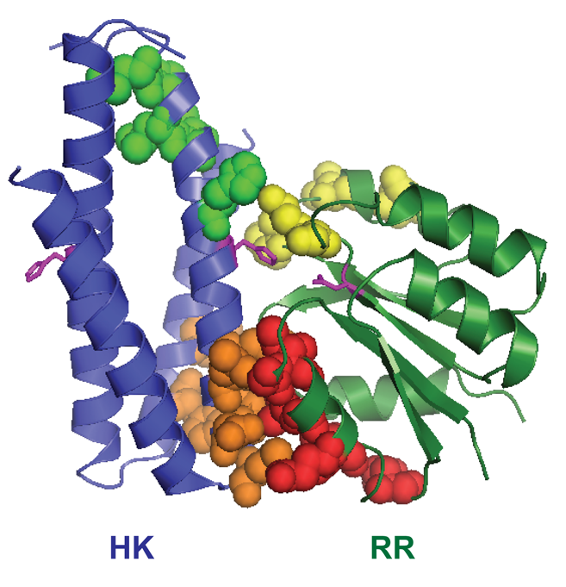
Structural Analysis based on Histidine Phosphotransferase
Residues do not perfectly correlate with contact residues of the Spo0B:Spo0F model

Slide 5
Primary Alignments

Slide 6
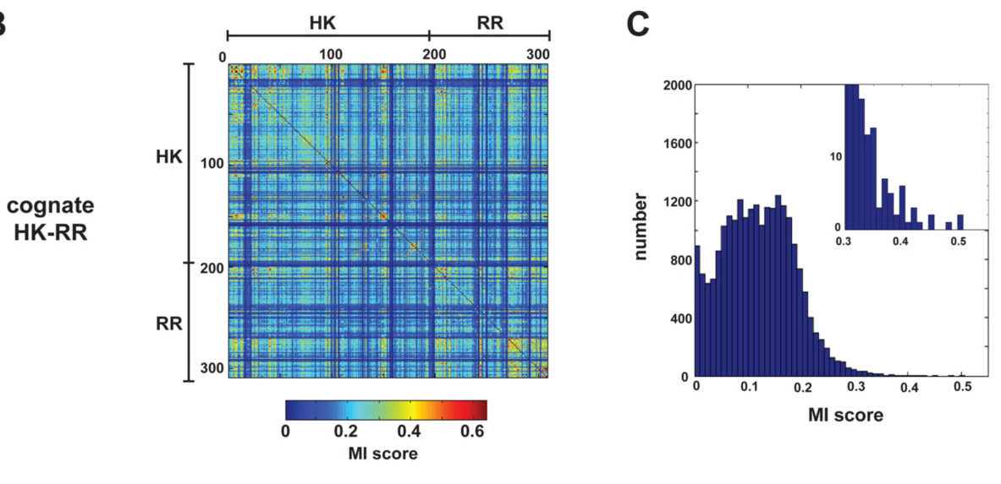
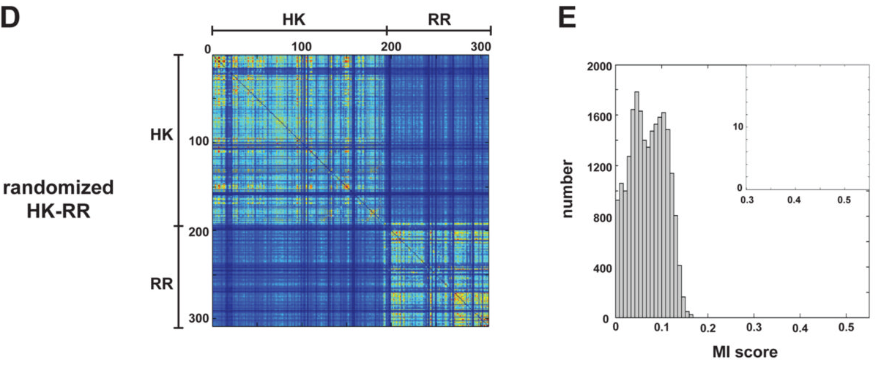
Search for covarying residues

Slide 7
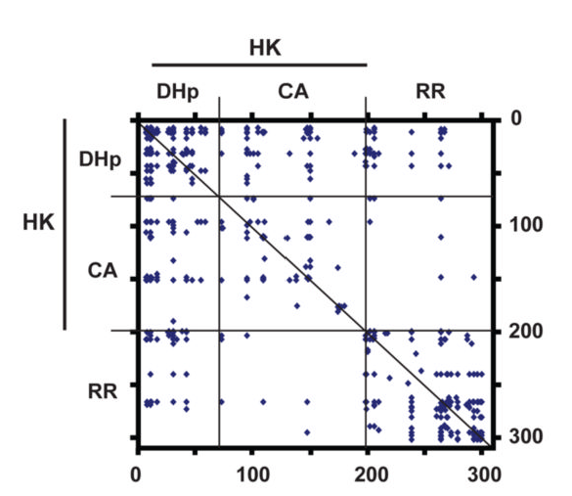
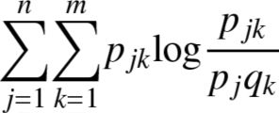
Search for Covarying Residues
43 amino acids found with an MI greater than .35
36 of them included the dHp domain of histidine kinase and it’s response regulator
Formula for MI:

Slide 8
DHp Domain is Critical

Slide 9
7 Residue Chimera Construct
Mutants with varying levels of homology to the EnvZ DHp domain.
Holds 7 Specificity – determining residues at the C- terminal, N-terminal portion of helix 2, and a connecting loop.

Slide 10
More Chimera Testing

Slide 11
Kcat/Km Analysis
Summary of Kinetic Preference for Wild-Type, Chimeric, and Mutant Kinases
Histidine Kinase | Kinetic Preference: RstA versus OmpRa | Kinetic Preference Relative to EnvZ | Kinetic Preference: CpxR versus OmpR^{b} | Kinetic Preference Relative to EnvZ
EnvZ | 0.0031 | 1 | 0.0013 | 1
RstB | 2566 | 8 × 10⁵ | — | —
Chim1 | 1408 | 5 × 10⁵ | — | —
Mut4 | 206 | 7 × 10⁴ | — | —
Mut5 | 94 | 3 × 10⁴ | — | —
CpxA | — | — | 296 | 2 × 10⁵
Chim2 | — | — | 690 | 5 × 10⁵
ª Specificity constants (k_{cat}/K_{M}) were measured for each kinase relative to the response regulators RstA and OmpR. The kinetic preference value reported is the ratio of these two constants.
^{b} Specificity constants (k_{cat}/K_{M}) were measured for each kinase relative to the response regulators CpxR and OmpR. The kinetic preference value reported is the ratio of these two constants.

Slide 12
Mutation of Residues and Analysis

Slide 13
New Mutants containing Loop

Slide 14
Well behaved Chimeras

Slide 15
In Vivo Testing

Slide 16
Critique
Key Assumptions
Phylogeny is greatly reduced by screening for genomes with less than 90 % identity.
Covariance determines the amino acids that would be more deterministic in histidine specificity.
Pit-Fall
Need a combination of approaches for better understanding.

Slide 17
Significance
Proof of the possibility to rewire the specificity of input systems by modifying a small number of residue.
Model through which we can add complexity and apply to other biological systems in vivo.
Cross-talk Suppression between the CpxA-CpxR and EnvZ-OmpR Two-Component Systems in E. coli; Albert Siryaporn & Mark Goulian

