Slide 1




Determining the Mechanisms of Primary Cilia bending in response to Fluid Shear Stress
D.A. Hoey^{1,2}, J. Geraedts¹, C.R. Jacobs¹
1, Columbia University 2, Royal College of Surgeons in Ireland
Department of Biomedical Engineering Department of Anatomy
Cell and Molecular Biomechanics Lab
Presented at the 28th Scientific Conference of the SPRBM (1/15/10)

Slide 2

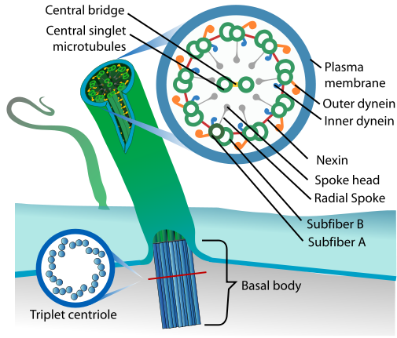
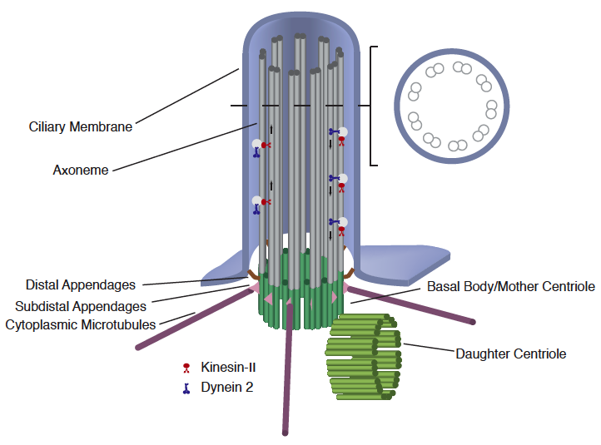
Cilium
Motile Cilium (9+2)
  Cells lining the trachea
  Nodal Cilium (blastocyst)
  Inner/Outer arm Dynein Motors
  Radial Spokes
  Nexin links
Non-Motile (9+0)
  Found in almost all vertebrate cells
  Mechanosensor
  Chemosensor
(Temiyasathit et al, 2010)
Notes:
Nodal, motile and non-motile cilia work in concert
Exception, blood cells and intercalated cells of kidney duct

Slide 3
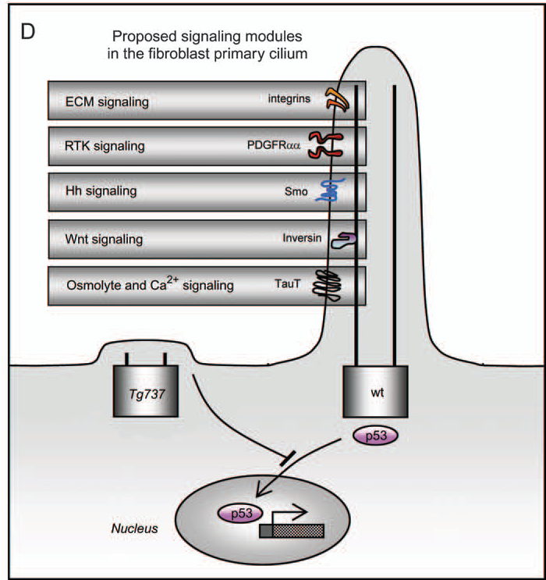
Primary Cilium (9+0)
Chemo-sensor
  ECM (integrins)
  RTK (PDGFR)
  Hh (Smo)
  Wnt (Inversin)
  Ca2+ (TauT)
Pathology (ciliopathies)
  Developmental disorders
  Cancer
  Blindness
  Obesity
(Christensen et al, 2007)
Notes:
PDGFR – cell survival, apoptosis, proliferation
Tie – surface epithelium of the oviduct – blood vessel formation

Slide 4
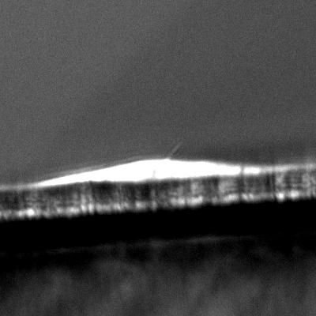
Primary Cilium (9+0)
Mechano-sensor
  Kidney (PC1/2)
  Bone
  Cartilage
Pathology (ciliopathies)
  Polycystic kidney disease
  Reduced bone formation
(Malone et al, 2007; Praetorius and Spring, 2001)
Notes:
PDGFR – cell survival, apoptosis, proliferation
Tie – surface epithelium of the oviduct – blood vessel formation
Tyler Johnston (DIC image 0.02Pa) Stiff vs Compliant, examples.

Slide 5
Aims
3D imaging of a primary cilium profile in response to fluid flow
  Plane of bending
  Bending profile
Model the response of a cilium in response to flow
  Determine flexural rigidity (EI)
Investigate mechanism of bending

Slide 6
Imaging
IMCD cell line
  SSTR3:eGFP tag
  Cilia length (5um)
Leica TCS SP5 Confocal Laser Scanning Microscope
  100x (1.46 NA) oil immersion
0 um 10

Slide 7
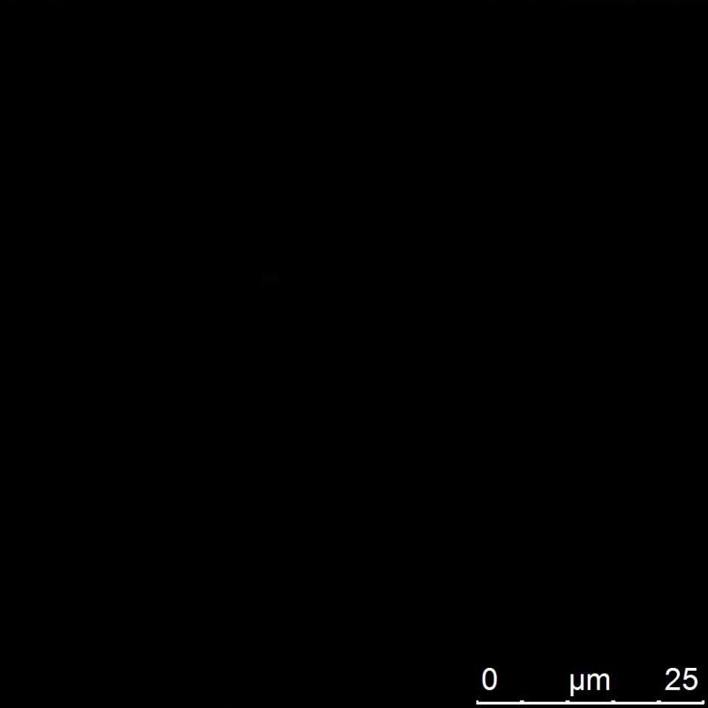

3D Imaging
Z-series projection (XYZ)
  0.1um - step size
  Line average (x4)
  Pixel size 25.25nm
Determine cilium length

Slide 8
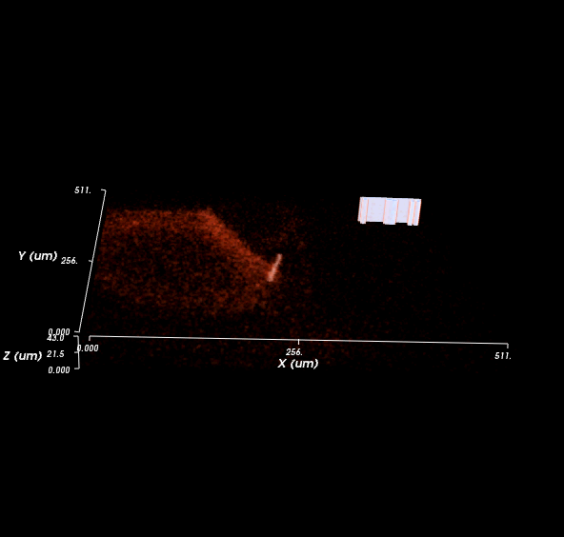
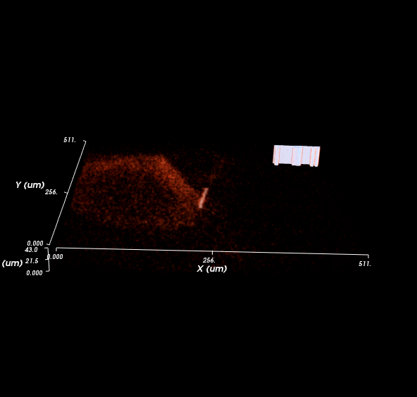
3D Imaging
Z-series projection through time (XYZT)
  Resonant scanner
  ImageSurfer (NIH) used for volume rendering through time

Slide 9
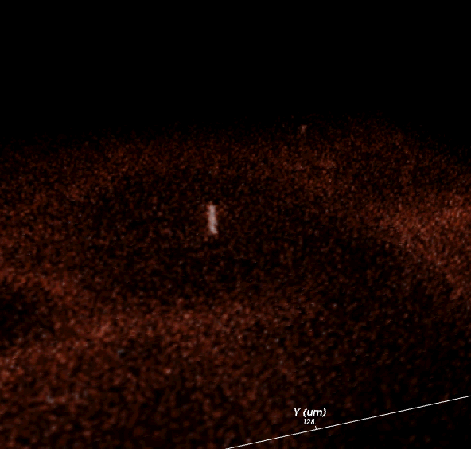
3D Imaging
Z-series projection through time under flow shear stress (XYZT)
  Flow HBSS over culture dish using hand operated syringe
Parameters
  3 frames/sec
  0.5um - step size
  Line average (x2)
Notes:
Pixel size, to determine scale

Slide 10
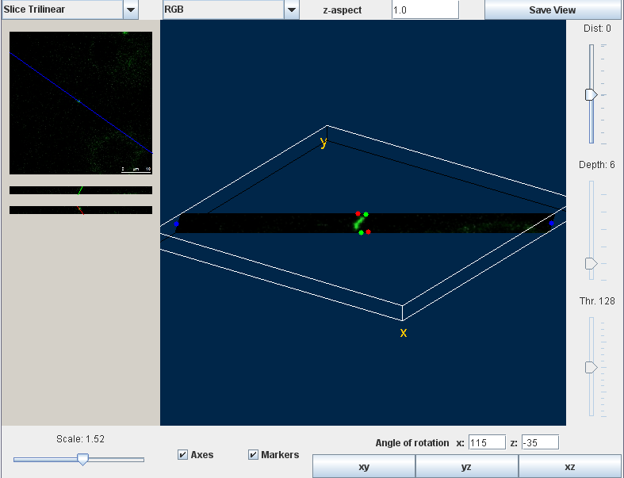
3D Imaging
Z-series projection through time under flow shear stress (XYZT)
  Flow HBSS over culture dish using hand operated syringe
Import Z-series of interest into ImageJ
  Volume render 1.31 macro to determine plane of bending
Notes:
Pixel size, to determine scale

Slide 11
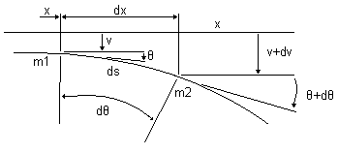
Modeling
Model assumptions
  Cilium is a homogenous cantilevered cylindrical beam
Euler-Bernoulli Beam bending equation
  …………….. (1)
  where, θ is the angle of the slope of the bent
  beam at any pt s along its length
  , M is the bending moment
  , EI is the flexural rigidity
  Beam subjected to uniform load, q
      …………….. (2)
(Holden, 1972)
Notes:
Never yielded a closed form solution
Flexural rigidity is defined as the force couple required to bend a rigid structure to a unit curvature.

Slide 12
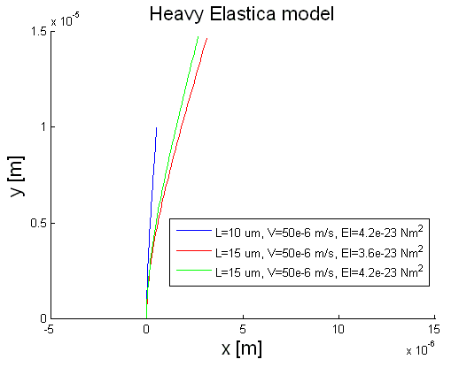
Heavy Elastic Model
Expand θ as a Maclaurin series
Boundary conditions
Coordinates obtained using a line integral along the length of beam
(Holden, 1972)
(Schwartz et al, 1997)
Notes:
Coordinates obtained using a line integral along the length of the beam

Slide 13
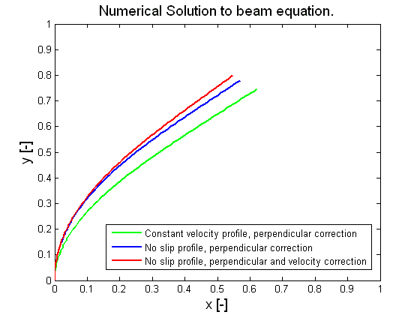
Heavy Elastic Model
Numerical Solution
  Non-dimensional,
  Coordinates
  Additions
    Load a function of cilium length, k=k(s)
    Perpendicular correction
(Holden, 1972)
Notes:
Drag force, k=k(s)

Slide 14
Determining EI
Fitting model to bending profile
  E.g. Image taken from Schwartz et al, 1997
  Assume a value for k, where
    Fit reference points
    Update k
(Holden, 1972)
Model Output:
EI =: 1.06358e-023 [Nm^2].
Fit error: 0.00711261 [-].
(Schwartz et al, 1997)
EI = 2.47e-023 [Nm^2].

Slide 15

Mechanism of Bending
MT tightly bound
I = 7.66E-29 m^4
MT connected
I = 1.38E-29 m^4
MT independent
I = 4.28E-031 m^4
MT Model
EI = 1.06E-23 Nm^2
E = 1.2GPa, (Gittes et al, 1993)
I = 8.86E-33 m^4
MT
Model
MT
ID
MT
Connect
MT
TB
Notes:
Is this related to basal tilt.
Doublet movement

Slide 16
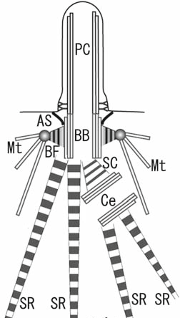
Conclusions
Techniques
  3D imaging of primary cilia bending in response to flow
  Model of primary cilia bending in response to flow
Microtubules act independently
  Basal tilt

Slide 17

Thank You
References:
Christensen et al (2007); Traffic; 8:97-109
Gittes et al (1993); J Cell Biol; 120:923-934
Hagiwara et al (2008); Med Mol Morphol; 41:193-198
Holden (1972); Int J Solids Structures; 8:1051-1055
Malone et al (2007); PNAS; 104:13325-13330
Scwhartz et al (1997); Am J Physiol; 272:132-138
Temiyasathit et al (2010); NYAS: In Press.
Questions???
Acknowledgements:
CMBL Lab members
Prof. Yoder (Univ. of Alabama) for generously donating the IMCD cells.
Supported by:
IRCSET-Marie Curie International Mobility Fellowship in Science, Engineering and Technology
NYSTEM: New York Stem Cell Grant

