Slide 1
Electrical Spiking in Escherichia coli Probed with a Fluorescent Voltage-Indicating Protein Science July 15, 2011
by: Joel M. Kralj, Daniel R. Hochbaum,
Adam D. Douglass, and Adam E. Cohen
Presented by: William Morejón and Shikha Kaji

Slide 2
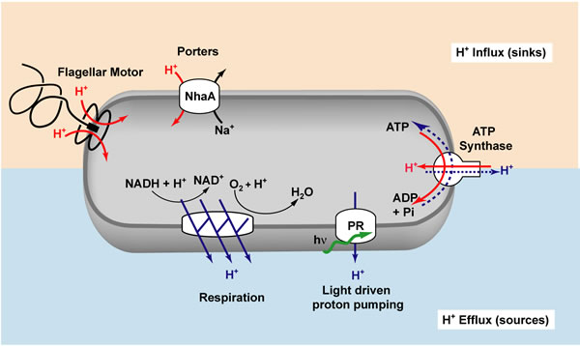
Role of Membrane Potential in Bacterial Survival
Oxidative phosphorylation
Flagellar motion
Cell Division
Chemotaxis
Membrane Transport
U.S. Department of Energy’s Lawrence Berkeley National Laboratory,
University of California at Berkeley
http://www.lbl.gov/Science-Articles/Archive/PBD-proteorhodopsin.html

Slide 3
Motivation
Little is known about electrophysiology of bacteria at the level of single cells
Cannot probe voltage dynamics in an intact bacterium
size of bacterium
cell wall
Goal: develop voltage indicating proteins that provide fast/sensitive tools for monitoring electrical dynamics

Slide 4
Green-Absorbing Proteorhodopsin (GPR)
Light-driven proton pump in aquatic organisms
Transport of proton through GPR produces a change in protein color
V_{m}
cell membrane
hv
H⁺
Notes:
Use of voltage-sensitive fluorescent protein based on green-absorbing proteorhodopsin (GPR). Rhodopsin proteins transduce sunlight to a change in membrane potential (phototaxis and solar energy capture in microbial hosts—aquatic organisms)

Slide 5
Reverse Role of GPR
Use membrane potential to reposition a proton to induce a color shift
Color determinant is Schiff’s Base
pKa>12, protons are too tightly bound to be removed by V_{m}
Reversal does not work as hypothesized
V_{m}
cell membrane
cell membrane
H⁺
Notes:
Here, we run this process backwards. Change in membrane potential into an optical signal.

Slide 6
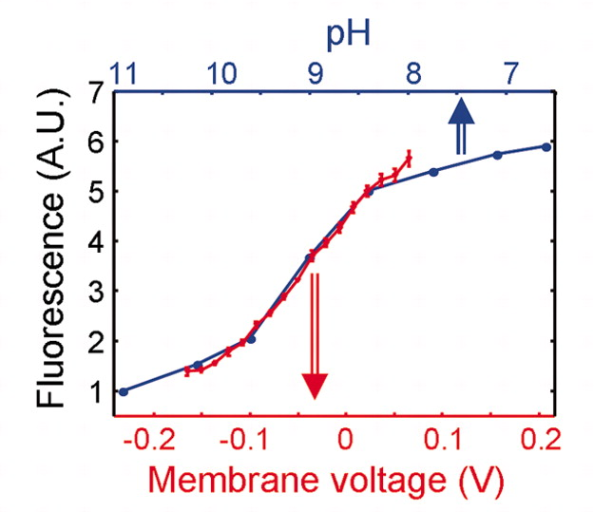
Mutating GPR to respond to Vm = PROPS
GPR^{D97N} has SB with pKa = 9.6, good for voltage sensing
This mutant was named Proteorhodopsin Optical Proton Sensor (PROPS)
Showed pH- and voltage- dependent fluorescence
Lacked light-induced proton pumping
Notes:
Fluoresence of PROPS was 5x as bright at an induced Vm of 70mv than -170mV. As pH decreases and induced voltage increases, Fluoresence increases.

Slide 7
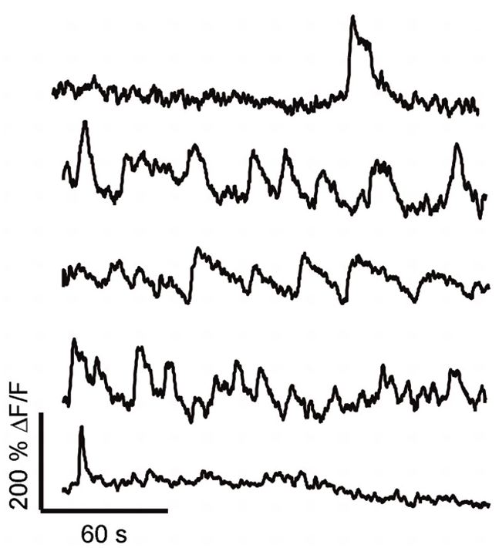
Quasi-periodic cell-wide blinks in fluoresence
Blinks occurred simultaneously over entire cell
Blinks were uncorrelated between neighboring cells
Notes:
Variety of blinking behaviors

Slide 8
Source of Blinking
Fluctuations in
Internal pH?
Electrical
Fluctuations?

Slide 9
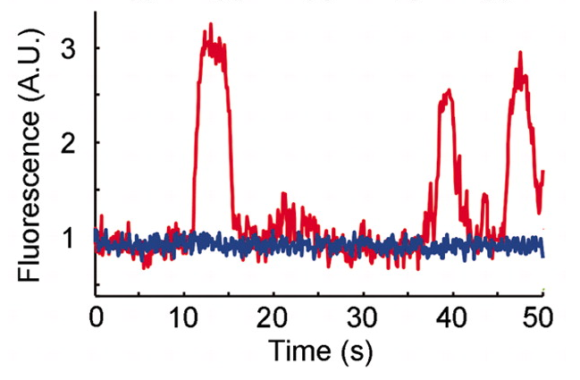
Blinks did not arise from fluctuations in internal pH
Co-expressed cytoplasmic pH indicator, super-ecliptic pHluorin, and PROPS simultaneously to observe fluorescence
Found pH was constant during blinks
PROPS
pHluorin
CONSTANT!
ΔpH not causing blinks!

Slide 10
Blinks Arose from Electrical Depolarization
Used torque of flagellar motor as an indicator of protonmotive force (PMF)
Cells of Strain JY29 adhered to coverslip by a SINGLE flagellum
Monitor blinking of PROPS and rate of rotation simultaneously
BLINK = loss of PMF (slows flagellum)
BLINK!
Slower!
Normal Speed

Slide 11
Blinks Arose from Electrical Depolarization!
Notes:
Adhere JY29 strain to coverslip

Slide 12
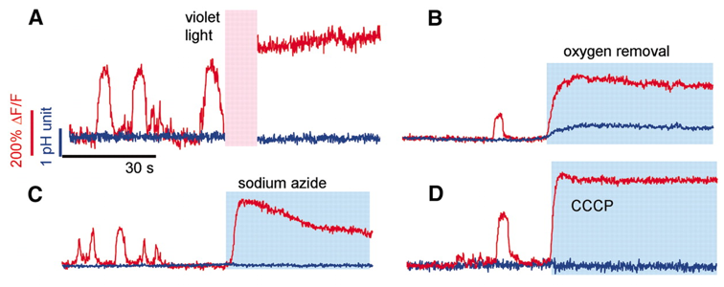
Effect of Cell Metabolic State on Blinks
Interruption of aerobic respiration STOPPED blinking & cells expressing PROPS were BRIGHT
Inhibition of Electron Transport Chain by Violet Light
Inhibition of Electron Transport Chain by O₂ removal
Inhibition of F₁-Adenosine Triphosphatase (ATPase) by sodium azide
Dissipation of PMF by CCCP (Carbonyl Cyanide m-Chlorophenyl Hydrazone)
No Blinks! High PROPS Fluorescence!

Slide 13
In Summary…
PROPS in E. coli reveals an electrical spiking at up to 1 Hz
Sensitive to electrical perturbations
Bacterial efflux machinery may be electrically regulated and give insight into the role of ion channels and pumps

Slide 14
Future Work
PROPS does not express in eukaryotes
Modify forms of related microbial rhodopsins to enable electrophysical studies in eukaryotic mitochondria and neurons
Discover which channels or pores regulate spiking
Determine whether spiking is indicative of different biological processes

