Slide 1
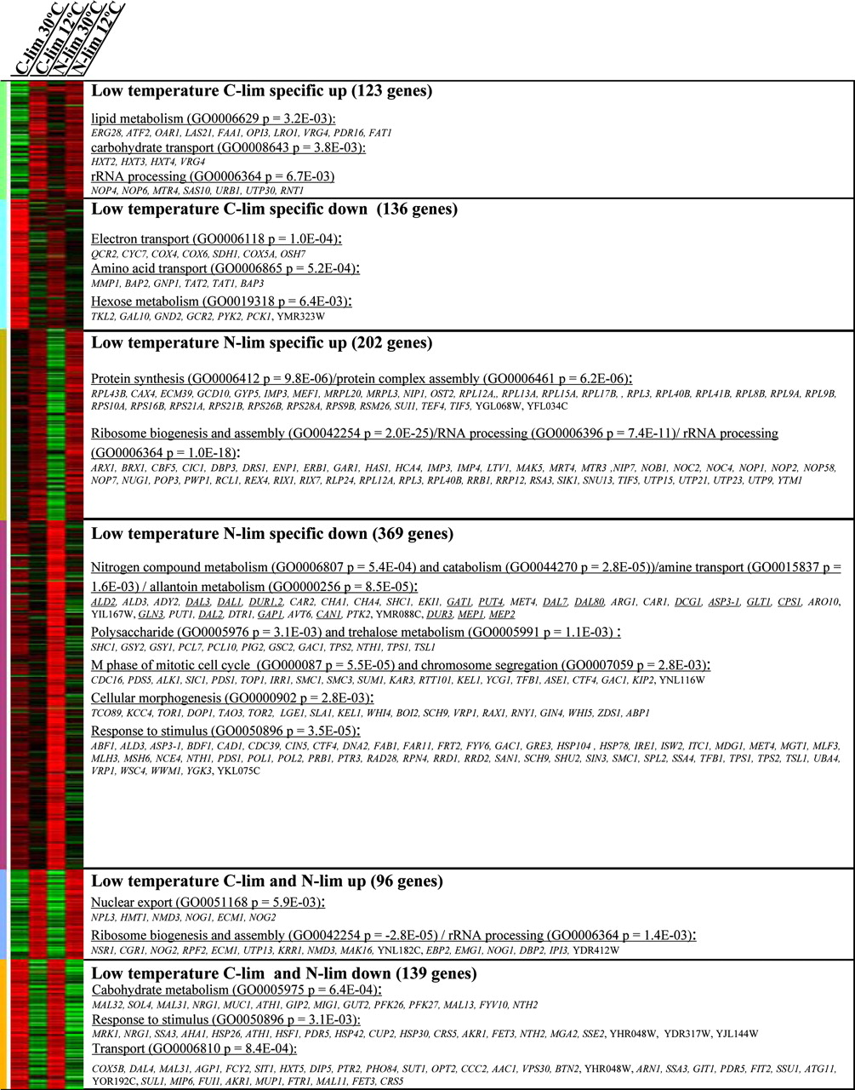
Heat map of transcript level ratios
Transcription level of 1065 genes with differential expression grown at 12 and 30C
Looks at growth limiting nutrients
19 nitrogen catabolite repression genes

