Slide 1
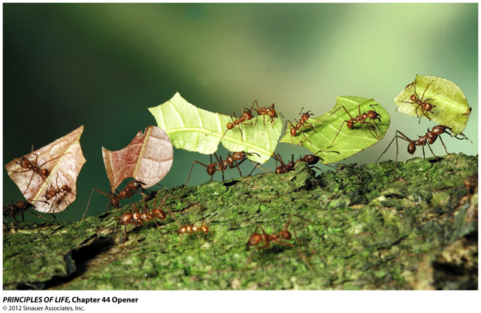
Ecological and Evolutionary
Consequences of Species
Interactions
44

Slide 2
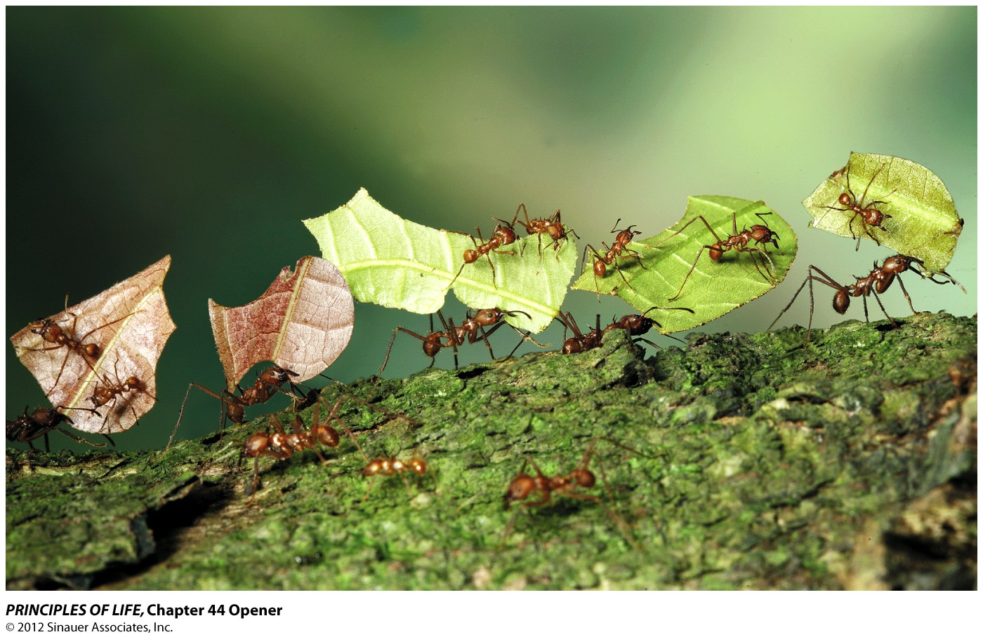
Chapter 44 Opener

Slide 3
Chapter 44 Ecological and Evolutionary Consequences of Species Interactions
Key Concepts
44.1 Interactions between Species May Be Positive, Negative, or Neutral
44.2 Interspecific Interactions Affect Population Dynamics and Species Distributions
44.3 Interactions Affect Individual Fitness and Can Result in Evolution
44.4 Introduced Species Alter Interspecific Interactions

Slide 4
Chapter 44 Opening Question
How could the intricate ecological relationship between leaf-cutter ants and fungi have evolved?

Slide 5
Answer to Opening Question
In the mutualism between leaf-cutter ants and the fungus they cultivate, both species gain nutrition from the interaction.
Ants also disperse the fungus and protect it from pathogens.
It may have started when ants began eating the fungi growing on refuse in their nests. Ants that provided better growing conditions had more fungus to eat and thus higher fitness.

Slide 6
Answer to Opening Question
Fungi that provided ants with more nutrients were more likely to be propagated by ants.
The ants expanded their food base by feeding leaves to the fungi (ants can’t digest the leaves).
The fungi then had access to food they would not be able to use if ants did not chop it up for them.

Slide 7
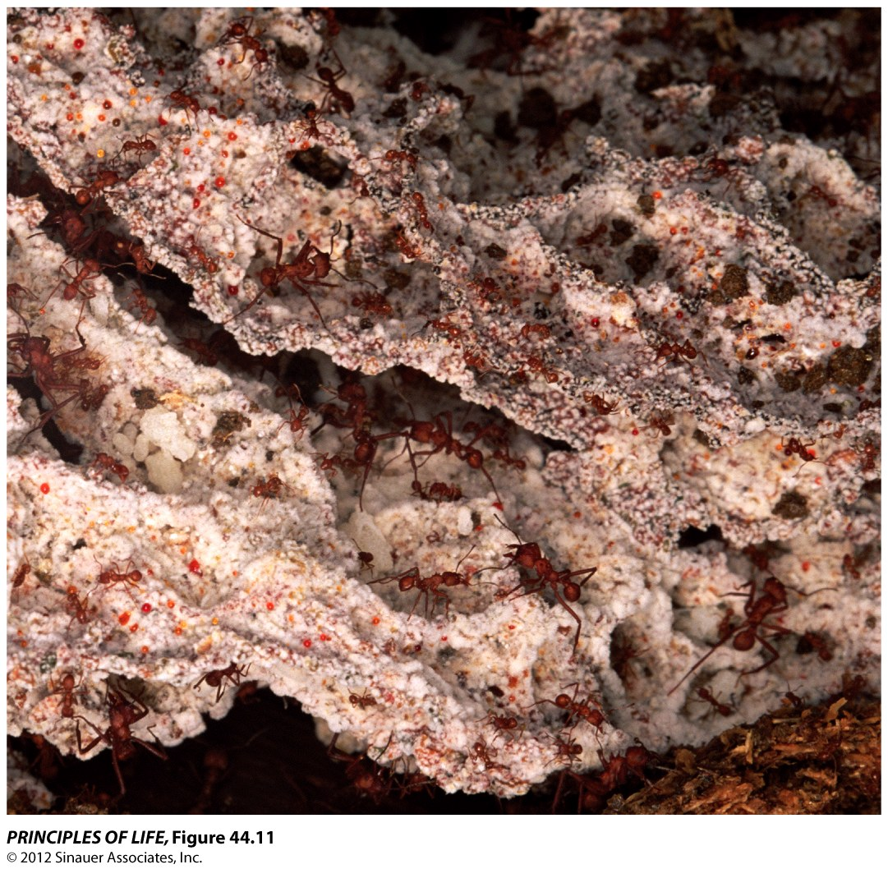
Figure 44.11 A Fungal Garden

Slide 8
Answer to Opening Question
Leaf-cutter ants and their fungi have been very successful:
They are major herbivores in the Neotropics, and have expanded into dry environments that are normally hostile to fungi.

Slide 9
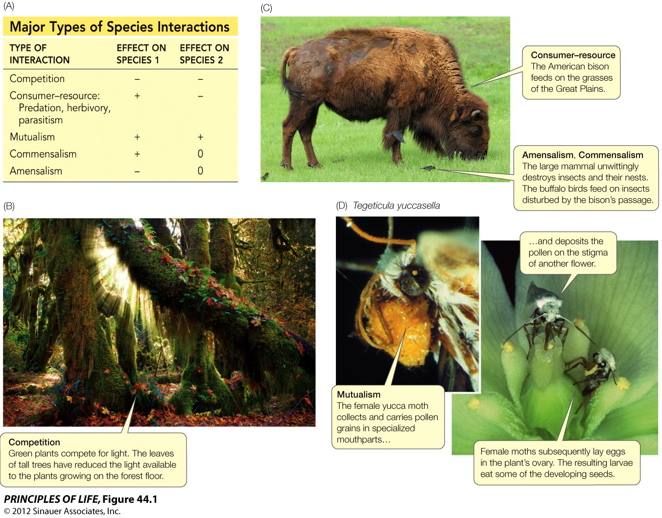
Figure 44.1 Types of Interspecific Interactions

Slide 10
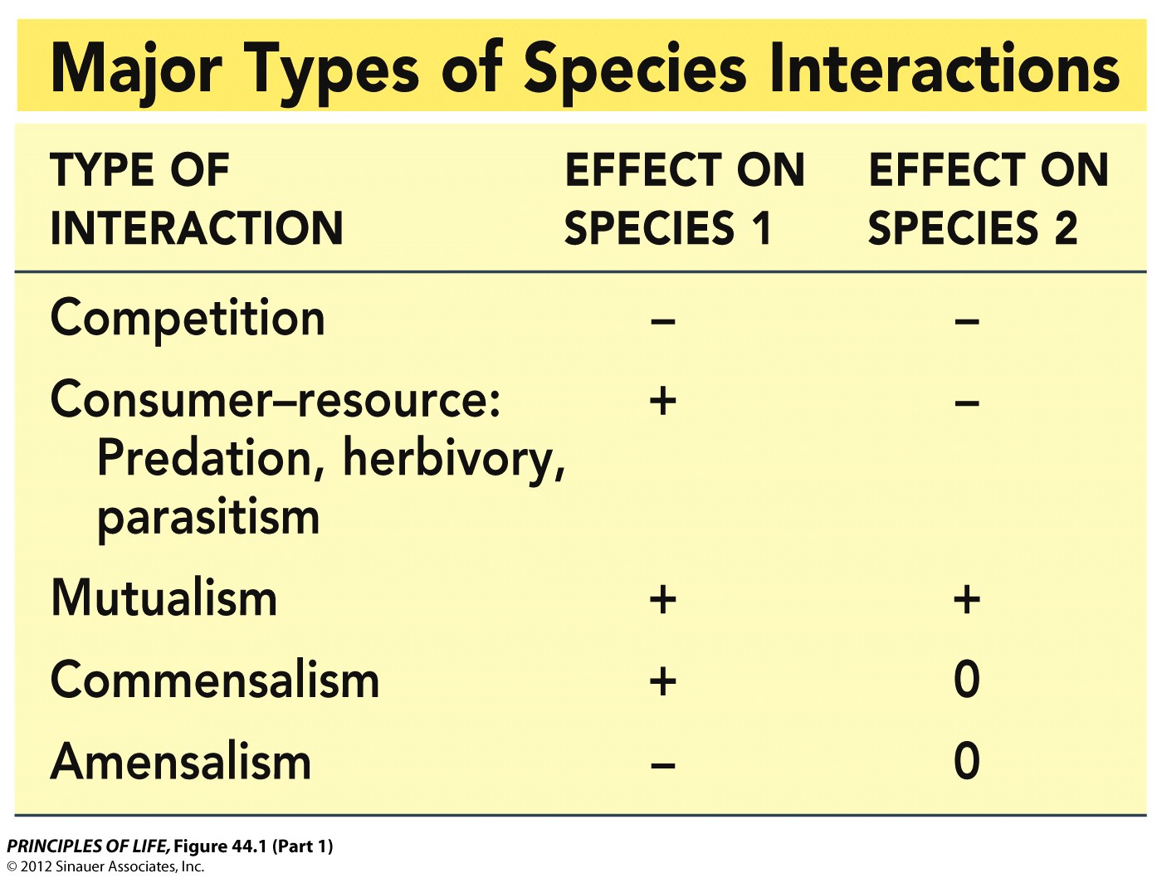
Figure 44.1 Types of Interspecific Interactions (Part 1)

Slide 11
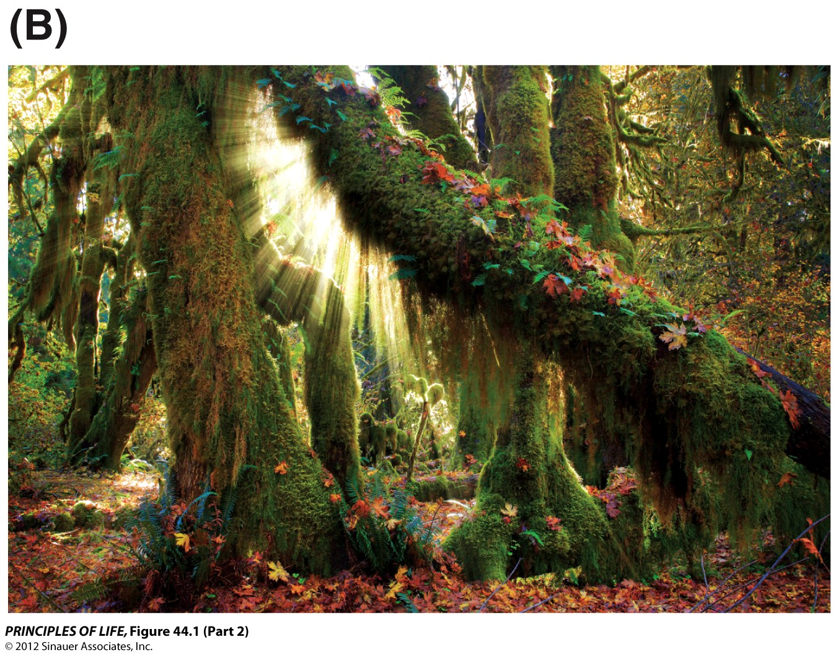
Figure 44.1 Types of Interspecific Interactions (Part 2)

Slide 12
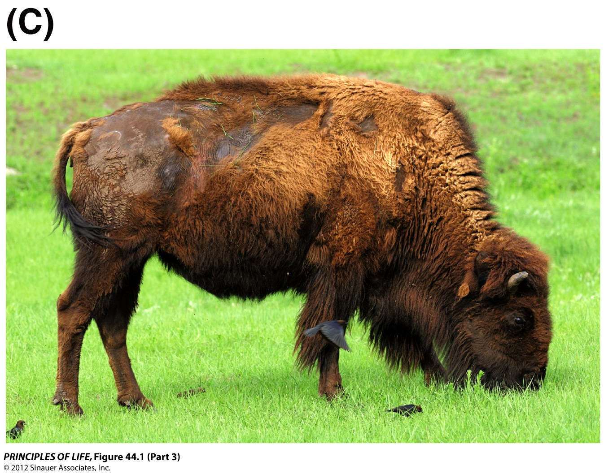
Figure 44.1 Types of Interspecific Interactions (Part 3)

Slide 13
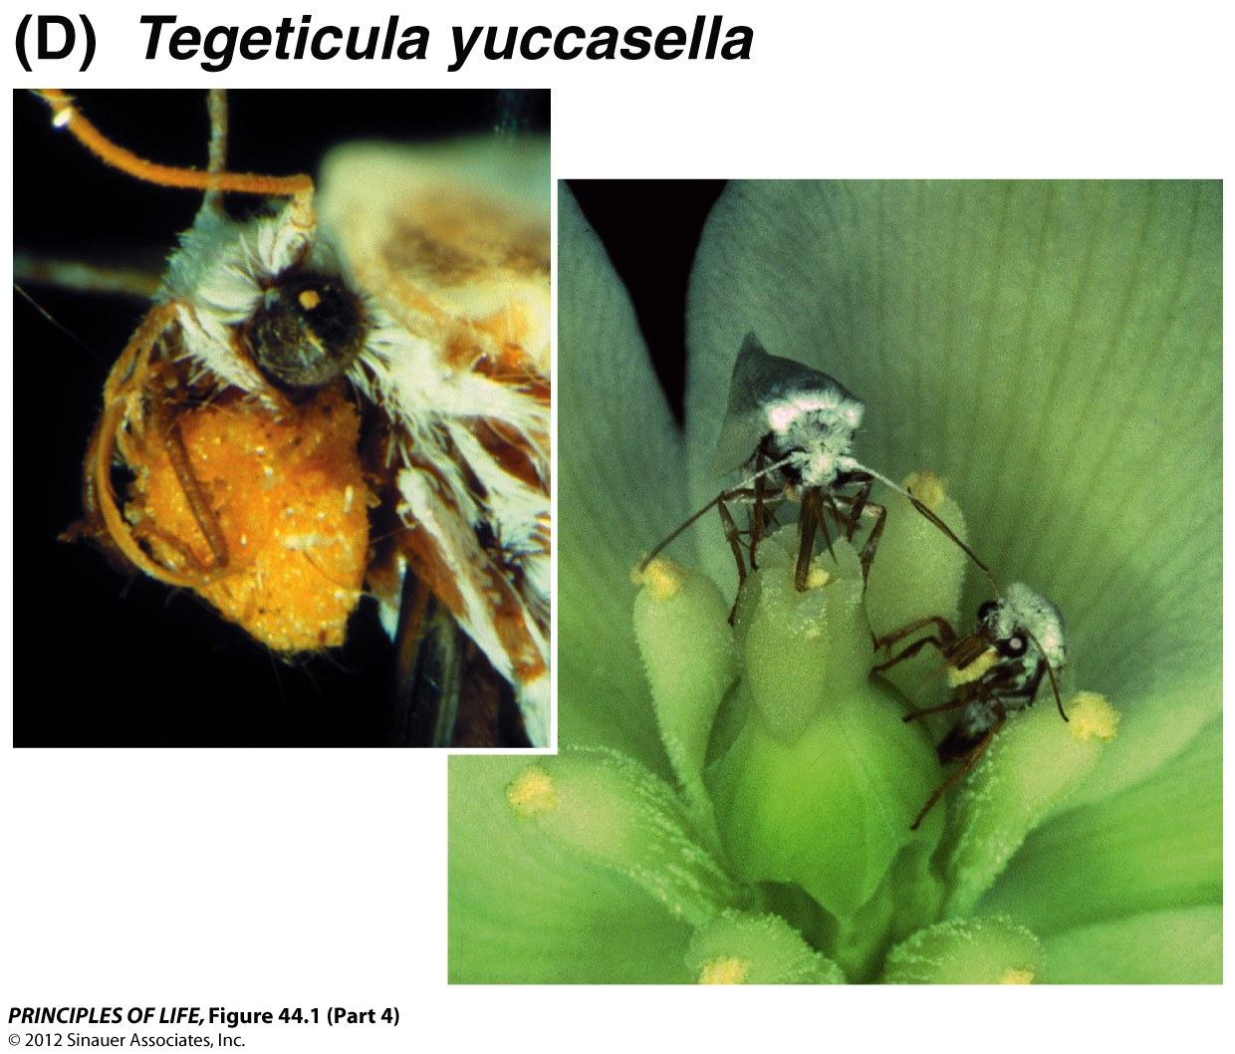
Figure 44.1 Types of Interspecific Interactions (Part 4)

Slide 14
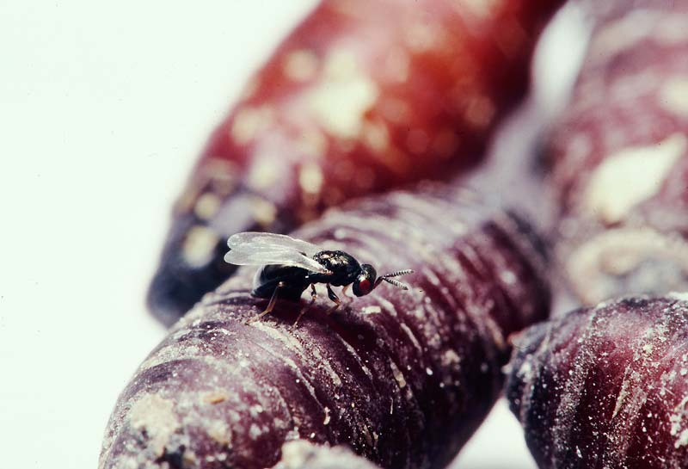
Figure 53.x2 Parasitic behavior: A female Nasonia vitripennis laying a clutch of eggs into the pupa of a blowfly (Phormia regina)

Slide 15
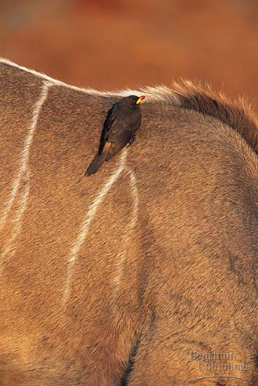
Figure 53.x3 Commensalism between a bird and mammal

Slide 16
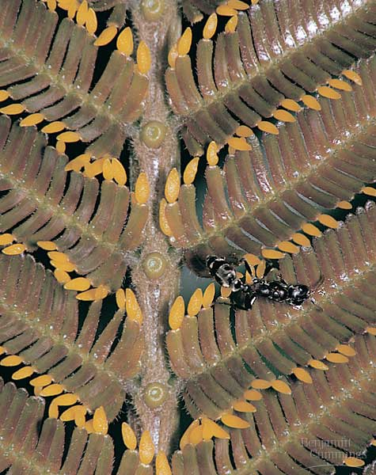
Figure 53.9 Mutualism between acacia trees and ants

Slide 17
Apply the Concept p. 862
In many animals that face uncertain availability, a tendency to collect and store more food than they can eat immediately has evolved. Desrt seed eating rodents such as Merriam’s kangaroo rat, will harvest as many seeds as you put in front of them and bury the seeds in shallow depots scattered around their territory. In some years seed production is low, and the rodents eat all the seeds they manage to store. In other years they store more seeds than they are able to eat, and uneaten stored seeds are likely to germinate as grass seedlings.
In a classic long-term study done in the 1930s and 1940s, researchers monitored the effect of kangaroo rats on native grasses. They established replicate enclosures, removed kangaroo rats from half of them, then monitored the abundance of grasses in the two types of enclosures over a period of 10 years. From 1931 to 1935 the region experienced a severe drought and grass populations declined. Rains returned in 1935. The year 1941 saw particularly high (for the desert) rainfall. Use the graph to answer the following questions.

Slide 18
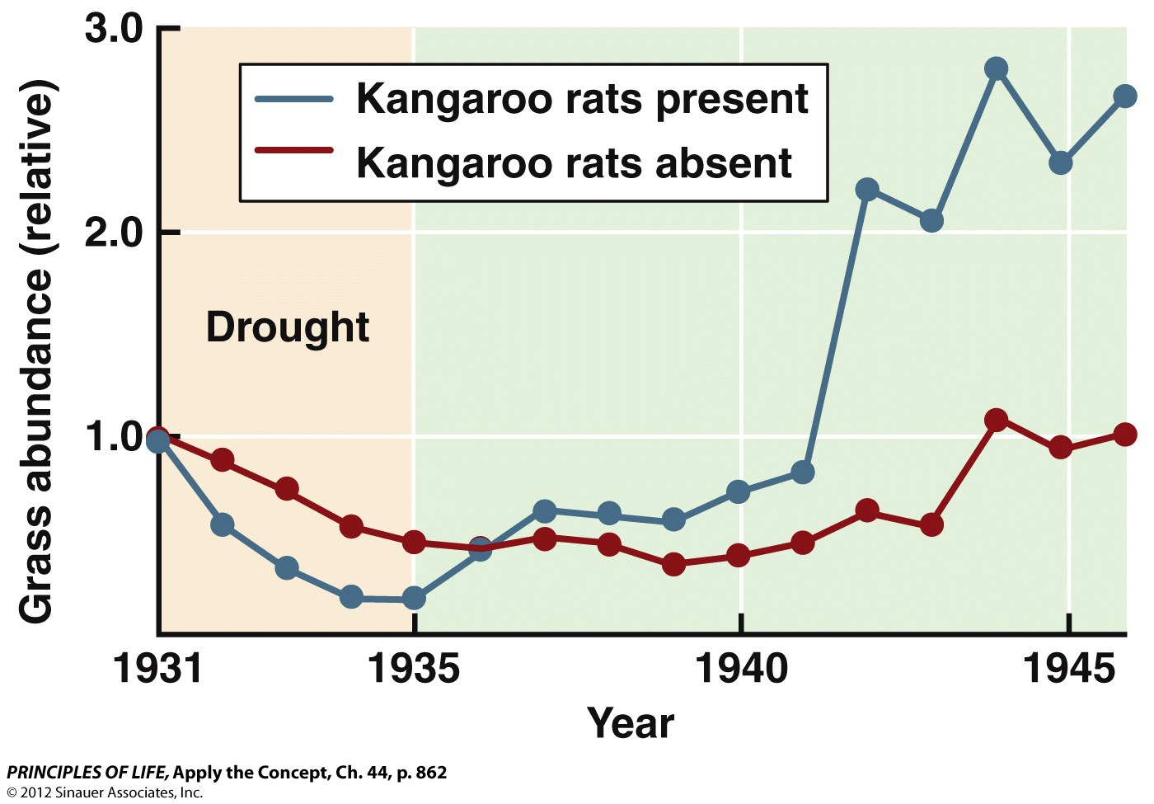
Apply the Concept, Ch. 44, p. 862

Slide 19
Questions:
1. During the drought, did kangaroo rats have a positive, negative, or neutral effect on the per capita growth rate of grasses? Explain your reasoning.
2. Did the effect of kangaroo rats on grasses change after rains returned? Explain your reasoning.
3. What aspects of kangaroo rat behavior are detrimental to grasses? What aspects might help grasses?
4. How might year-to-year variation in rainfall influence the relative strengths of the positive and negative effects kangaroo rats have on grasses growth rates?

Slide 20
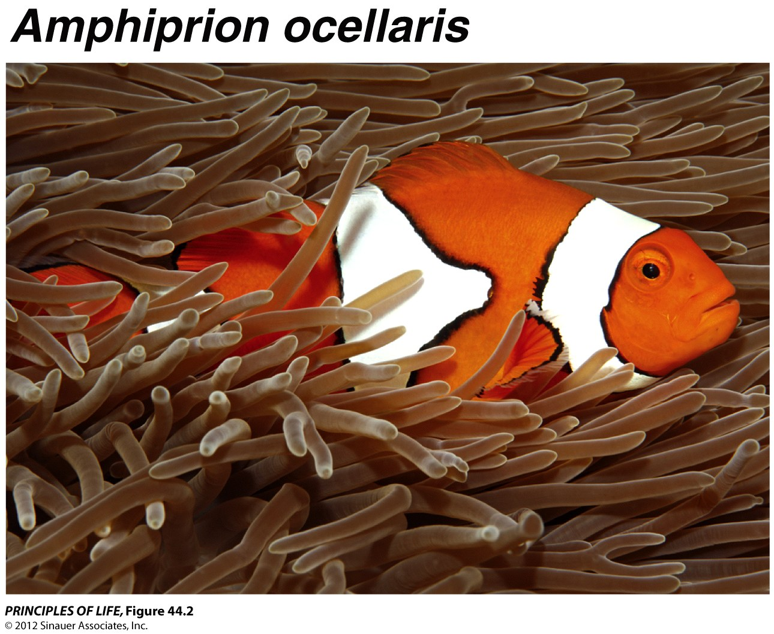
Figure 44.2 Interactions between Species Are Not Always Clear-Cut

Slide 21
Concept 44.1 Interactions between Species May Be Positive, Negative, or Neutral
Consider the following scenarios and discuss what type of interspecific interaction they represent. Write down one word for each that describes each pair’s relationship.
Unicellular algae found inside coral polyps, known as zooxanthellae, use sunlight to produce reduced carbon compounds via photosynthesis. The coral uses these compounds to fuel its metabolism and in turn supplies the zooxanthellae with carbon dioxide, nitrogen, and other nutrients. The coral also provides shelter and protection from predators.
Ticks attach themselves to birds and suck their blood; the birds incur a metabolic cost when they replace the lost blood.
Grizzly bears eat salmon that are returning to their place of birth to spawn.
Bromeliads (a plant) grow on the branches of trees in tropical rainforest, gaining a place relatively high in the canopy where there is more sunlight. The tree neither benefits nor is harmed.
Wild pigs forage by rooting in the top layer of soil. This activity disturbs and exposes burrowing organisms that the pigs do not eat.

Slide 22
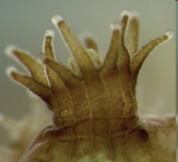
Concept 44.1 Interactions between Species May Be Positive, Negative, or Neutral
Unicellular algae found inside coral polyps, known as zooxanthellae, use sunlight to produce reduced carbon compounds via photosynthesis. The coral uses these compounds to fuel its metabolism and in turn supplies the zooxanthellae with carbon dioxide, nitrogen, and other nutrients. The coral also provides shelter and protection from predators. This relationship is an example of
a. mutualism.
b. parasitism.
c. predation.
d. commensalism.
e. amensalism.
Zooxanthellae within a polyp of Porites astreoides
Notes:
Answer: a
(The relationship is beneficial for both organisms, thus it is considered a mutualism.)
INSTRUCTOR NOTE:
Refer to Figure 44.1A of the textbook.
IMAGE CREDIT:
National Coral Reef Institute

Slide 23
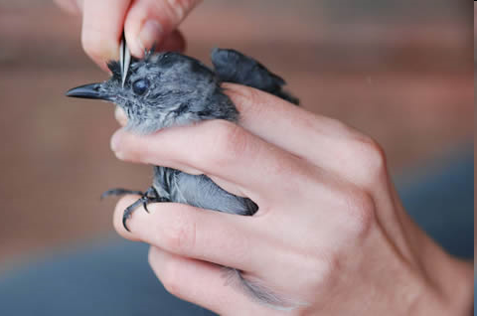
Concept 44.1 Interactions between Species May Be Positive, Negative, or Neutral
Ticks attach themselves to birds and suck their blood, which contains nutrients beneficial to the tick (food). The birds incur a metabolic cost when they expend energy to replace the lost blood. This relationship is an example of
a. mutualism.
b. predation.
c. commensalism.
d. parasitism.
e. amensalism.
Notes:
Answer: d
(Parasitism, because ticks benefit [+], while birds incur a cost [–]. The tick does not completely eat the host, which separates parasitism from predation.)
INSTRUCTOR NOTE:
Refer to Figure 44.1A of the textbook.
IMAGE CREDIT:
U.S. EPA

Slide 24
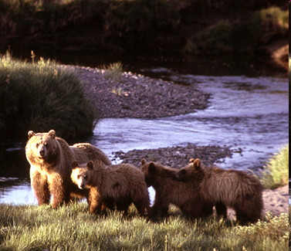
Concept 44.1 Interactions between Species May Be Positive, Negative, or Neutral
Grizzly bears catch and eat salmon that are swimming up a river. This relationship is an example of
a. commensalism.
b. mutualism.
c. predation.
d. amensalism.
e. parasitism.
Notes:
Answer: c
(Salmon are killed and consumed, benefitting the grizzlies [+] but not the salmon [–].)
INSTRUCTOR NOTE:
Refer to Figure 44.1A of the textbook.
IMAGE CREDIT:
U.S. National Park Service

Slide 25
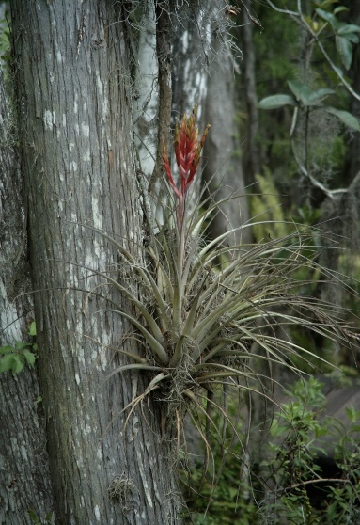
Concept 44.1 Interactions between Species May Be Positive, Negative, or Neutral
Bromeliads (a plant) grow on the branches of trees in tropical rainforest, gaining a place relatively high in the canopy where there is more sunlight. The tree neither benefits nor is harmed. This relationship described is an example of
a. commensalism.
b. mutualism.
c. predation.
d. amensalism.
e. parasitism.
Notes:
Answer: a
(Epiphytic plants grow on other plants but are not parasitic. These plants, such as bromeliads, gain ecological benefits from living on larger plants [+], gaining access to a substrate upon which to grow relatively high in the canopy. Host trees are not affected in any significant way by this relationship [0]. Some plants are specialized as epiphytes; for example, species of bromeliads and orchids.
INSTRUCTOR NOTE:
Refer to Figure 44.1A of the textbook.
IMAGE CREDIT:
U.S. Geological Survey

Slide 26
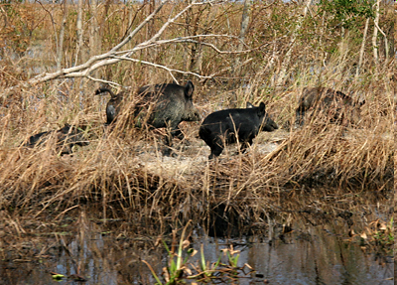
Concept 44.1 Interactions between Species May Be Positive, Negative, or Neutral
Wild pigs forage by rooting around in the top layer of soil. This activity disturbs and exposes burrowing organisms that the pigs don’t eat. The exposed soil organisms then become vulnerable to predation by other animals. This relationship described is an example of
a. commensalism.
b. mutualism.
c. predation.
d. amensalism.
e. parasitism.
Notes:
Answer: d
(This is amensalism because the burrowing organisms are harmed [–] while the feral pig is unaffected [0]. The pig does not benefit since it does not eat these particular organisms.)
INSTRUCTOR NOTE:
Refer to Figure 44.1A of the textbook.
IMAGE CREDIT:
U.S. Fish & Wildlife Service

Slide 27
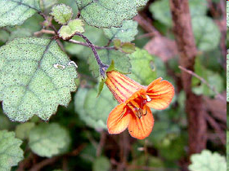
Concept 44.2 Interspecific Interactions Affect Population Dynamics and Species Distributions
One way that ecologists predict population growth rates is to examine the ratio of young to adults within a population. If birth rates are low, few young will survive to replace adults that die, and the population growth rate will be low or negative. Conversely, if birth rates and survival of young are high, the population growth rate will be positive.
The native New Zealand shrub Rhabdothamnus solandri is a long-lived plant whose large yellow and orange flowers are pollinated by native birds (the bellbird, stitchbird, and tui). Sandra Anderson and colleagues studied pollination, plant reproduction, and the ratio of young to adults on the North Island of New Zealand (“mainland” sites), where the birds are rare, and on nature reserves on small islands just off the mainland, where the birds are common.
Rhabdothamnus flower
Notes:
REFERENCE:
Anderson, Sandra H., Dave Kelly, Jenny J. Ladley, Sue Molloy, and Jon Terry. 2011. Cascading effects of bird functional extinction reduce pollination and plant density. Science 331 (6020): 1068–1071.
doi:10.1126/science.1199092
IMAGE SOURCE:
Photo by John Smith-Dodworth, courtesy of the NZ Plant Conservation Network

Slide 28
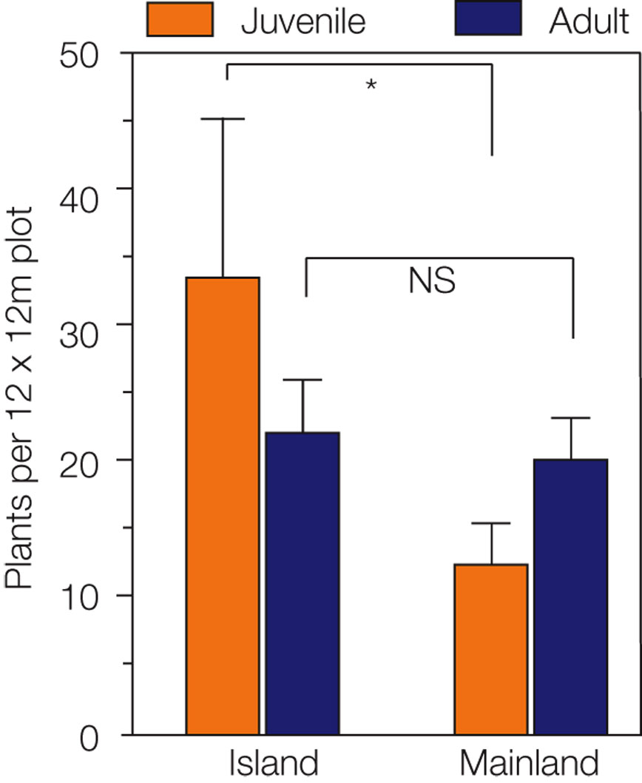
Concept 44.2 Interspecific Interactions Affect Population Dynamics and Species Distributions
The researchers counted adult plants and seedlings (offspring of the adult plants) in populations on the mainland and on the small islands just offshore. The results of the study are shown below.
Discuss the results shown, and make some predictions about likely population growth rates on the mainland versus the small offshore islands as a result of the availability of the bird pollinators for pollination.
Notes:
INSTRUCTOR NOTES:
On the islands (many pollinators) the plants produce enough seedlings to replace themselves, while on the mainland (few pollinators) they do not, so population sizes will decrease toward zero (local extinction).
This example illustrates Concept 44.2 of the textbook: If the plants and pollinators are interacting frequently, as on the islands, the populations of the plants are stable, whereas if the plants and pollinators are interacting infrequently, as on the mainland, the population dynamics for the plants are different—populations are declining toward extinction.
Additionally, the distribution of the plant species is affected—at some time in the future if this dynamic continues the plant will be extinct on the mainland but not on the islands.

Slide 29
Concept 44.2 Interspecific Interactions Affect Population Dynamics and Species Distributions
Which of the following is a logical prediction about population growth rates on the mainland versus the small offshore islands as a result of the availability of the bird pollinators for pollination?
a. On the mainland (few pollinators), birth rate is low and population size will likely decrease.
b. On the islands (many pollinators), birth rate is high and population size will likely remain stable or increase.
c. On the mainland, over time this population may become locally extinct.
d. All of the above
e. None of the above
Notes:
Answer: d

Slide 30
Concept 44.2 Interspecific Interactions Affect Population Dynamics and Species Distributions
Interspecific interactions also modify per capita growth rates:
Interspecific competition—effect of the other species would be subtracted in the growth model.
Consumer–resource interactions—effect of the consumer is subtracted in the equation for the resource species; the effect of the resource is added in the equation for the consumer, since the consumer benefits.

Slide 31
Concept 44.2 Interspecific Interactions Affect Population Dynamics and Species Distributions
Interspecific interactions also modify per capita growth rates:
Interspecific competition—effect of the other species would be subtracted in the growth model.
Consumer–resource interactions—effect of the consumer is subtracted in the equation for the resource species; the effect of the resource is added in the equation for the consumer, since the consumer benefits.

Slide 32
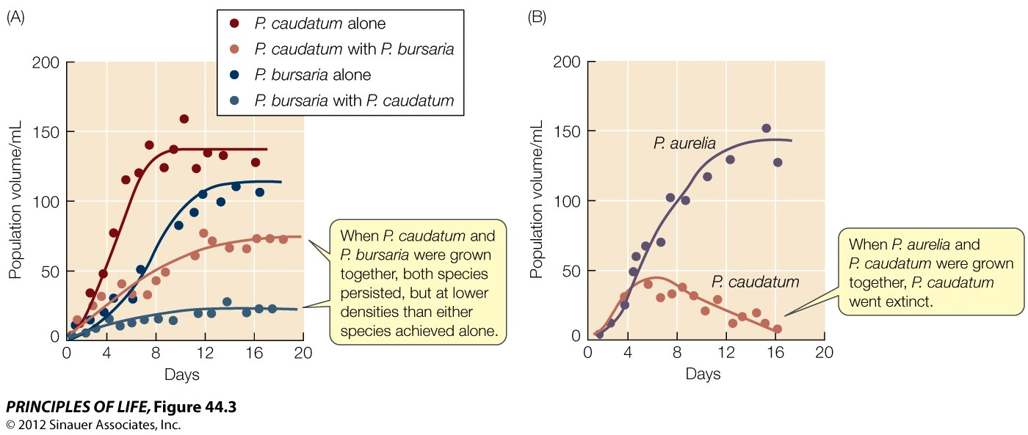
Figure 44.3 Interspecific Competition Affects Population Growth

Slide 33
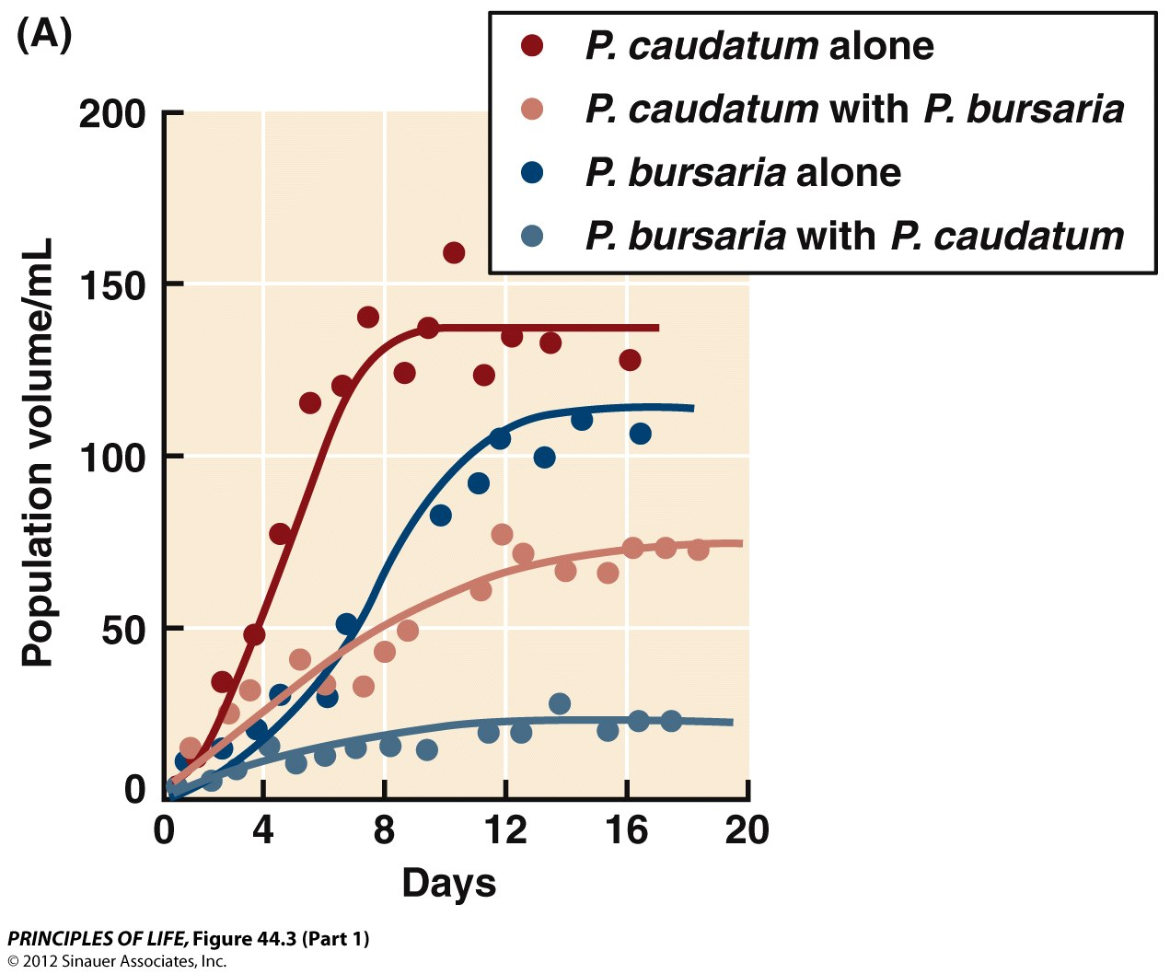
Figure 44.3 Interspecific Competition Affects Population Growth (Part 1)

Slide 34
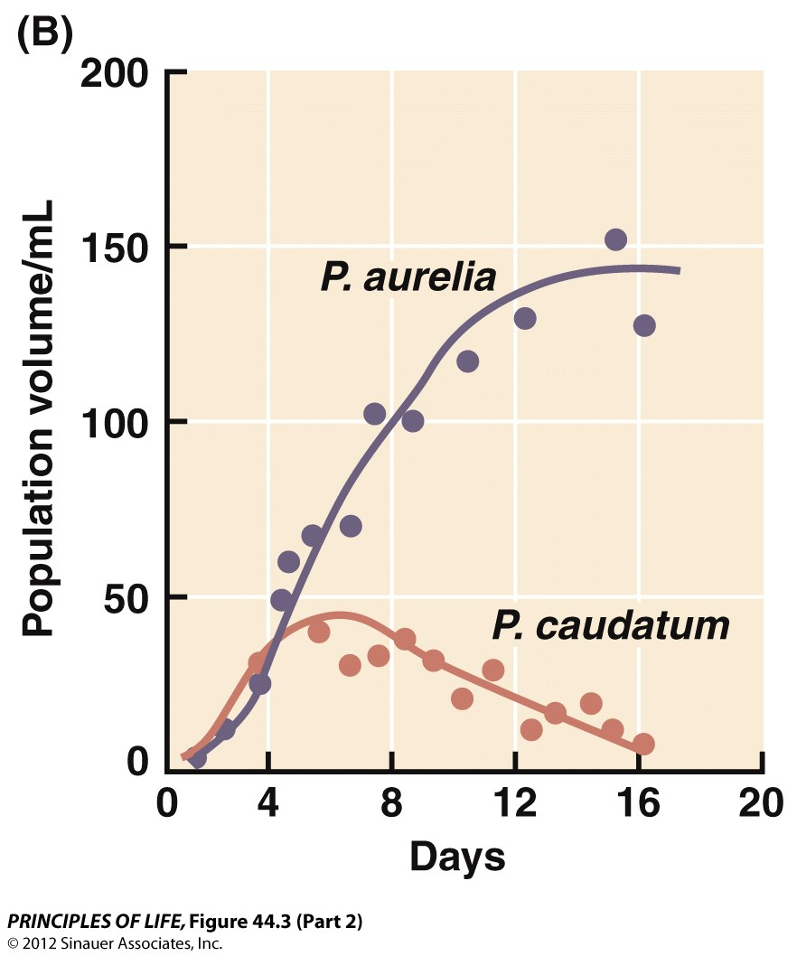
Figure 44.3 Interspecific Competition Affects Population Growth (Part 2)

Slide 35
Interspecific growth rates can modify per capita growth rates
But only have a major effect if greater than intraspecific competition
Per capita growth rate (r) of species A = [maximum possible r for species A in uncrowded conditions minus an amount that is a function of A’s own population density] – [an amount that is a function of the population density of competing species B]
Alpha₁₂ = competition coefficient
When a₁₂ is < 1 the effect of species 2 on species 1 is less than the effect of species 1 on its own members
When a₁₂is > 1 the effect of species 2 on species 1 is greater than the effect of species 1 on its own members

Slide 36
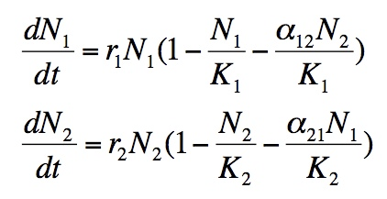
Lotka-Volterra equation

Slide 37
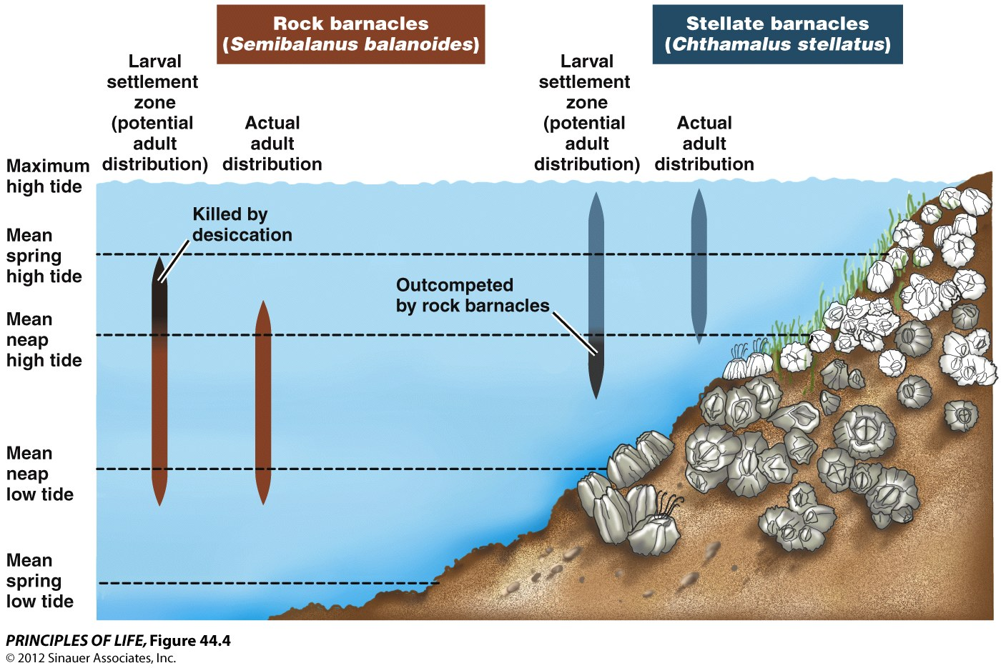
Figure 44.4 Interspecific Competition Can Restrict Distributions

Slide 38
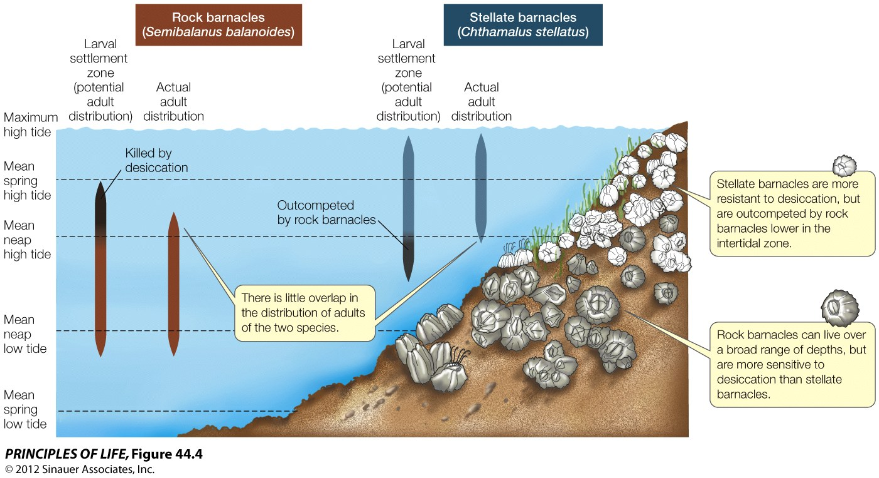
Figure 44.4 Interspecific Competition Can Restrict Distributions

Slide 39
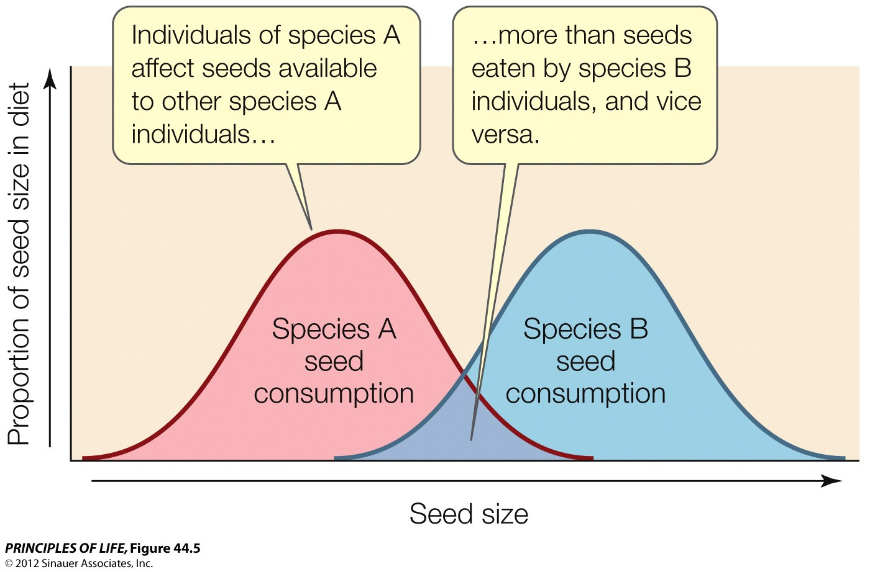
Figure 44.5 Resource Partitioning Can Result in Intraspecific Competition Being Greater than Interspecific Competition

Slide 40
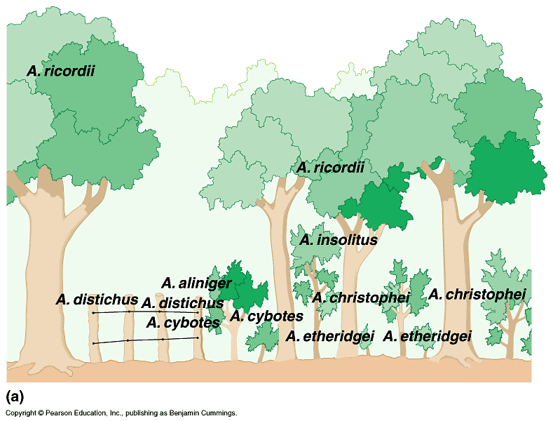
Figure 53.3a Resource partitioning in a group of lizards

Slide 41
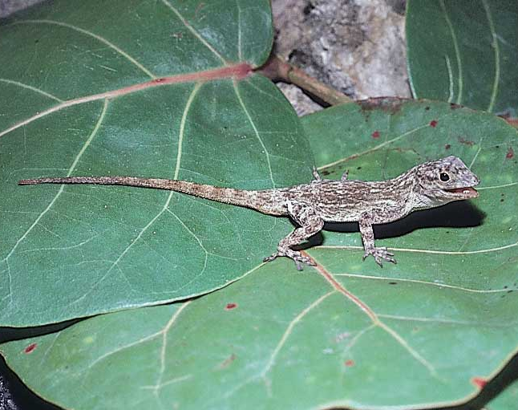
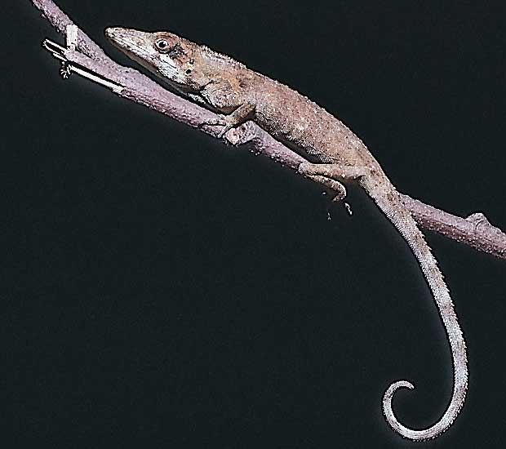
Figure 53.3bc Anolis distichus (left) and Anolis insolitus (right)

Slide 42
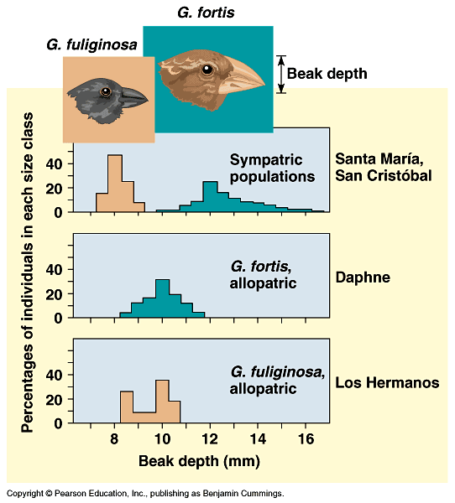
Figure 53.4 Character displacement: circumstantial evidence for competition in nature

Slide 43
Concept 44.2 Interspecific Interactions Affect Population Dynamics and Species Distributions
One way that ecologists predict population growth rates is to examine the ratio of young to adults within a population. If birth rates are low, few young will survive to replace adults that die, and the population growth rate will be low or negative. Conversely, if birth rates and survival of young are high, the population growth rate will be positive.
The native New Zealand shrub Rhabdothamnus solandri is a long-lived plant whose large yellow and orange flowers are pollinated by native birds (the bellbird, stitchbird, and tui). Sandra Anderson and colleagues studied pollination, plant reproduction, and the ratio of young to adults on the North Island of New Zealand (“mainland” sites), where the birds are rare, and on nature reserves on small islands just off the mainland, where the birds are common.
Rhabdothamnus flower
Notes:
REFERENCE:
Anderson, Sandra H., Dave Kelly, Jenny J. Ladley, Sue Molloy, and Jon Terry. 2011. Cascading effects of bird functional extinction reduce pollination and plant density. Science 331 (6020): 1068–1071.
doi:10.1126/science.1199092
IMAGE SOURCE:
Photo by John Smith-Dodworth, courtesy of the NZ Plant Conservation Network

Slide 44
Concept 44.2 Interspecific Interactions Affect Population Dynamics and Species Distributions
The researchers counted adult plants and seedlings (offspring of the adult plants) in populations on the mainland and on the small islands just offshore. The results of the study are shown below.
Discuss the results shown, and make some predictions about likely population growth rates on the mainland versus the small offshore islands as a result of the availability of the bird pollinators for pollination.
Notes:
INSTRUCTOR NOTES:
On the islands (many pollinators) the plants produce enough seedlings to replace themselves, while on the mainland (few pollinators) they do not, so population sizes will decrease toward zero (local extinction).
This example illustrates Concept 44.2 of the textbook: If the plants and pollinators are interacting frequently, as on the islands, the populations of the plants are stable, whereas if the plants and pollinators are interacting infrequently, as on the mainland, the population dynamics for the plants are different—populations are declining toward extinction.
Additionally, the distribution of the plant species is affected—at some time in the future if this dynamic continues the plant will be extinct on the mainland but not on the islands.

Slide 45
Concept 44.2 Interspecific Interactions Affect Population Dynamics and Species Distributions
Which of the following is a logical prediction about population growth rates on the mainland versus the small offshore islands as a result of the availability of the bird pollinators for pollination?
a. On the mainland (few pollinators), birth rate is low and population size will likely decrease.
b. On the islands (many pollinators), birth rate is high and population size will likely remain stable or increase.
c. On the mainland, over time this population may become locally extinct.
d. All of the above
e. None of the above
Notes:
Answer: d

Slide 46
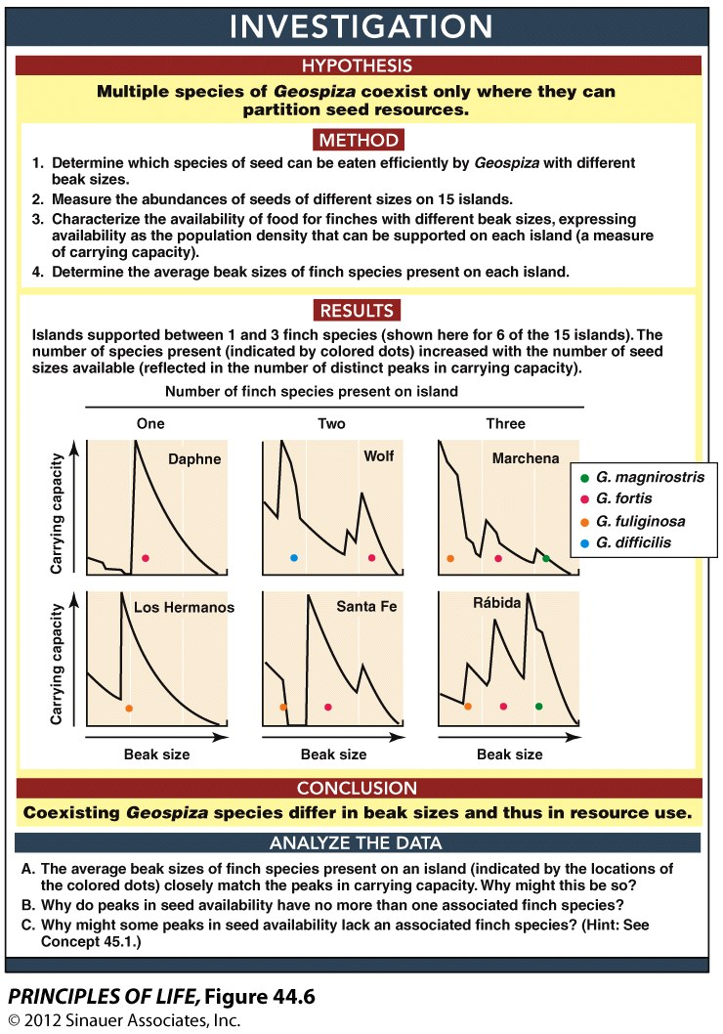
Figure 44.6 Resource Paritioning Allows Competitors to Coexist

Slide 47
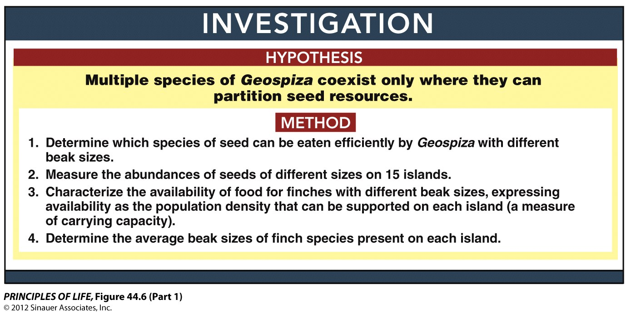
Figure 44.6 Resource Paritioning Allows Competitors to Coexist (Part 1)

Slide 48
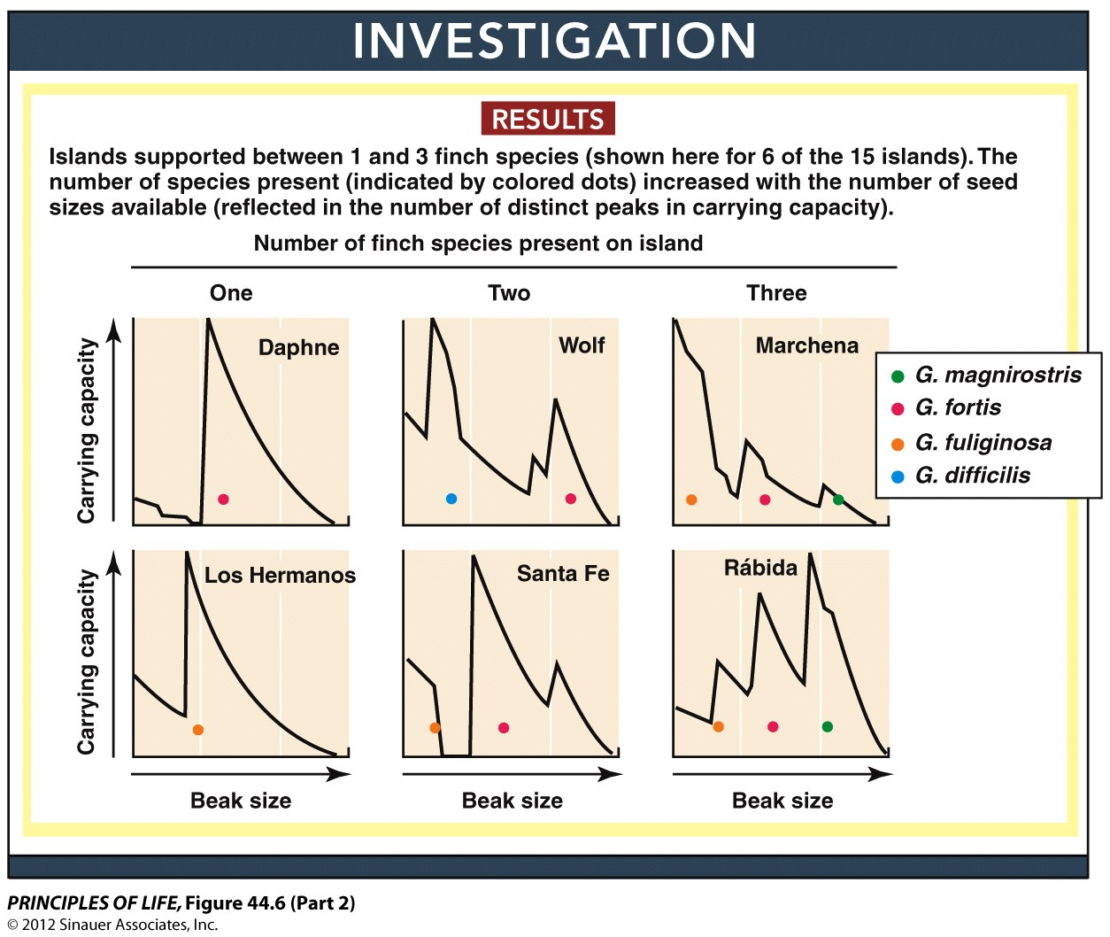
Figure 44.6 Resource Paritioning Allows Competitors to Coexist (Part 2)

Slide 49
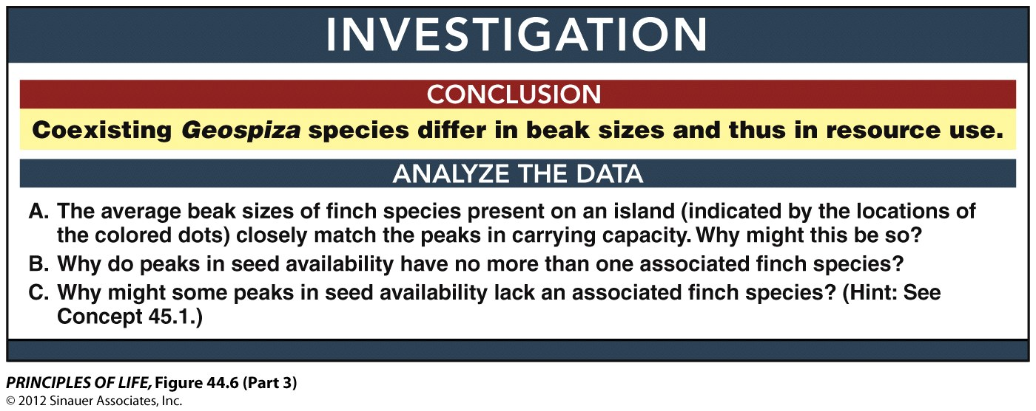
Figure 44.6 Resource Paritioning Allows Competitors to Coexist (Part 3)

Slide 50
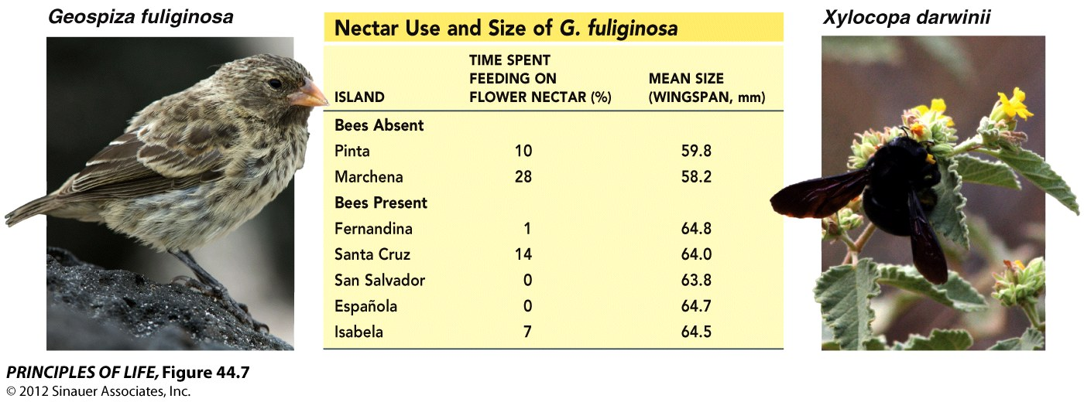
Figure 44.7 Finch Morphology Evolves in Response to Competition with Carpenter Bees

Slide 51
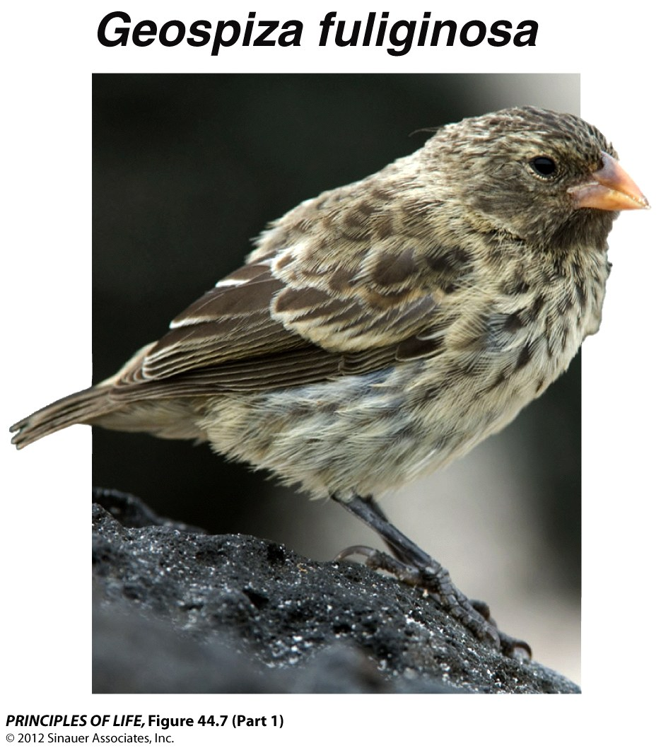
Figure 44.7 Finch Morphology Evolves in Response to Competition with Carpenter Bees (Part 1)

Slide 52
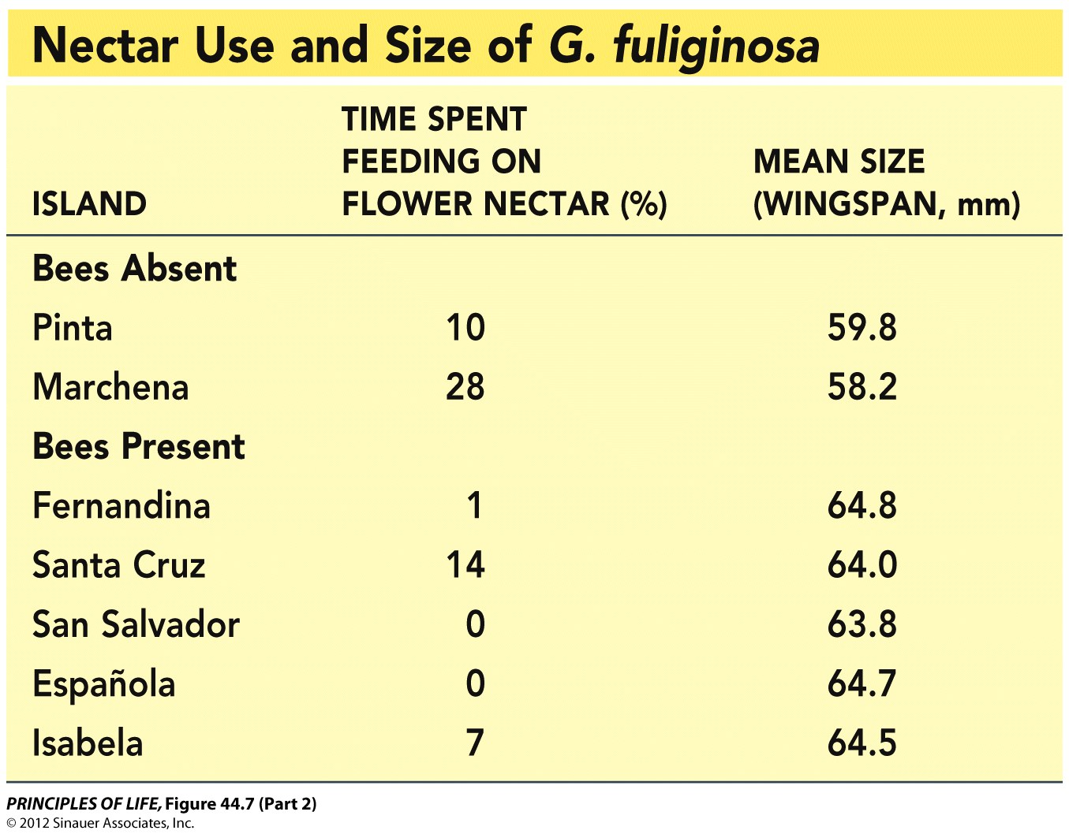
Figure 44.7 Finch Morphology Evolves in Response to Competition with Carpenter Bees (Part 2)

Slide 53
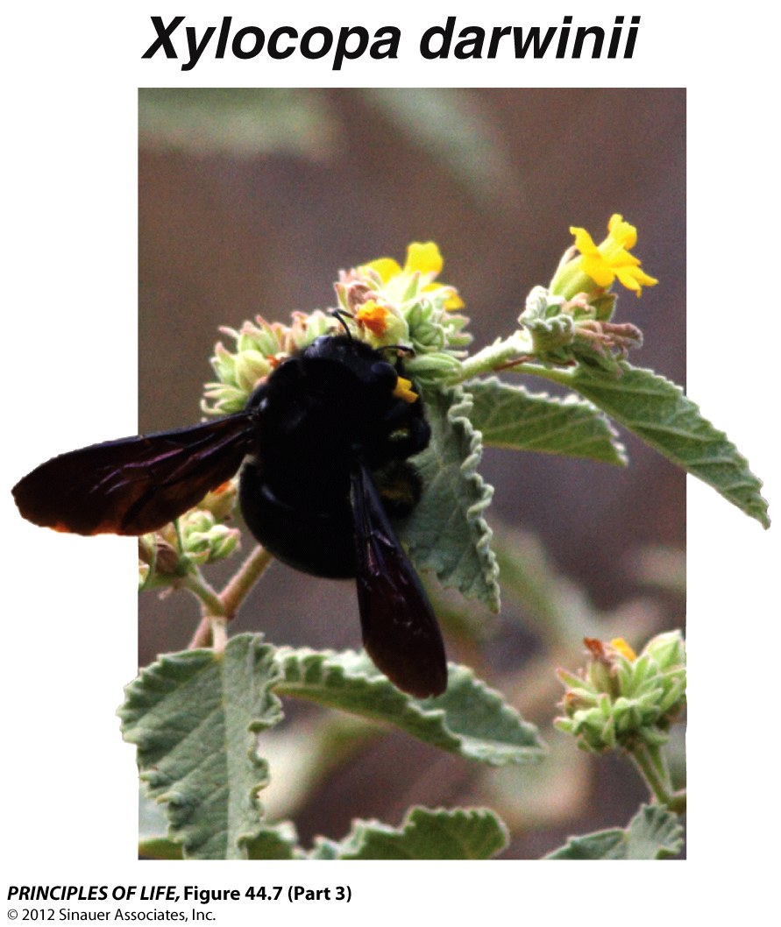
Figure 44.7 Finch Morphology Evolves in Response to Competition with Carpenter Bees (Part 3)

Slide 54
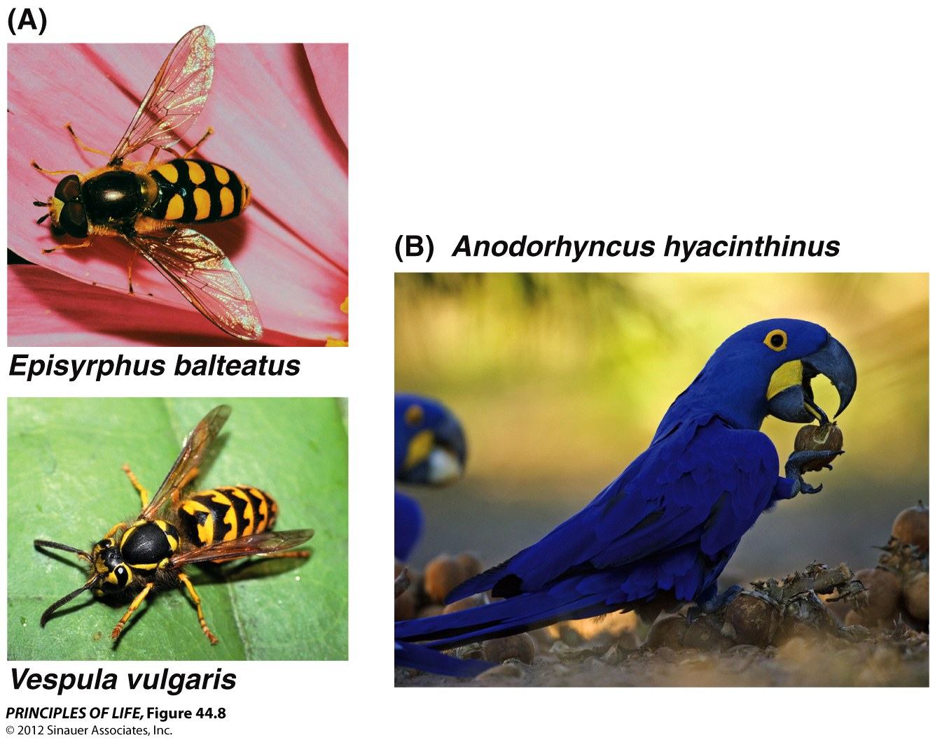
Figure 44.8 Defense Mechanisms and “Arms Races”

Slide 55
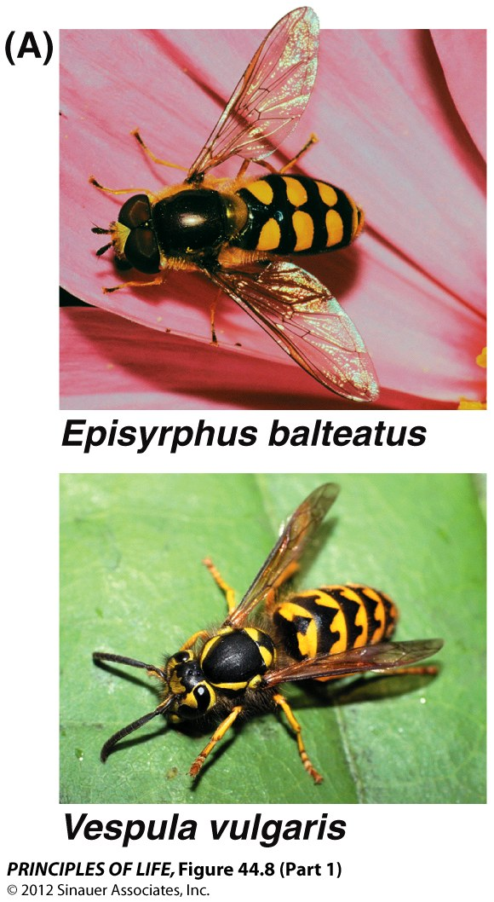
Figure 44.8 Defense Mechanisms and “Arms Races” (Part 1)

Slide 56
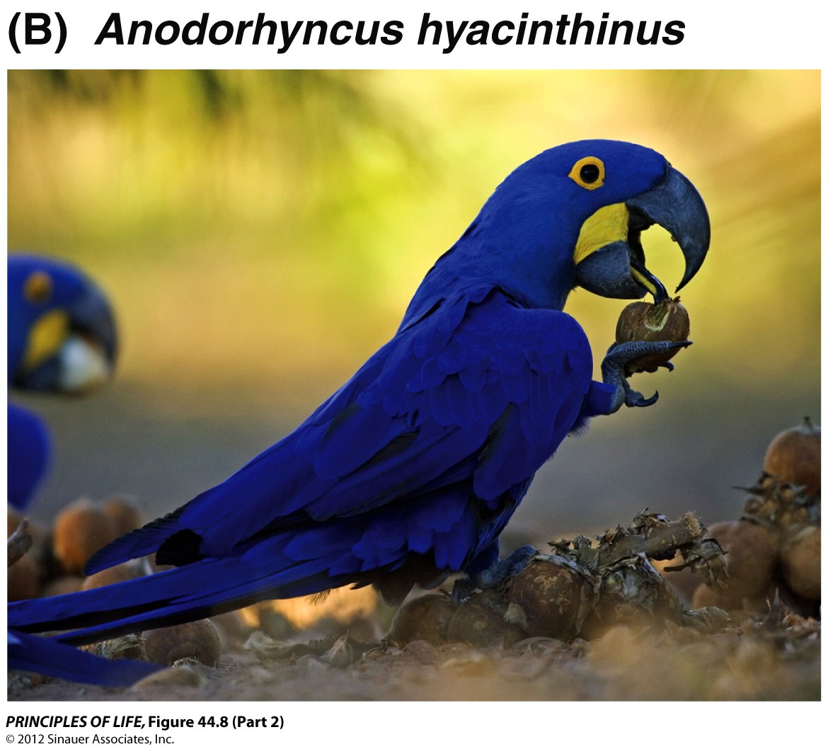
Figure 44.8 Defense Mechanisms and “Arms Races” (Part 2)

Slide 57
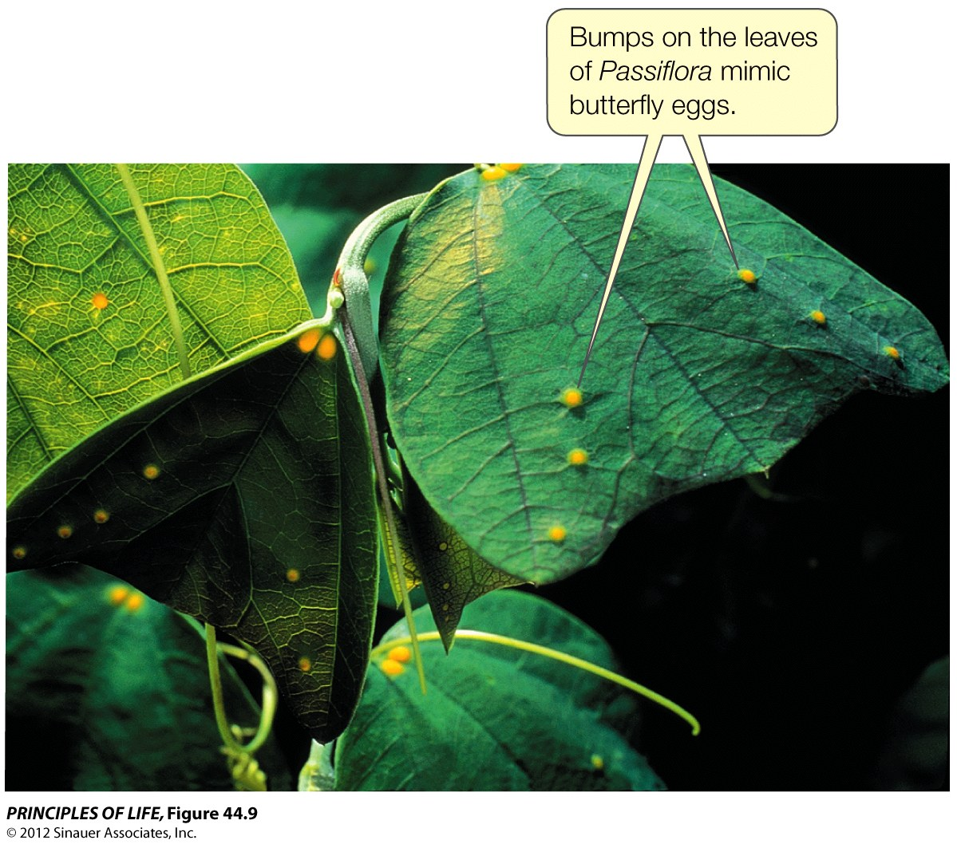
Figure 44.9 Using Mimicry to Avoid Being Eaten

Slide 58
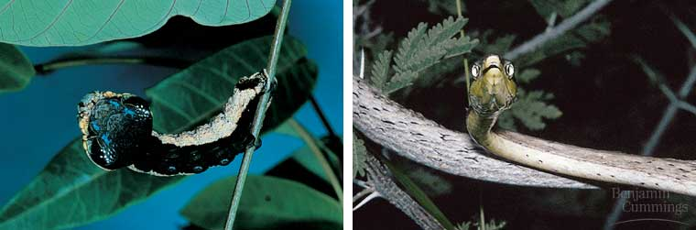
Figure 53.7 Batesian mimicry

Slide 59
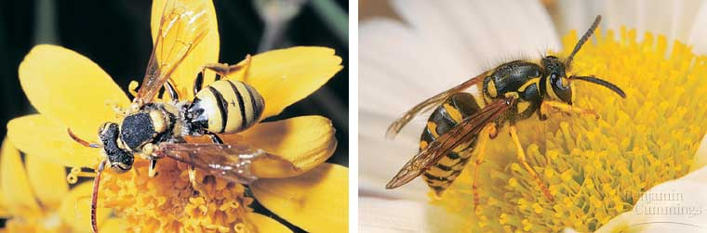
Figure 53.8 Müllerian mimicry: Cuckoo bee (left), yellow jacket (right)

Slide 60
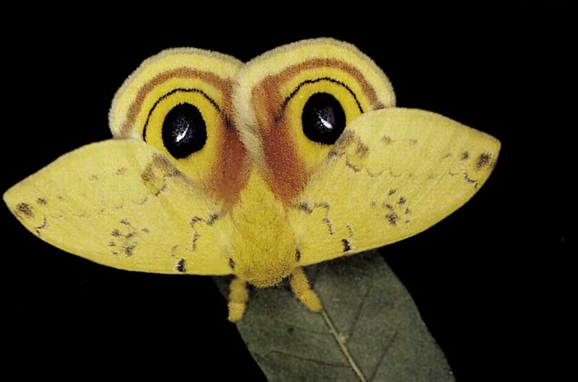
Figure 53.x1 Deceptive coloration: moth with "eyeballs"

Slide 61
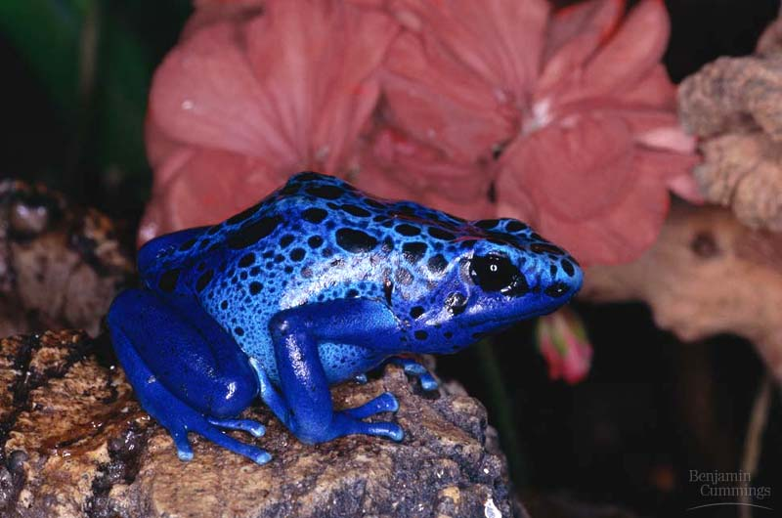
Figure 53.6 Aposematic (warning) coloration in a poisonous blue frog

Slide 62
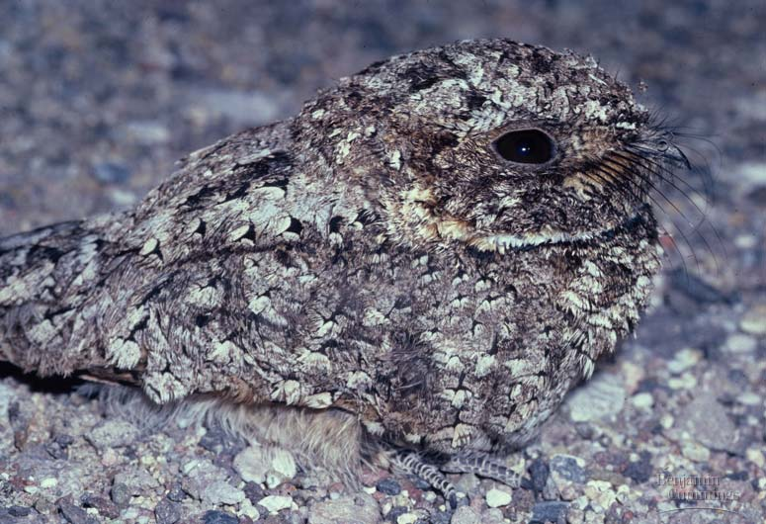
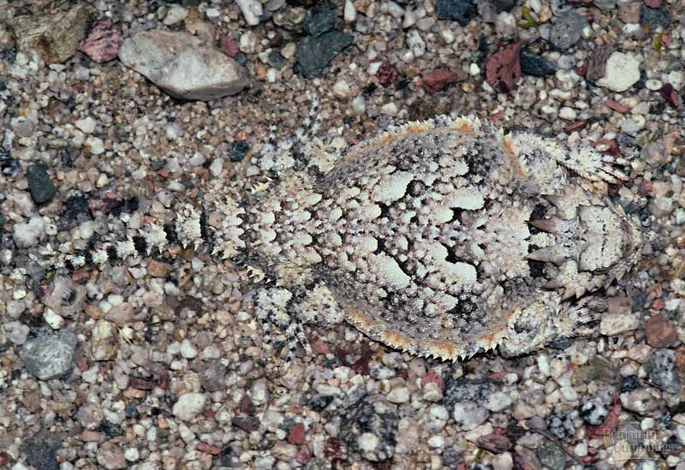
Figure 53.5 Camouflage: Poor-will (left), lizard (right)

Slide 63
Apply the concept p.868
Interactions affect individual fitness and can result in evolution
Crabs feed on mussels, and individual mussels can respond to the presence of crabs in their environment by thickening their shells if they can perceive the threat. On the east coast of North America, blue mussels (Mytilus edulis) face two non-native predators. The European green crab (Carcinus maenas) was introduced to the US almost 200 years ago and the Asian shore crab ( Hemigrapsus sanguineus) arrived only 20 years ago. C. maenas has spread all along the Atlantic coast whereas H. sanguineus has not yet reached northern Maine. Have mussels evolved the ability to detect this new enemy and respond to it?
Researchers collected very young M. edulis from northern populations that have experienced C. maenas but not H. sanguineus and from southern populations that have experienced both predator species. They grew mussels from each population on floating docks under three different conditions: no crab nearby (controls); a hungry C. maenas caged nearby; and a hungry H. sanguineus caged nearby. After 3 months researchers measured mussel shell thickens.

Slide 64
Use the graph to answer the following questions. Error bars indicate 95% confidence intervals; bars with different letters are statistically different from one another (P<0.05)
Have mussel populations exposed to predation by non-native crabs evolved the ability to detect and respond to them by thickening their shells?
Which comparison is critical to your conclusion?
Do mussels in southern populations have thinner shells than in northern populations? Would a difference in average shell thickness between the two populations invalidate your conclusion?
What do these data suggest about how quickly evolution can take place?

Slide 65
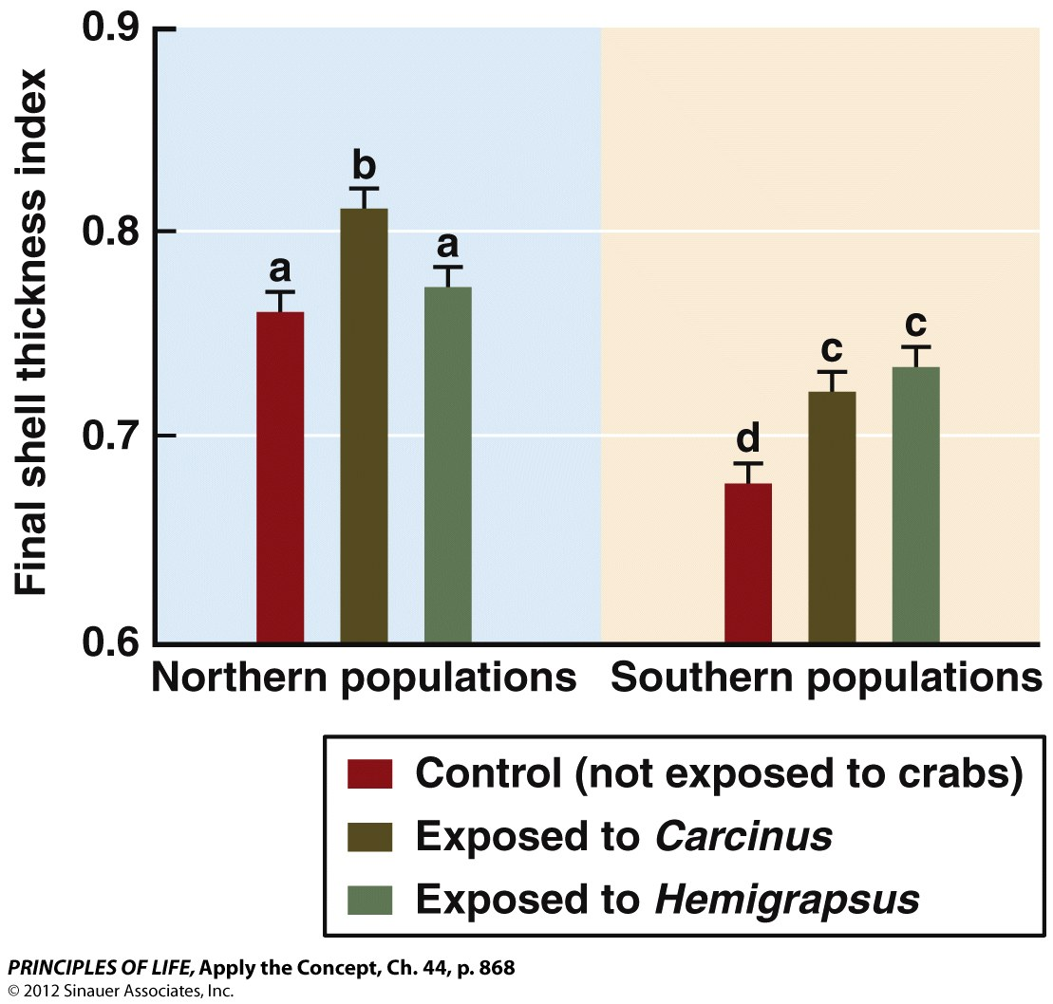
Apply the Concept, Ch. 44, p. 868

Slide 66

Apply the Concept, Ch. 44, p. 868

Slide 67

Figure 44.10 An Invasive Species

Slide 68
Concept 44.3 Interactions Affect Individual Fitness and Can Result in Evolution
Antibiotics, also known as antimicrobials, are drugs used for treating infections caused by bacteria and have saved countless lives. Antibiotics are produced naturally by many organisms.
Antibiotic resistance in bacteria is a growing global concern because when a person or animal is infected with an antibiotic-resistant bacterium, standard antibiotic treatment therapies are less effective or may not work at all. It is estimated that more Americans die each year from drug-resistant Staphylococcus aureus infections than die from HIV/AIDS.
Antibiotics work by killing the bacteria that an organism is infected with. Bacteria can reproduce asexually, so if for example a dose of antibiotics kills 99% of the bacteria causing the infection, the remaining 1% can still reproduce. That 1% remaining are said to be “antibiotic resistant.” The offspring of these antibiotic resistant bacteria will also have antibiotic resistant genotypes.
Notes:
SOURCES:
http://www.scientificamerican.com/article.cfm?id=bacteria-antibiotic-resistance
http://www.fda.gov/newsevents/publichealthfocus/default.htm

Slide 69

Concept 44.3 Interactions Affect Individual Fitness and Can Result in Evolution
Which of the following statements correctly describe the phenomenon of antibiotic resistance?
a. Resistant bacteria have a higher fitness in the presence of the antibiotic than the bacteria that are killed by the drug.
b. Antibiotic resistance is an example of differences in individual fitness leading to evolution.
c. Widespread use of manufactured antibiotics is inadvertently resulting in selection for resistant bacteria, making the drugs less and less effective over time. Overuse of antibiotics is likely to accelerate the spread of drug-resistant bacteria.
d. This is an example of an evolutionary arms race between humans (drug producers) and microorganisms.
e. All of the above
Notes:
Answer: e

Slide 70
Concept 44.4 Introduced Species Alter Interspecific Interactions
Let’s return to the native New Zealand shrub Rhabdothamnus solandri. Recall that its flowers are pollinated by native birds that are common on island nature reserves but not on the mainland. Why? New Zealand has no native terrestrial mammals. Around 1870, ship rats and other mammals were introduced to New Zealand, where they rapidly decimated populations of native birds by eating their eggs. But the rats and other introduced mammal populations have never reached the offshore islands.
Sandra Anderson and her colleagues explored how this alters plant–pollinator interactions. They conducted an experiment to compare the pollination success of plants in mainland versus island populations of R. solandri. They covered some R. solandri flowers with bags to see if they would self-pollinate when pollinators could not reach them. Other flowers were left alone and received natural pollination by birds (controls). Pollen was added by hand to a third set of flowers that also received natural pollination. Researchers then looked at the percentage of flowers of each type that produced a fruit (“% fruit set”), a sign indicating successful pollination and fertilization.
Notes:
REFERENCE:
Anderson, Sandra H., Dave Kelly, Jenny J. Ladley, Sue Molloy, and Jon Terry. 2011. Cascading effects of bird functional extinction reduce pollination and plant density. Science 331 (6020): 1068–1071.
doi:10.1126/science.1199092

Slide 71

Concept 44.4 Introduced Species Alter Interspecific Interactions
For class discussion: What do these comparisons suggest regarding pollination success?
Notes:
INSTRUCTOR NOTE:
Fruit set was reduced because of inadequate bird visitation to pollinate the flowers.
71

Slide 72
Concept 44.4 Introduced Species Alter Interspecific Interactions
What might we conclude from this study of pollination success and what we know of the natural history of this system?
a. Fruit set was reduced on the mainland because of inadequate bird visitation to pollinate the flowers.
b. Hand pollination is not effective at increasing pollination success.
c. Without intensive hand pollination, conservation of R. solandri requires conservation of their mutualistic pollinators, the native bird species.
d. Introduced mammals have disrupted the mutualism between New Zealand’s native birds and R. solandri.
e. a, c, and d
Notes:
Answer: e
INSTRUCTOR NOTES:
Optional extension question: Ask students if it looks like there might be evidence for selection occurring here. Direct their attention toward the bag treatments on the island versus the mainland. The increased success of the bag treatment (self-pollination) on the mainland (looking at the graph it looks like the mainland self-pollination fruit set is about 2 times that on the island) suggests that perhaps there is selection for self-pollination occurring on the mainland. This is purely speculation though, as this particular result does not appear to be discussed in the original paper.
Note: It is important to point out that there is no statistical comparison of bagged fruit set on islands versus mainland—or of hand-pollination fruit set for that matter.
72

