Slide 1
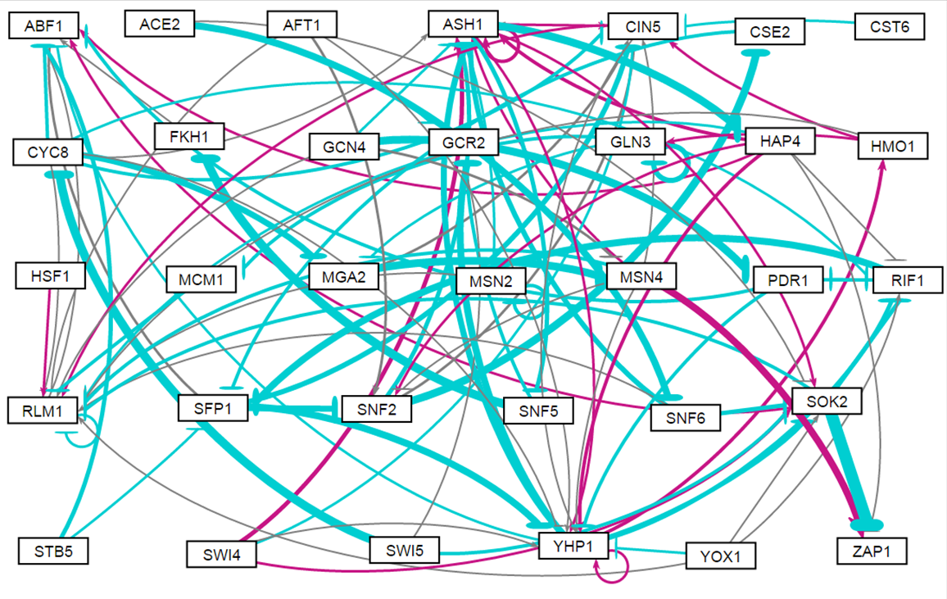
33 Genes, 98 edges

Slide 2
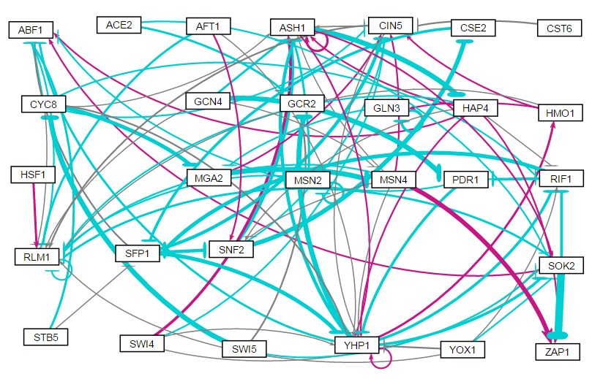
29 Genes, 88 Edges

Slide 3
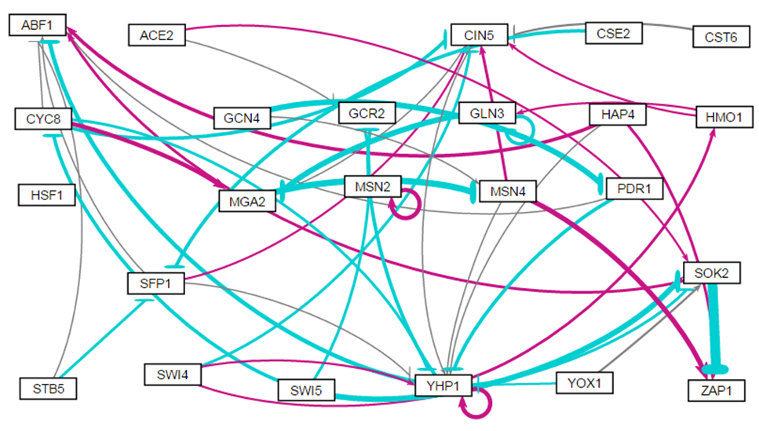
23 genes, 46 Edges

Slide 4
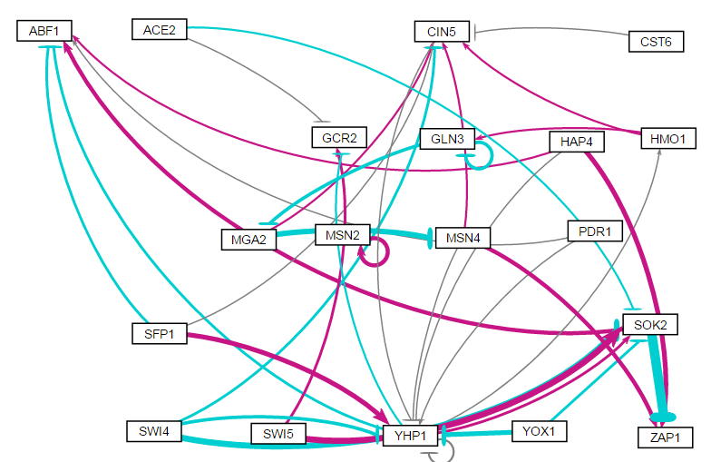
19 Genes, 36 Edges

Slide 5
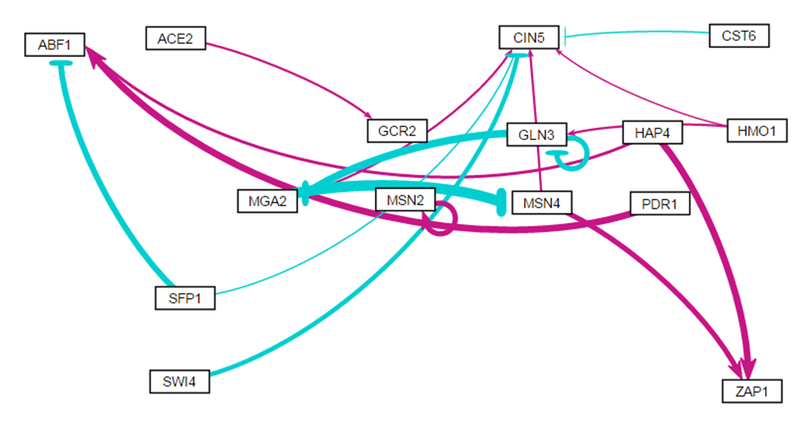
15 Genes, 27 Edges

