Slide 1
Encapsulation for Drug Delivery
31st July
iGEM Team 2009
Charles
Dave
Dineka
James
Kun
Nuri
Royah
Tianyi

Slide 2
The Project
“Auto-encapsulation of protein drugs for release in the small intestine.”
Problem
Overview
Module 1
Module 2
Module 3
Module 4 & 5
Mod. & Test.
Summary

Slide 3
Overview of Modules
START
Module 1:
Compound Production
Grow cells
Check
Module 2:
Encapsulation
M1: Compound Production
Check
Module 3:
Genomic Neutralisation
M2: Encapsulation
M3: Killing
Problem
Overview
Module 1
Module 2
Module 3
Module 4 & 5
Mod. & Test.
Summary

Slide 4
Gantt Chart
ACTIVITIES | Week 4 | Week 5 | Week 6 | Week 7 | Week 8 | Week 9 | Week 10
MIT Project description
Assay Protocols
Cloning strategy
Genetic Circuits
Biobricks
Genes to PCR
Wet lab plan
Gantt Chart
Dry lab plan
Order genes
Order Biobricks
Start Wet Lab
Timer
M1+Timer integration
M2
M3
Start Dry Lab
Genes delivered
Biobricks delivered
 | Complete
 | In progress
 | To do
 | Unknown
Problem
Overview
Module 1
Module 2
Module 3
Module 4 & 5
Mod. & Test.
Summary

Slide 5
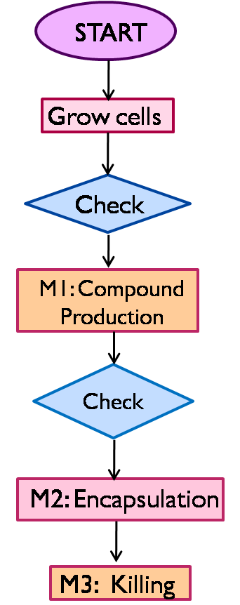
Module 1: Compound Production

Slide 6
M1 Progress Report
P(arabinose)
Protein of Interest
Arabinose inducible.
Cellulase BioBricked.
PAH BioBricked.
Cloning strategy formulated.
Problem
Overview
Module 1
Module 2
Module 3
Module 4 & 5
Mod. & Test.
Summary

Slide 7
Module 2: Encapsulation

Slide 8
M2 Progress Report
P(TetR)
P(TetR)
RcsB
B3023
Waal Ligase
OtsA
OtsB
TetR Repressible.
5 genes BioBricked.
Cloning strategy formulated.
Problem
Overview
Module 1
Module 2
Module 3
Module 4 & 5
Mod. & Test.
Summary

Slide 9
Module Integration
IPTG
P(arabinose)
P(LacI)
Protein of Interest
LacI
TetR
P(TetR)
P(TetR)
RcsB
B3023
Waal Ligase
OtsA
OtsB
Series of inverters
Tuneable timer – 3 potential inputs
Problem
Overview
Module 1
Module 2
Module 3
Module 4 & 5
Mod. & Test.
Summary

Slide 10
Module Integration
aTc
Testing
Problem
Overview
Module 1
Module 2
Module 3
Module 4 & 5
Mod. & Test.
Summary

Slide 11
Module 3: Genomic Neutralisation

Slide 12
Overall Specifications
Module 3
High killing rate
Failsafe mechanism
Neutralise genomic material
Limit protease degradation of our product
Non-toxic
Fast
Problem
Overview
Module 1
Module 2
Module 3
Module 4 & 5
Mod. & Test.
Summary

Slide 13
The system
Use restriction enzymes (REs) and constitutive methylation of DNA.
Encapsulation limits the induction mechanisms – chemical inducers will not be effective – place under control of a thermo-inducible system
Raise temperature to ~42°C to induce ‘killing’.
We would have to culture our cells at ~28°C.
Problem
Overview
Module 1
Module 2
Module 3
Module 4 & 5
Mod. & Test.
Summary

Slide 14
The system
BBa_K098995 [Harvard ‘08]
J23114
λcI
RBS
Cl T°sensitive
DpnI
TaqI
T
T
RBS
RBS
Strong, constitutive
No BB
J23103
Weak, constitutive
RBS
Dam
No BB
Problem
Overview
Module 1
Module 2
Module 3
Module 4 & 5
Mod. & Test.
Summary

Slide 15
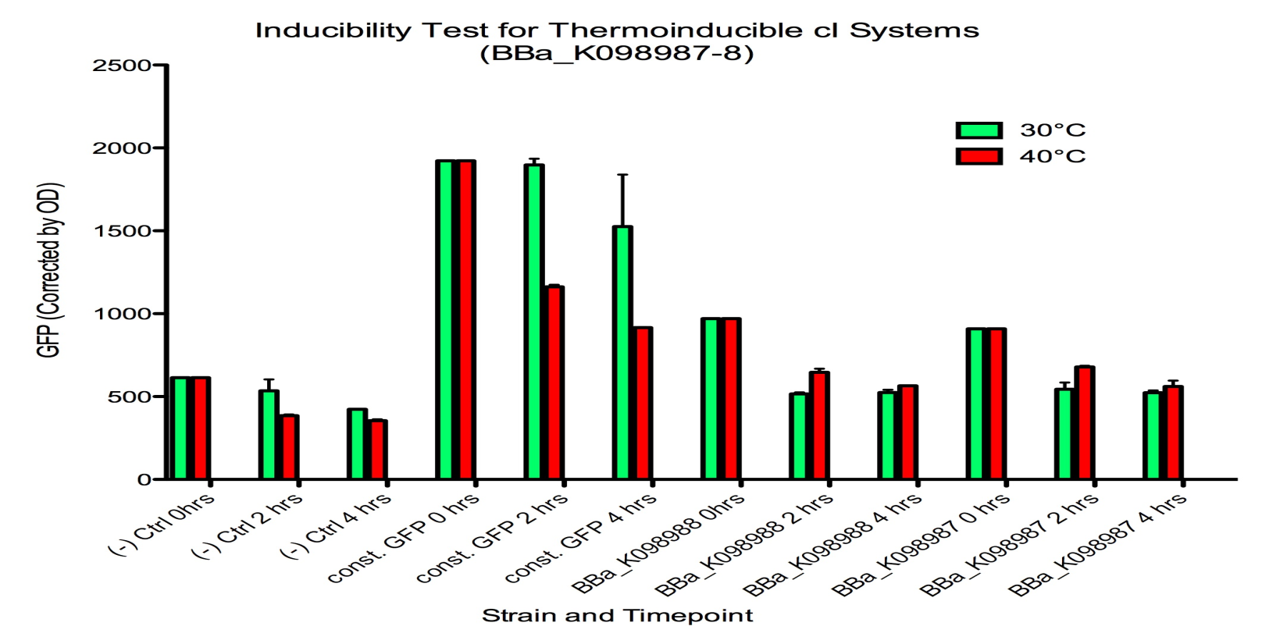
Problem
Harvard’s BioBrick is leaky – this is not an option for us; we don’t want to kill our cells early.
Problem
Overview
Module 1
Module 2
Module 3
Module 4 & 5
Mod. & Test.
Summary

Slide 16
Potential Solutions
1) Use native λ pL or pR promoters – obtain sequences for these and make our own.
Altered temperature induction sensitivity of the lambda p_{R}/cI857 system for controlled gene E expression in Escherichia coli
Wolfgang Jechlinger*, Michael P. Szostak¹, Angela Witte and Werner Lubitz
At 36°C bacteria grow normally, no lysis detected; at 42°C lysis occurs after 15 min.
2) Use a commercial system – these are available and reliable.
Plasmid | Composition | Selection Marker
pAWJ | cI857–λ pRmut(41C)–E | Tet
Problem
Overview
Module 1
Module 2
Module 3
Module 4 & 5
Mod. & Test.
Summary

Slide 17
Genetic Circuit
IPTG
P(arabinose)
P(LacI)
M1
Protein of Interest
LacI
TetR
M2
P(TetR)
P(TetR)
RcsB
B3023
Waal Ligase
OtsA
OtsB
Const - Strong
P(CI)
Const - Weak
M3
CI
DpnI
TaqI
DpnI
Temperature

Slide 18
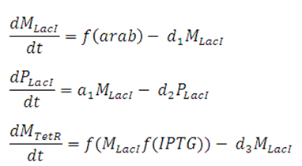
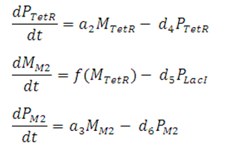
Timer Model
IPTG
P(arabinose)
P(LacI)
Protein of Interest
LacI
TetR

Slide 19
Switch

Slide 20
Delay Mechanism

Slide 21
Biobricks
Module | Biobrick | Available? | Size (bp) | Schematic
1 (1.1) | N/A | Clones | 1500
1 (1.2) | N/A | Clones | 2550
2 (2.1) | N/A | PCR/ Synthesise | 792
2 (2.2) | N/A | PCR/ Synthesise | 624
2 (2.3) | N/A | PCR | 1401
2 (2.4) | N/A | PCR | 1566
2 (2.5) | N/A | PCR/ Synthesise | 753
Problem
Overview
Module 1
Module 2
Module 3
Module 4 & 5
Mod. & Test.
Summary

Slide 22
Biobricks
Module | Biobrick | Available? | Size (bp) | Schematic
Timer (T.1) | BBa_Q04121 | A W (09 – KP1) | 1370
Timer (T.2) | BBa_Q04400 | A W (09 – KP1) | 902
3 (3.1) | BBa_K098995 | A W (09 – KP1) | 935
3 | Synthesise |  | 1566
3 | PCR/ Synthesise |  | 844
Problem
Overview
Module 2
Module 1
Module 2
Module 3
Module 4 & 5
Mod. & Test.
Summary

Slide 23
Wet Lab Plan

Slide 24
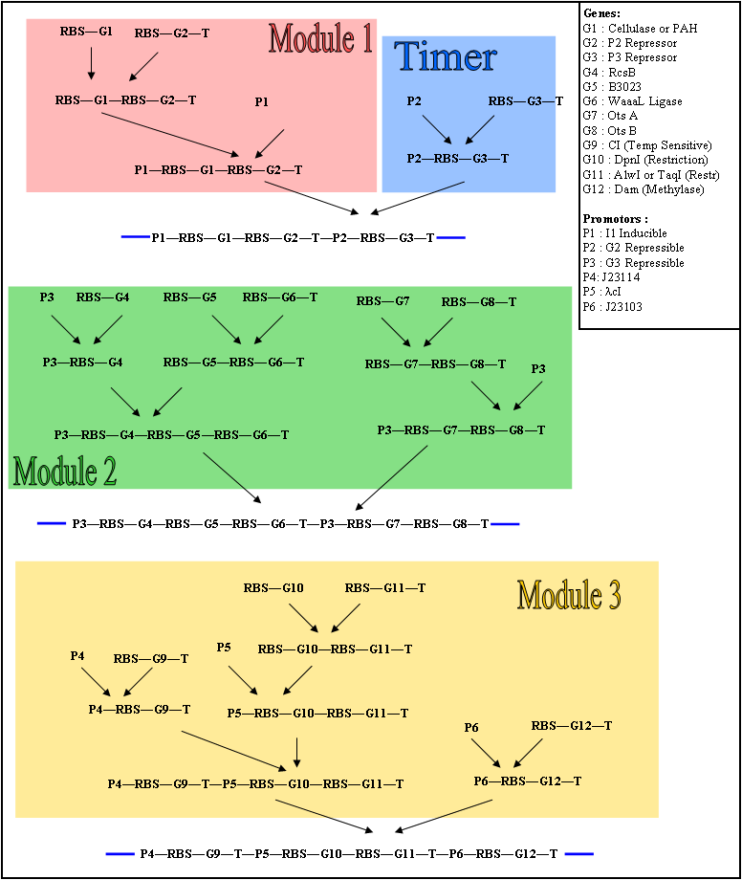
Cloning Strategy
Problem
Overview
Module 1
Module 2
Module 3
Module 4 & 5
Mod. & Test.
Summary

Slide 25
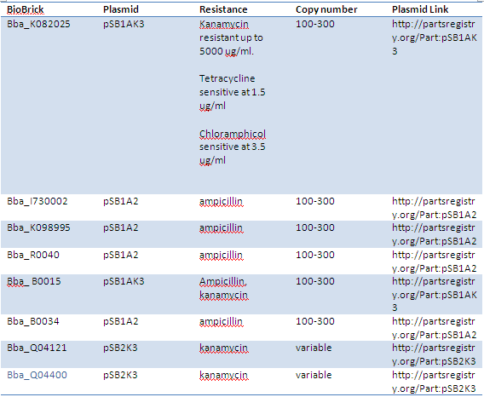
BioBricks and Plasmids

Slide 26
Testing

Slide 27
Testing Strategy
We aim to:
Characterise promoters.
Test individual genes for functionality.
Test constructs (operon).
Test integrated constructs (e.g. M1-M2).
Integrate testing with cloning strategy to minimise ligations.
Problem
Overview
Module 1
Module 2
Module 3
Module 4 & 5
Mod. & Test.
Summary

Slide 28
Checklist
Weekly Aims:
MIT Project description
Assay Protocols
Cloning Strategies
Genetic circuits
Biobricks
Genes to PCR
Wet lab plan
Problem
Overview
Module 1
Module 2
Module 3
Module 4 & 5
Mod. & Test.
Summary

Slide 29
Checklist
Week 5 Aims:
Lab induction & safety
Lab prep
Design primers
Orders (genes, clones, primers, assays)
Assemble timer (test?)
Problem
Overview
Module 1
Module 2
Module 3
Module 4 & 5
Mod. & Test.
Summary

Slide 30
Summary
Modular solution for the oral delivery of peptide drugs
Module 1 - Compound Production
Module 2 – Encapsulation
Module 3 – Genomic Neutralisation
Problem
Overview
Module 1
Module 2
Module 3
Module 4 & 5
Mod. & Test.
Summary

