Slide 1

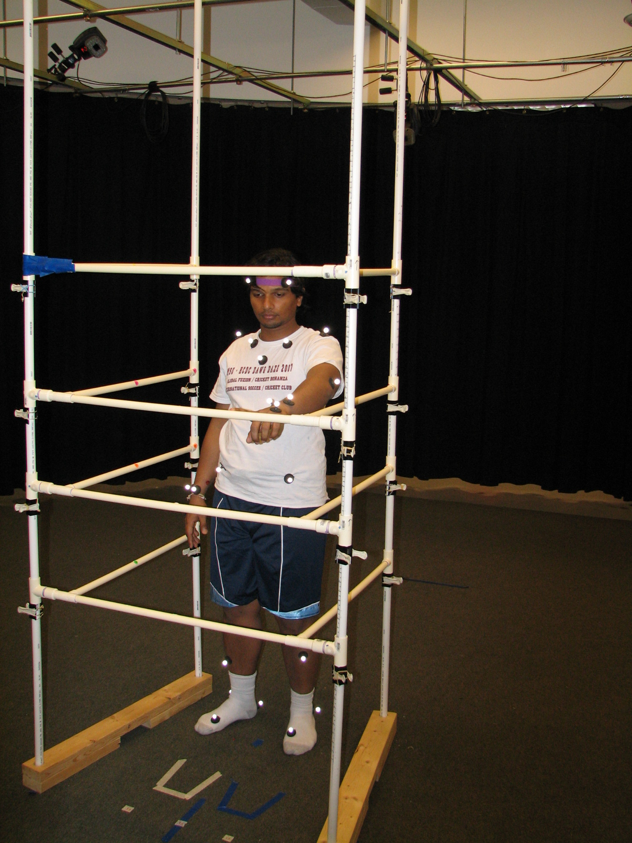
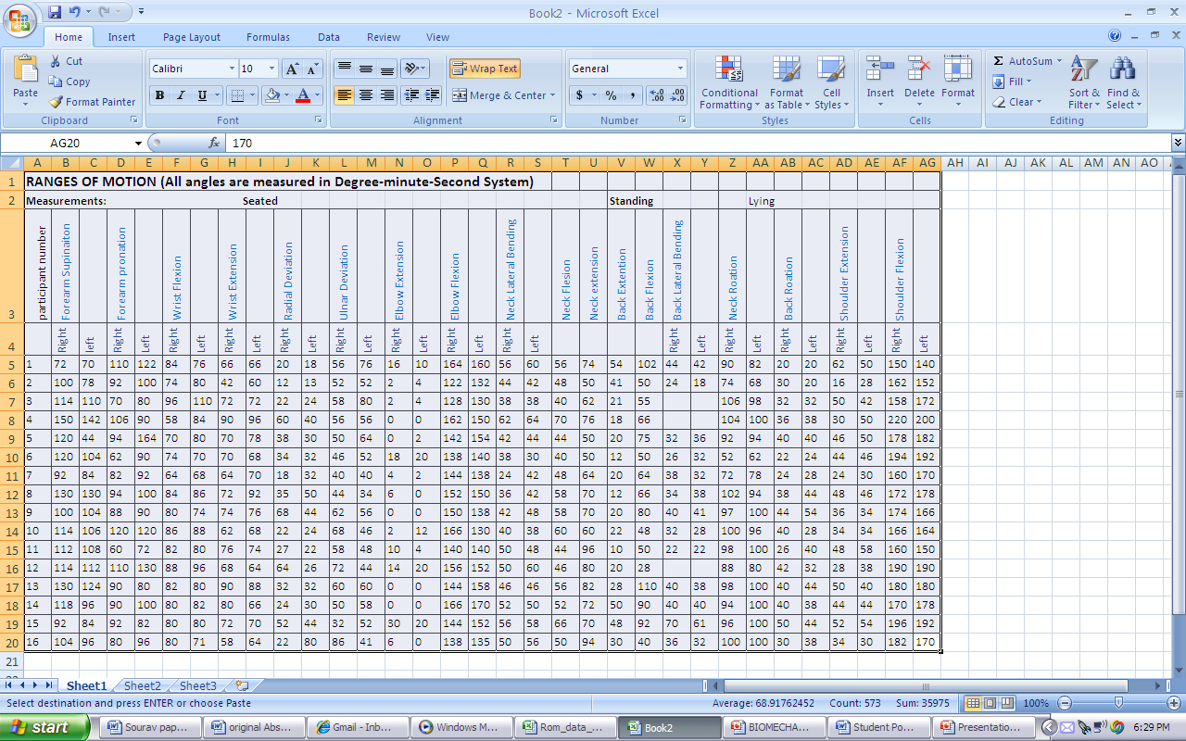
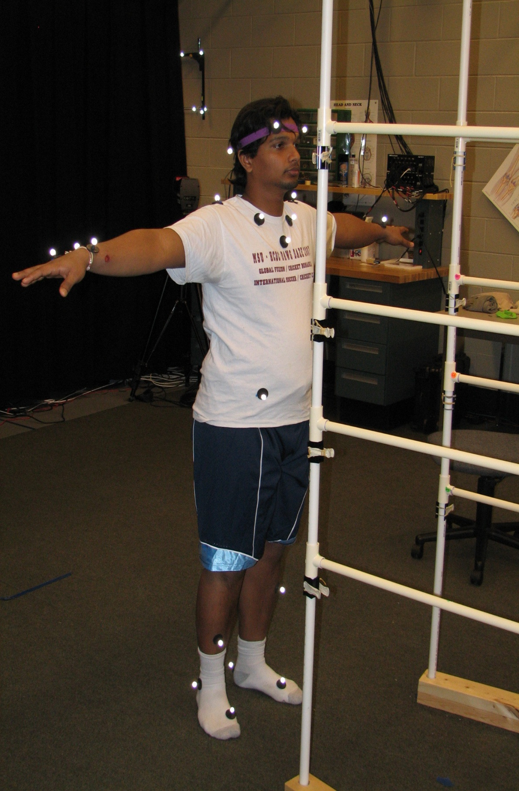
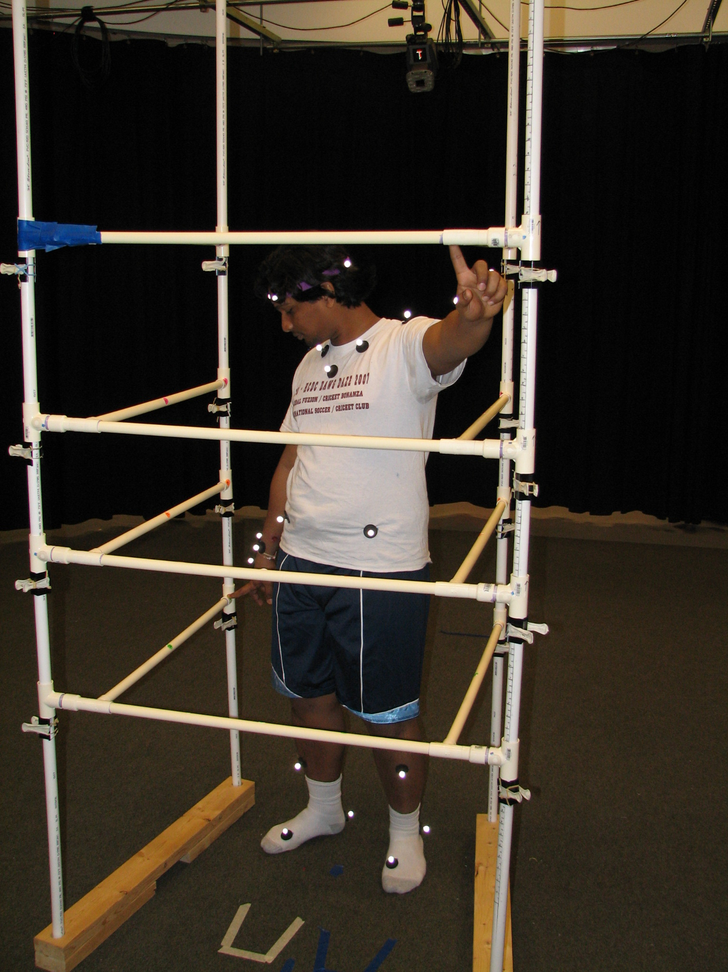
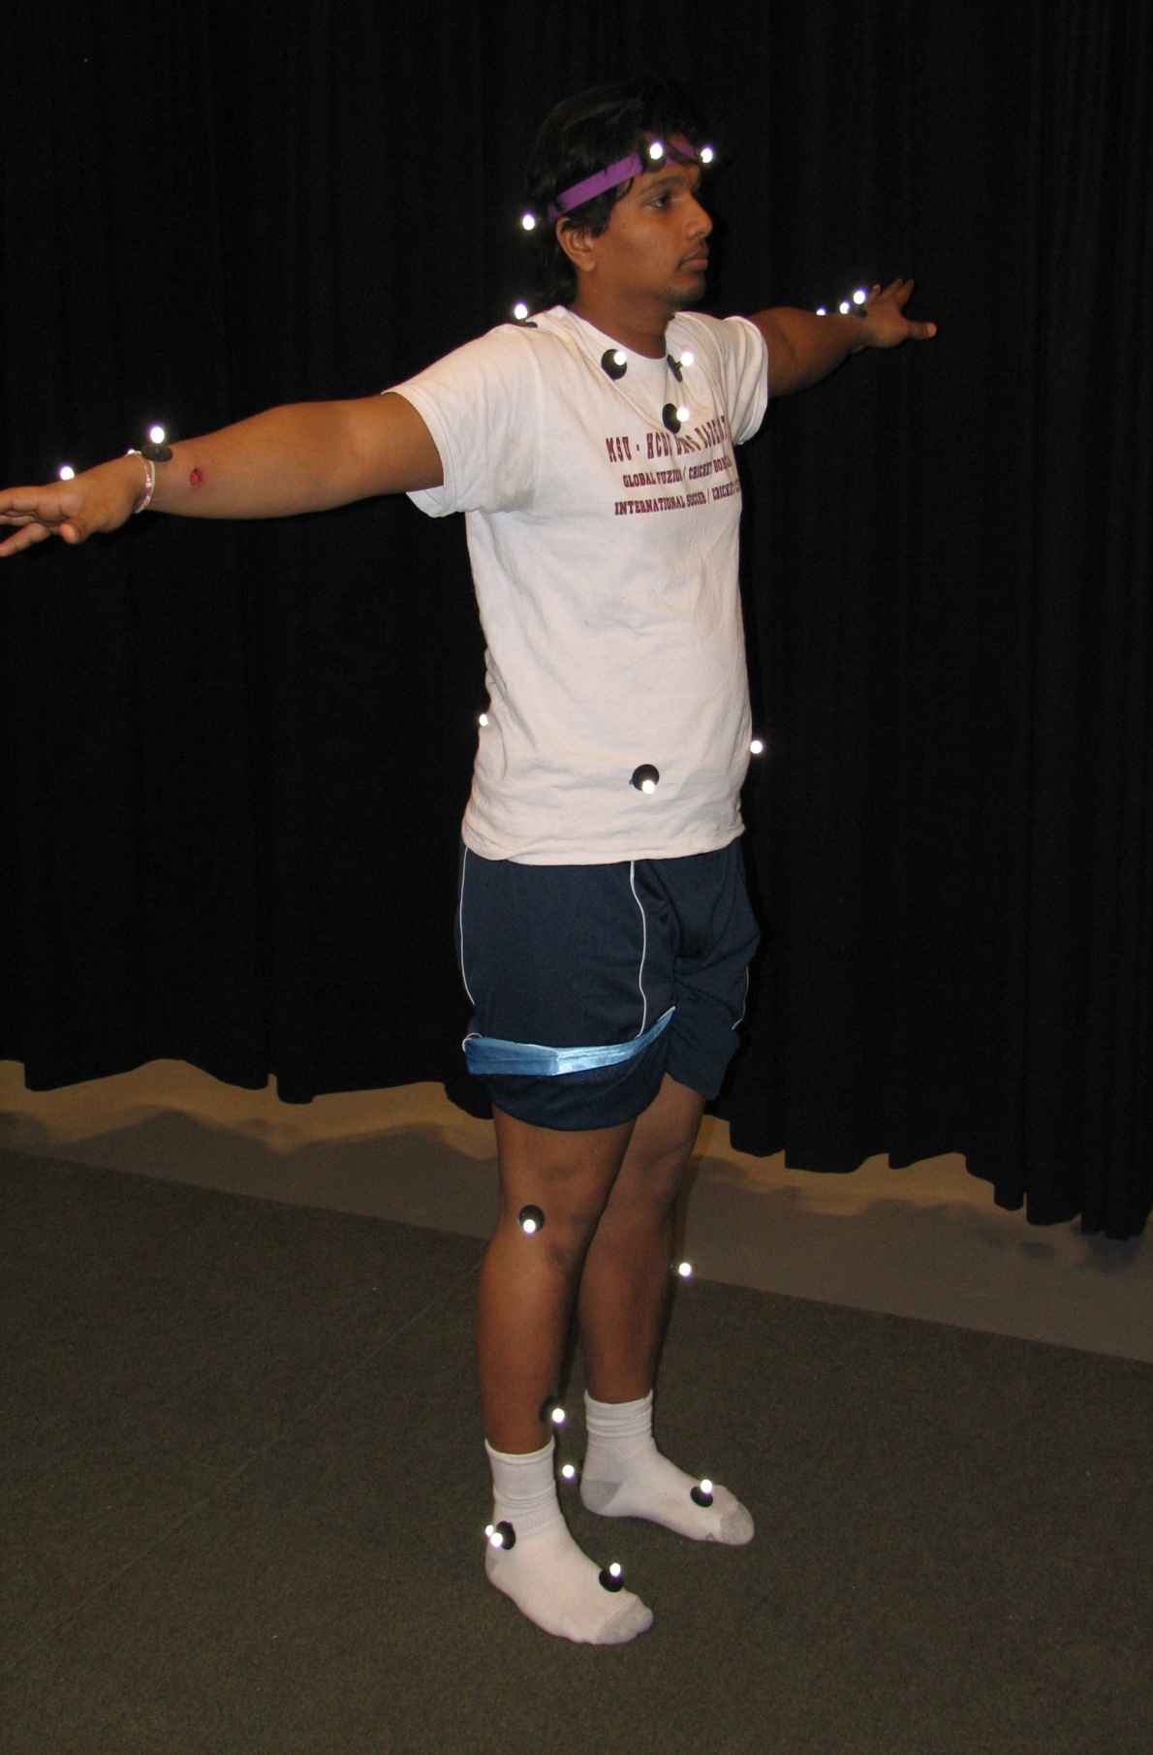
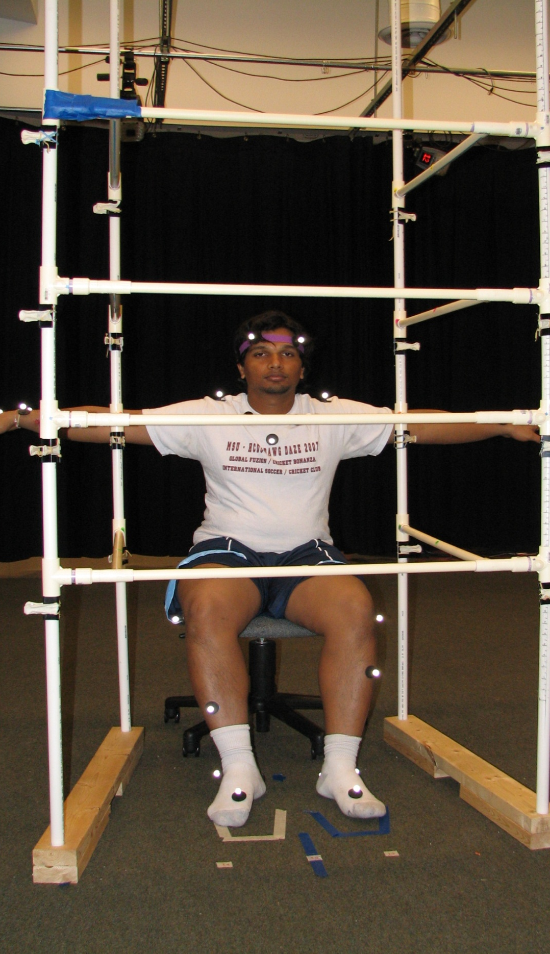
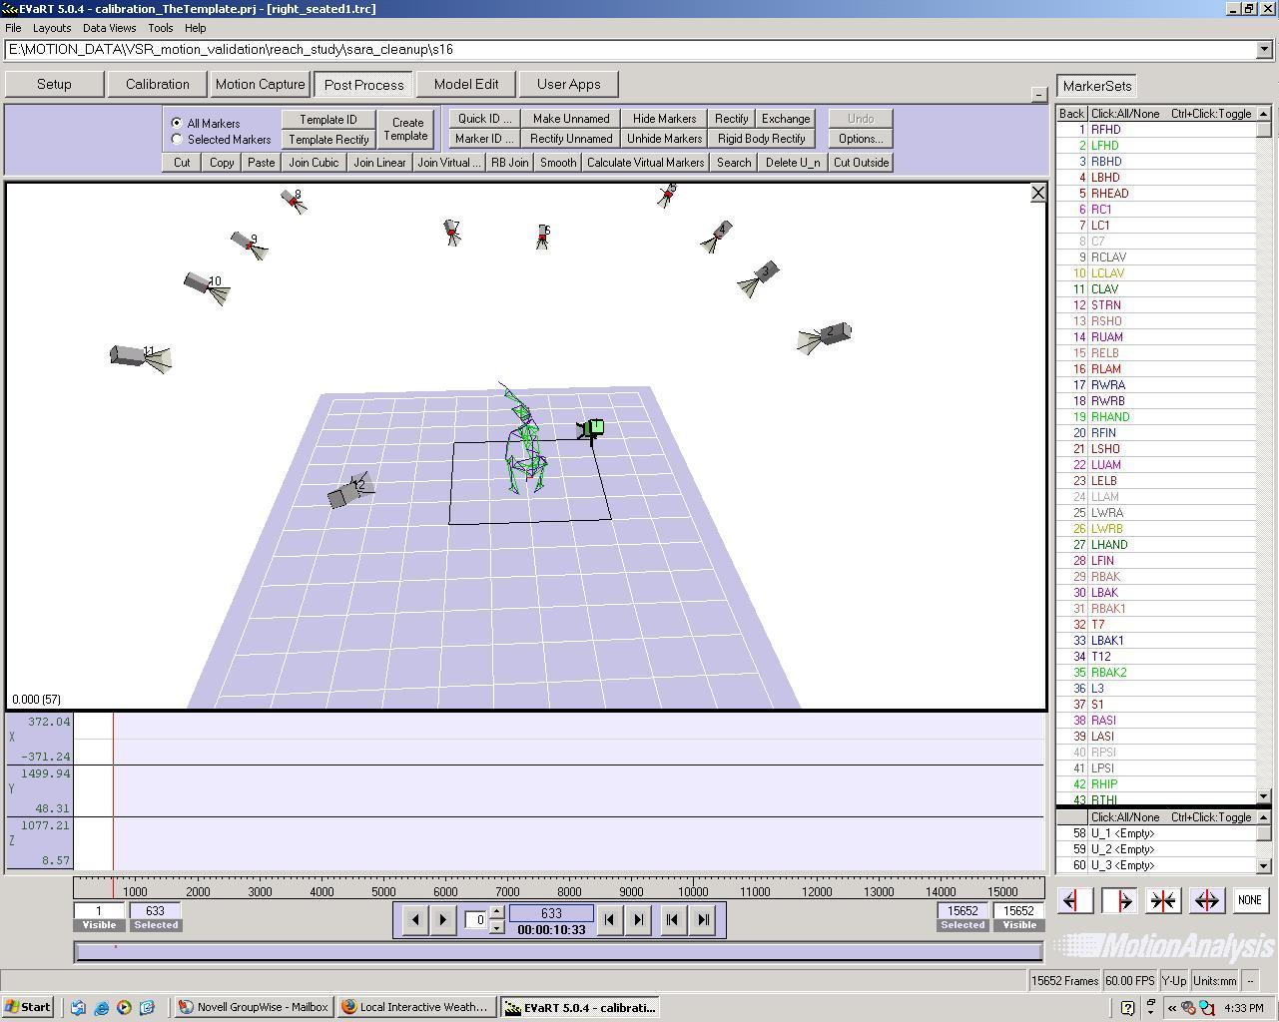
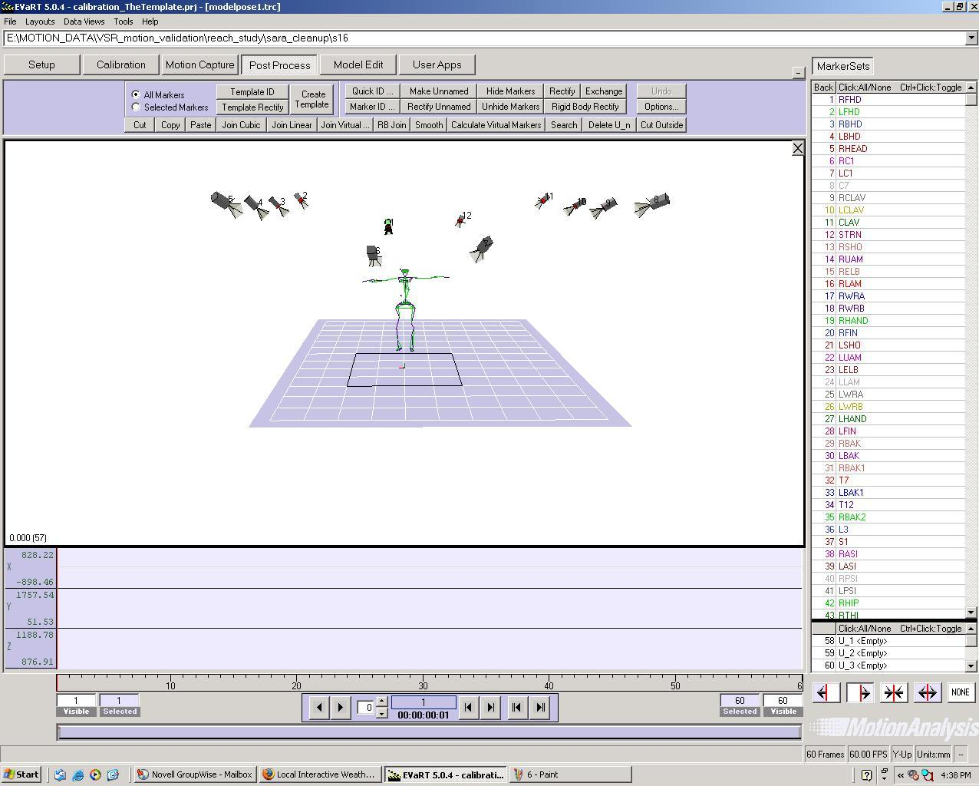
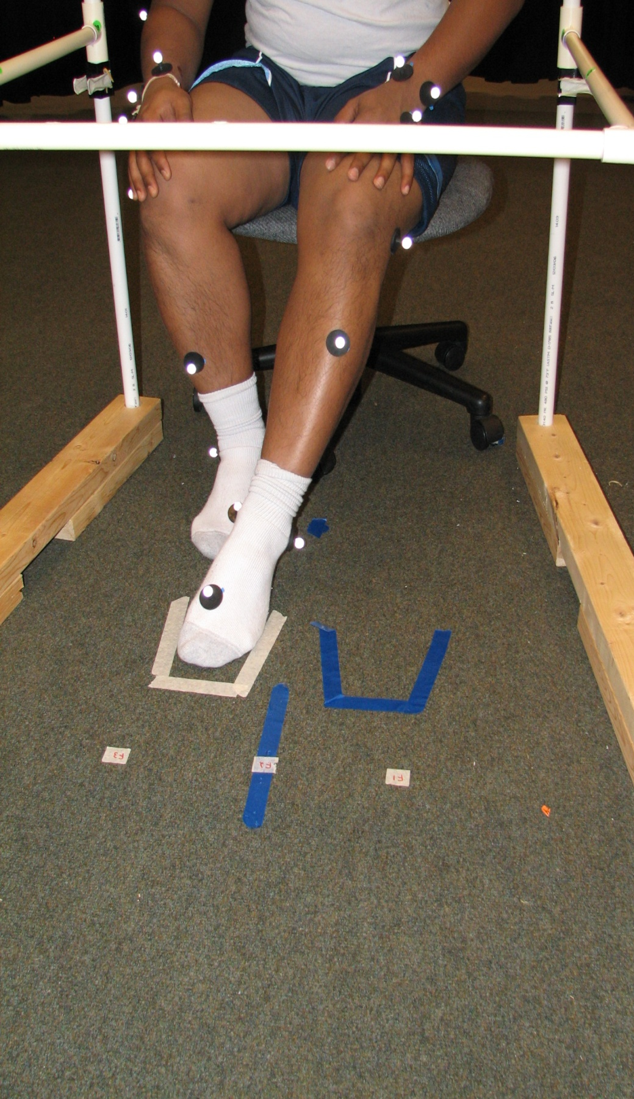
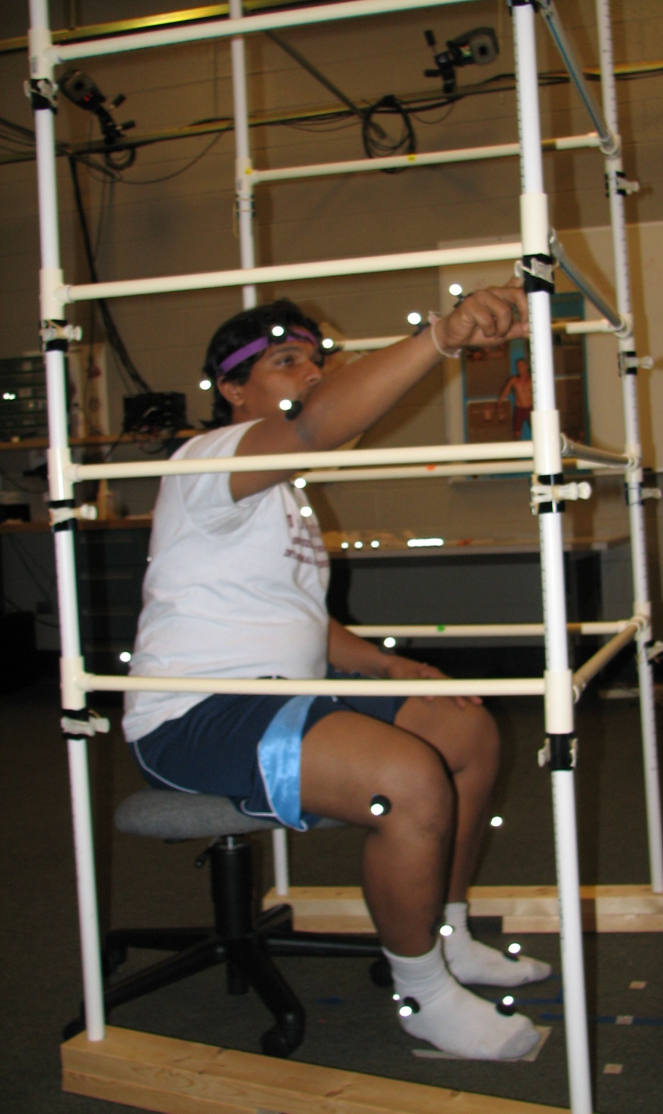
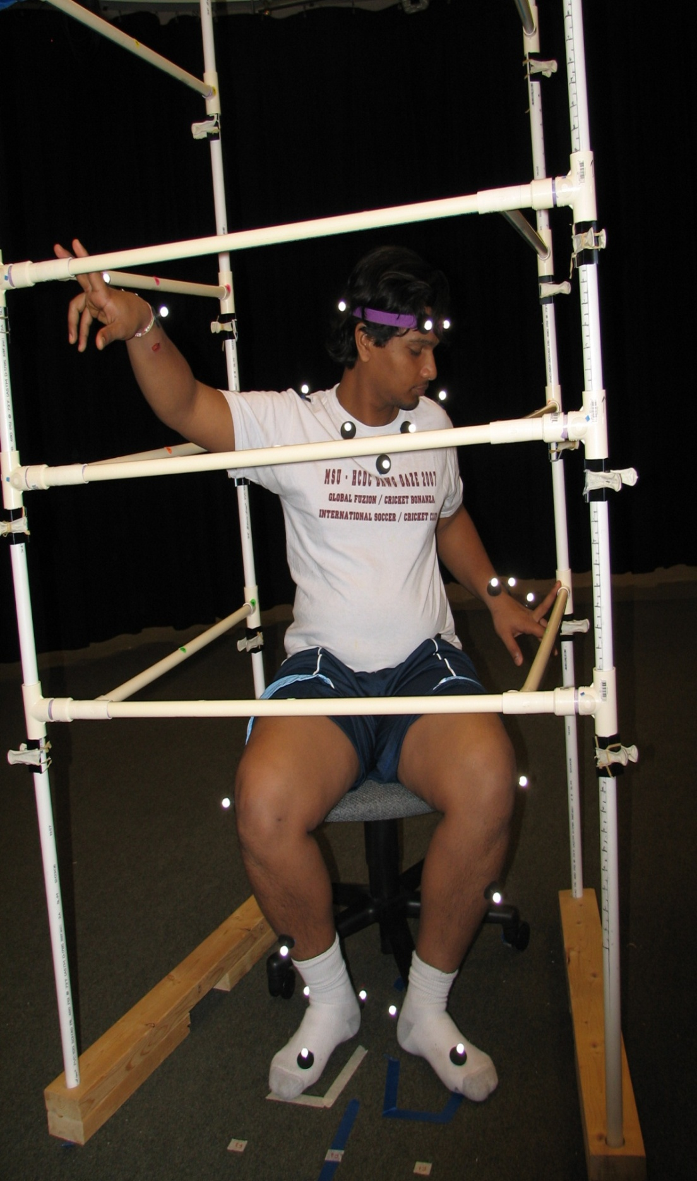

BIOMECHANICAL VALIDATION OF DIGITAL HUMAN MODELS:
A POSTURE AND MOTION STUDY WITH DIGITAL HUMAN MODELS
Sourav S Patnaik, John McGinley, Gary McFadyen,
Kari Babski- Reeves, Daniel Carruth
Human Factors and Ergonomics (HFE)
Research Group, Centre for Advanced Vehicular Systems,
Mississippi State University
ABSTRACT
Validation of posture and motion of digital human model is one of the various studies planned in the research design. For this purpose, we plan to recruit 50 healthy participants (25 male and 25 female, with no pathological disorders). 58 reflective markers were placed at selected portions of the body, keeping in view the biomechanics of the body parts. The subjects were then brought to the arena which was previously calibrated to minimize error due to dropped markers and phantom markers (e.g. interfering reflective objects).Range of motion data (TABLE–1) was collected for all major joints. Single and multiple effector reaching tasks were then performed. For all assessments, three repetitions were taken and the values were recorded. The data was then processed and thus used for further analysis.
RESULTS :Table 1
Range of Motion Data (ROM)
(2) Standing T- Pose
This pose is done
for initial calibration
of the motion
capture cameras
(4) Double arm - Standing
This task is similar to the previous one, only this task involves touching the spots simultaneously with both arms
(3) Single Arm -Standing
This task involves the subject to touch the various designated points on the rig designed as per his/her height. First left then right arm
Objective
Our basic objective is to validate the posture and motion prediction of upper and lower body. Further, we would validate the posture and motion prediction of whole body and also from basic fundamental tasks to more complex tasks.
Conclusion
The ROM data and motion
capture data collected would be useful in comparing bodily movements of the kinematic model with the digital human models and also various other applications.
Data Comparison and Model Fitting by
MOCAP Software
(1) Initial pose
This pose is done to see the proper placement and setting of markers on the subject.
(5) Sitting T- pose
This pose is done
for initial calibration
of the motion
capture cameras for the seated pose
Seated
Standing
Methods
1- Data acquisition
Kinematic model of body segment is created by linking the virtual markers and acquired motion capture data is applied to drive the motion of the model (see MOCAP Software Picture).
2- Data comparison
Comparison of rotation and displacement of selected joint is done, by analyzing the movement of markers in the newly created model which will then be compared to motions by a digital human model.
3- Model fitting
Assessment is done subjectively by ergonomic analysis. Then, qualitative assessment is done by appearance and predicted motions.
(7) Double Seated
This task involves reaching to two different points simultaneously.
REFERENCES
Chaffin, D.B., Faraway, J.J., Zhang, X and Woolley, C., (2000) . Stature , age and gender effects on reach motion postures. Human Factor, 42, 408 – 420.
Faraway, J.J.,(2000). Modeling reach motions using functional regression analysis. Digital human modeling for design and engineering conference and exposition, Dearbon, Michigan, June 6-8,2000.
Zhang, X., Chaffin, D.B.,(2000). A three dimensional dynamic posture prediction model for simulating in vehicle seated reaching movements: development and validation. Ergonomics, 43, 1314-1330..
(8) Feet Reach Task
In this task the subjects have to reach designated spots by their feet , one foot at a time.
(6) Single arm -Seated
This task involves reaching the specified points with one arm at a time.

