Slide 1
TEAM FOOD 3 Ideas Presentation
Divya Arcot, Isra Shabir, Megan Bumgarner
Spring 2011

Slide 2
IDEA 1
TARTAR REMOVAL SYSTEM:
“Bacto-Gum”

Slide 3
IDEA 1 - Method
Goal: To design a bacteria to remove tartar from teeth to prevent oral diseases and assist in oral hygiene.
Design:
Insert a gene into a bacterial plasmid that causes bacteria to consume tartar.
Contain bacteria in a capsule with food to keep them alive.
Deliver to the consumer in chewing gum form.

Slide 4
IDEA 1 - Importance
The removal of tartar will improve oral hygiene and cleanliness which is key to overall health of the body
Some diseases have symptoms which affect the mouth
Will serve as a vital product in preventing tooth decay and gum diseases (oral cancer, gingivitis, etc.)
The act of chewing causes secretion of saliva

Slide 5
IDEA 1 - Impact
Over all improvement in oral hygiene
Supplement to brushing, flossing, using mouthwash, etc.
Reduce dental costs
Many do not have insurance which covers dental care
Inexpensive enough to be marketed to impoverished countries
Make oral hygiene products easily accessible
Is safe enough to be sold at retail stores
Does not require a prescription
Will allow for aesthetically pleasing teeth

Slide 6
IDEA 1 - Competition
Currently, the only way to remove tartar is to go to a dentist and have them use professional tools.
Scaling/Root Planing (using a pointed instrument to remove encrusted material from the root surfaces of the teeth)
Debridement (removal of plaque and tartar using an ultrasonic device)
Surgery

Slide 7
IDEA 1 – Known & Unknown
Known
Unknown
Some types of bacteria reside in the mouth
Certain levels of acidity are bad for the bacteria
Tartar and plaque are created by both food and bacterial by products
Reaction of the general public to bacterial cleaning methods.
Whether bacteria will consume anything else in the mouth
How bacterial will react to salivary enzymes

Slide 8
Idea 1 - References
http://www.deltadentalins.com/oral_health/dentalhealth.html
http://en.wikiversity.org/wiki/The_Importance_of_Dental_Care_and_Oral_Hygiene
http://www.dentalfind.com/info/tartar

Slide 9
IDEA 2- Super-Rice
To genetically engineer rice into a special ‘super-rice’ rich in amino acids

Slide 10
Importance
Rice is an important staple in third world countries
Rich in protein, AND relatively cheap compared to other options; poor people benefit
Good alternative for people like vegetarians
Eliminates a percentage of meat associated cardiac health risks

Slide 11
Impact
Hunger and malnutrition are common to people in third world countries
Successful project = improved standard of living for such people
Another healthy option for Vegans and Vegetarians.
If tasty enough, could become a popular choice

Slide 12
Competition
Genetic engineering is common in today’s world- lots of projects around
Golden Rice – Vitamin A producing rice
Soy- good but not so popular in third world

Slide 13
‘Knowns Vs Unknowns’
Knowns/Facts/Approach:
Rice contains at max 10% protein only
Lacks lysine, threonine, cysteine, and histidine for starters.
Approach: use of engineered Recombinant DNA to produce these and more amino acids in rice

Slide 14
‘Knowns vs Unknowns’
Unknowns & Difficulties:
Genetic modification could disrupt genes having to do with reproduction- can only be verified if tested and grown
Super-rice taste
State approval for genetically modified food
Environmental opposition
Skepticism from target population
Costs

Slide 15
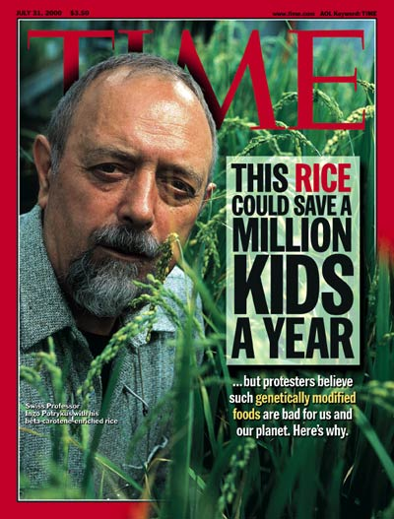
Environmental Opposition

Slide 16
IDEA 3 Clean Clay Consumption
Removing toxins in clay to benefit the health of people practicing geophagy using a method of bacterial filtration.

Slide 17
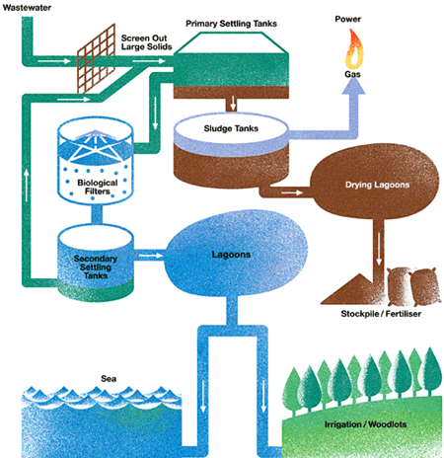
Methods
Settling tank
Filtration

Slide 18
Importance
Clay contains many minerals
Reducing the risks of consuming clay
Protecting health: reducing toxins
Increased stores of clay able to feed people

Slide 19
Impact
Pregnant women consuming clay in rituals.
People who eat clay for potential health benefits.
Third world countries who cannot afford most food options.

Slide 20
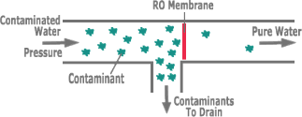
Competition
similar technologies but not really a direct competition
bacteria removing toxins from water

Slide 21
Known/Unknown
Known:
Clay is mineral rich
Lead, arsenic, and chalk have negative effects on the human body
Unknown:
Costs? (clean price vs. current price)
Specific type of bacteria (engineered or already existing?)
Bacterial waste products/waste removal?
Able to remove enough toxins to make it safe?

