Slide 1
Microbot Preparation
Joseph Lau and Bobby Wei

Slide 2
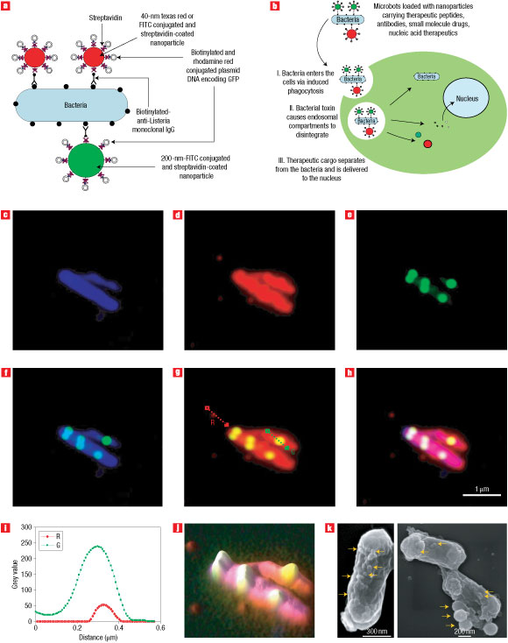
Vehicle for “bacfection”

Slide 3
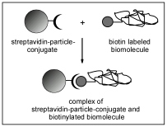
Strepavidin and biotin
Streptavidin has one of the strongest non-covalent interactions known to chemistry with the vitamin biotin
Biotin is a water-soluble B-complex vitamin that can be easily added to antibodies
Mechanism:
- Biotinylated antibodies latch onto receptor proteins on a bacteria’s surface and also bind to streptavidin-coated nanobots containing cargo

Slide 4
Advantages to nanoparticle system
Many copies of a particular cargo can be carried on a single bacterium
Because bacteria do not need to be transformed or genetically engineered in any way, method is simpler and cheaper
Versatile sizes and types of cargo can be attached inside streptavidin-ated polystyrene nanoparticles

Slide 5
Preparation of the biotinylated antibodies
Monoclonal Antibody C11E9
Biotinylated-anti-Listeria antibody
Buy from Invitrogen
Make payment
Open package

Slide 6
Preparation of Nanoparticles
Streptavidin or neutravidin-immobilized green (200nm, 40nm) or red (40nm) fluorescent polystyrene particles (1 and 0.5% solids content, respectively)
Purchase from a commercial source (FluoSpheres, Invitrogen, Carlsbad, CA) and were used as supplied by the manufacturer throughout the study

Slide 7
Preparation of microbots
Mix L. monocytogenes with phosphate buffered saline (PBS), Monoclonal Antibody C11E9, and centrifuge 10,000 xg for 5 minutes
Mix bacterium with streptavidinated-nanoparticles and incubate for 15 minutes

Slide 8
The reason we’re doing this:
A lot of projects contain existing technologies that are combined in novel ways.
This novel method of drug delivery and localization of bacteria will involve using the strepavidin-biotin extracellular system as well as ribozymes => iGEM victory

