Slide 1
The ECM, Cell Adhesion, and Integrins
2/4/16
Lecture 4, ChE 575

Slide 2
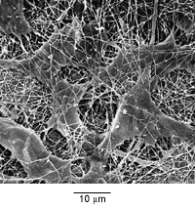
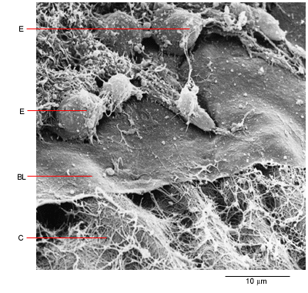
Natural Cell Microenvironment: ECM
The extracellular matrix:
is made and remodeled by cells that reside within it.
is a well-defined composite of proteins and polysaccharides (sugars).
regulates cell function (adhesion, survival, migration, etc).
contains unique chemical and physical features in each tissue
Fibroblasts in connective tissue
Molecular Biology of the Cell
Epithelial, basal lamina, connective tissue
Molecular Biology of the Cell

Slide 3
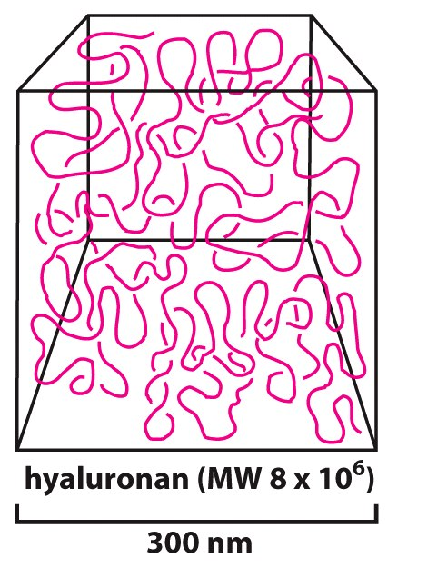
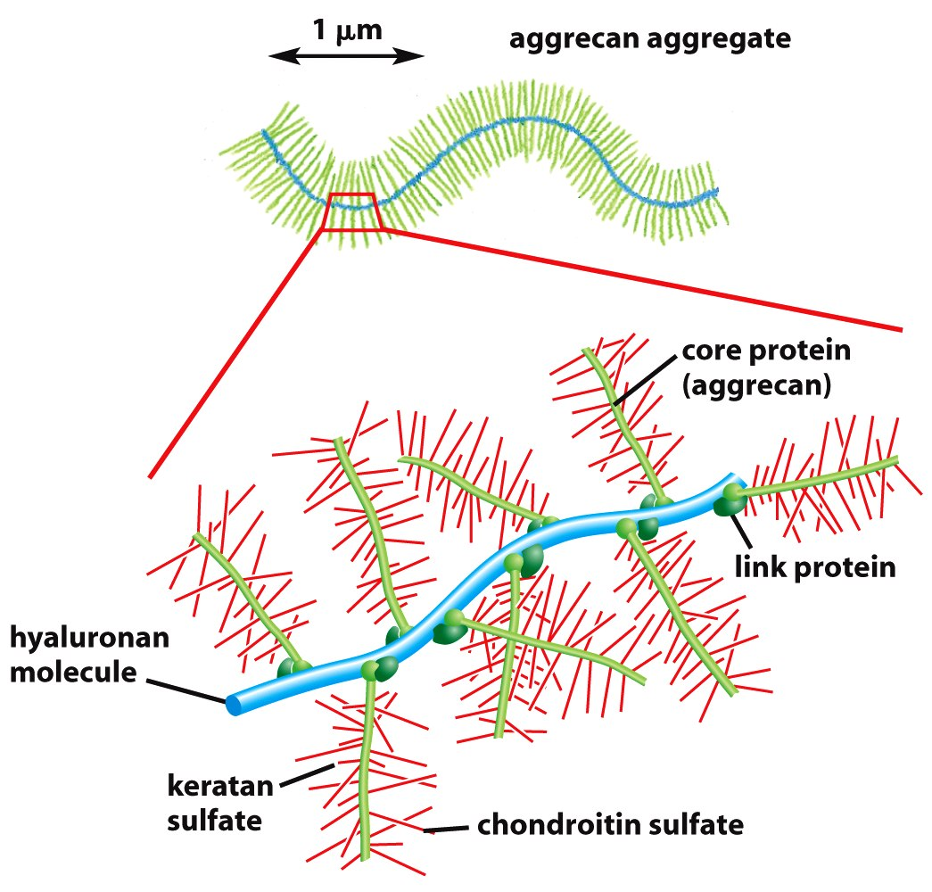
Sugars (such as hyaluronan) resist compressive forces
As well as connect to proteins to provide an organizing structure for cell-ECM signaling

Slide 4
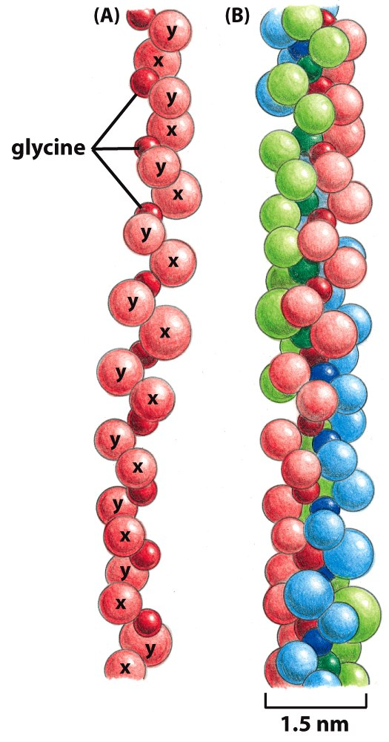
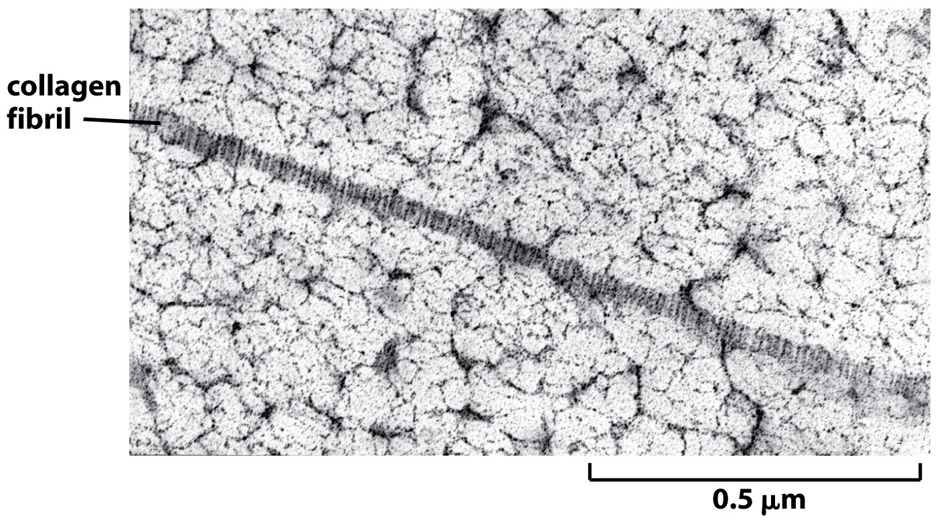
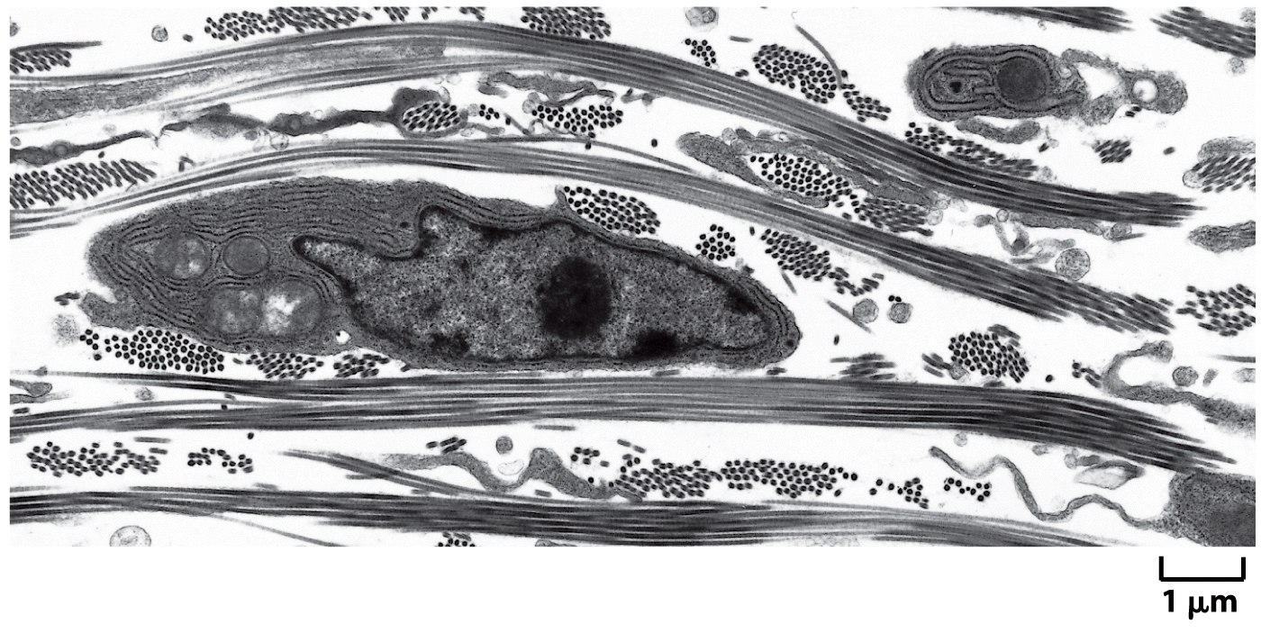
Collagen

Slide 5
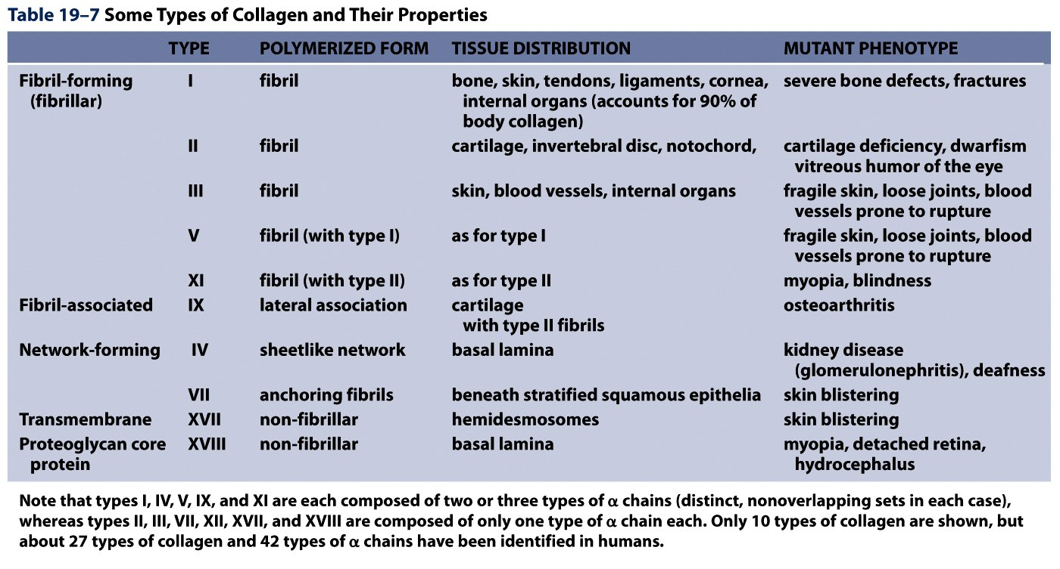
Collagens are Chemically and Structurally Diverse
Table 19-7 Molecular Biology of the Cell (© Garland Science 2008)

Slide 6
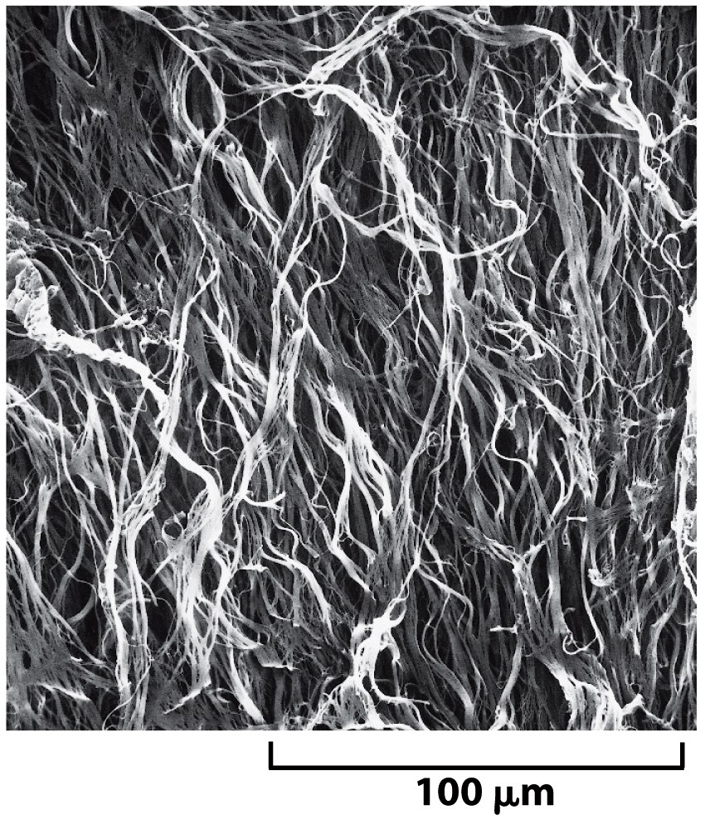
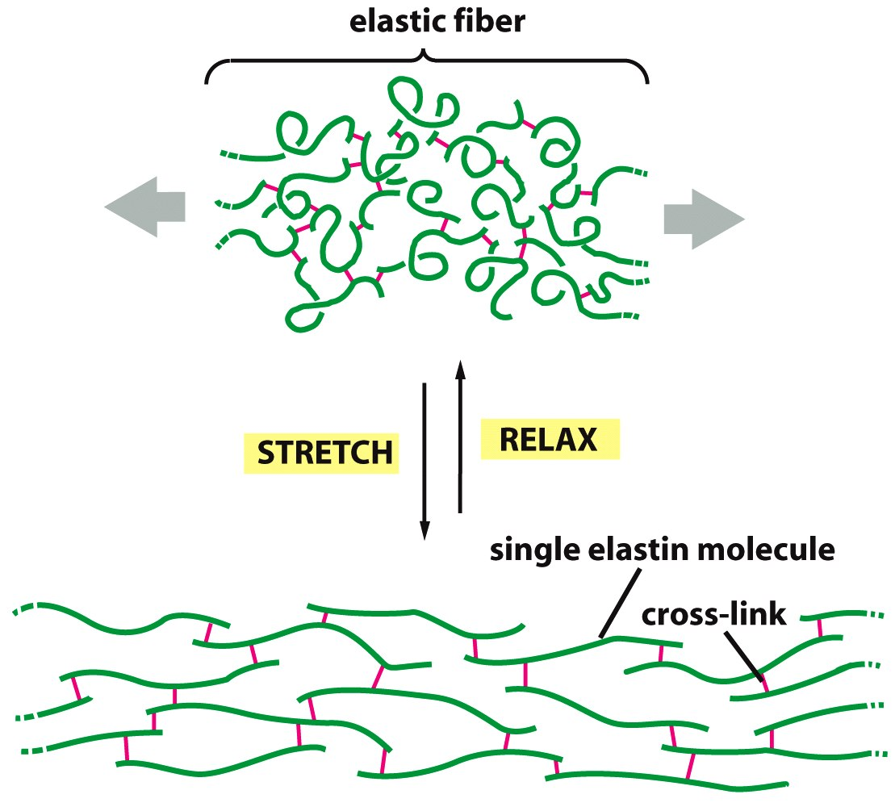
Elastin: five times more extensible than rubber!

Slide 7
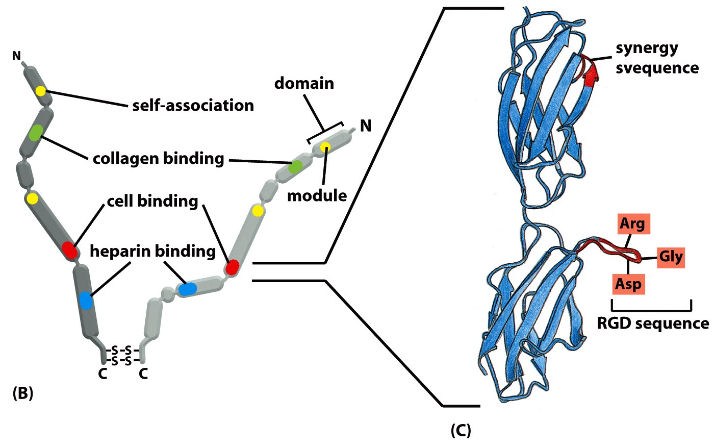
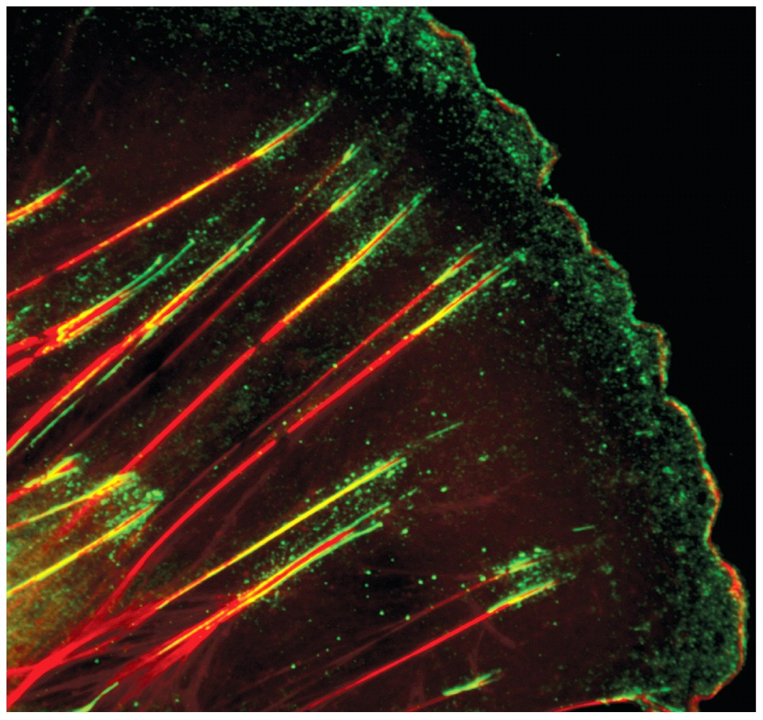
Fibronectin
Small fibronectin adhesive spots
Fibronectin fibers at fibrillar adhesion sites
Red: actin microfilaments

Slide 8
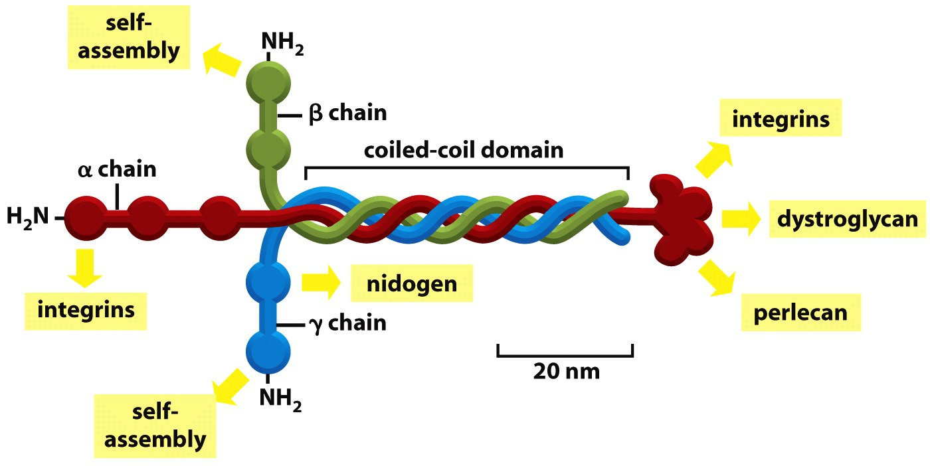
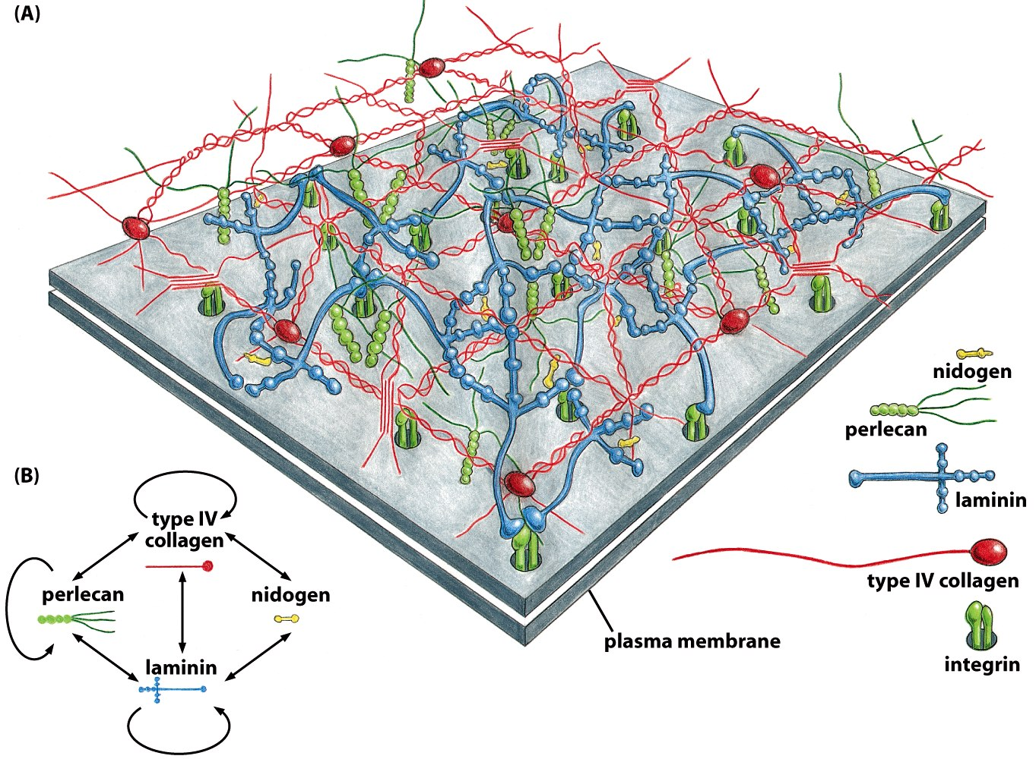
Laminin: Critical Organizer of Basal Lamina

Slide 9
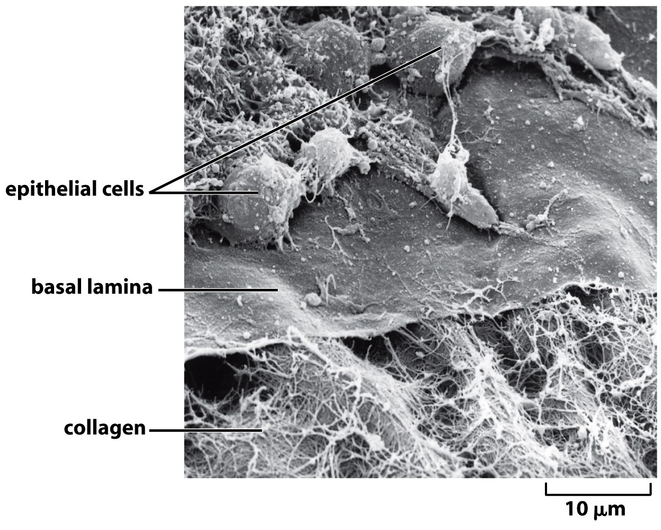
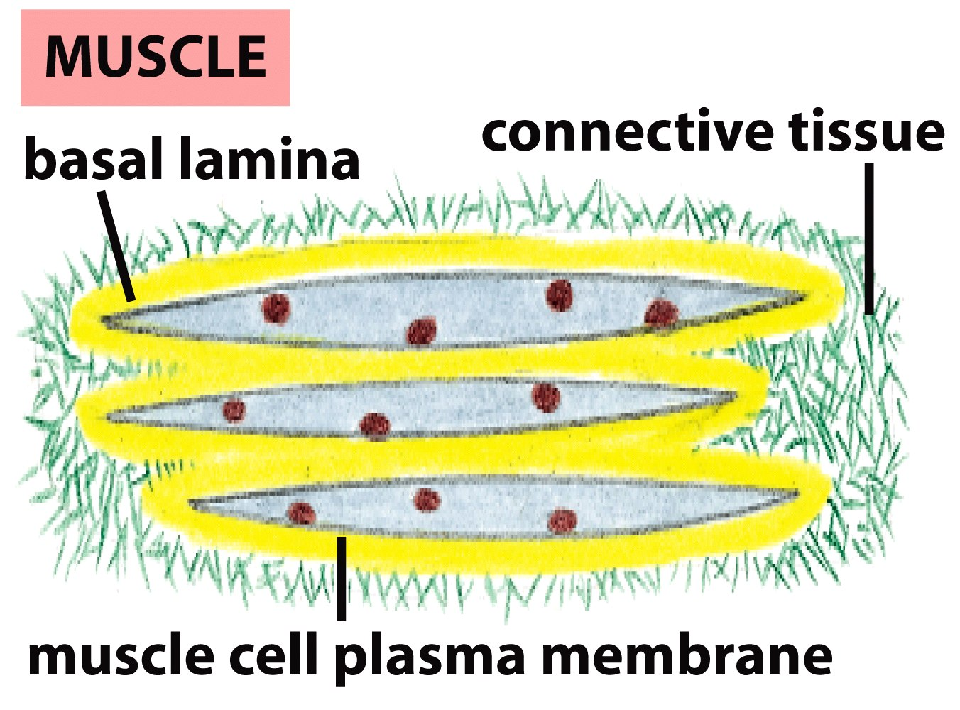
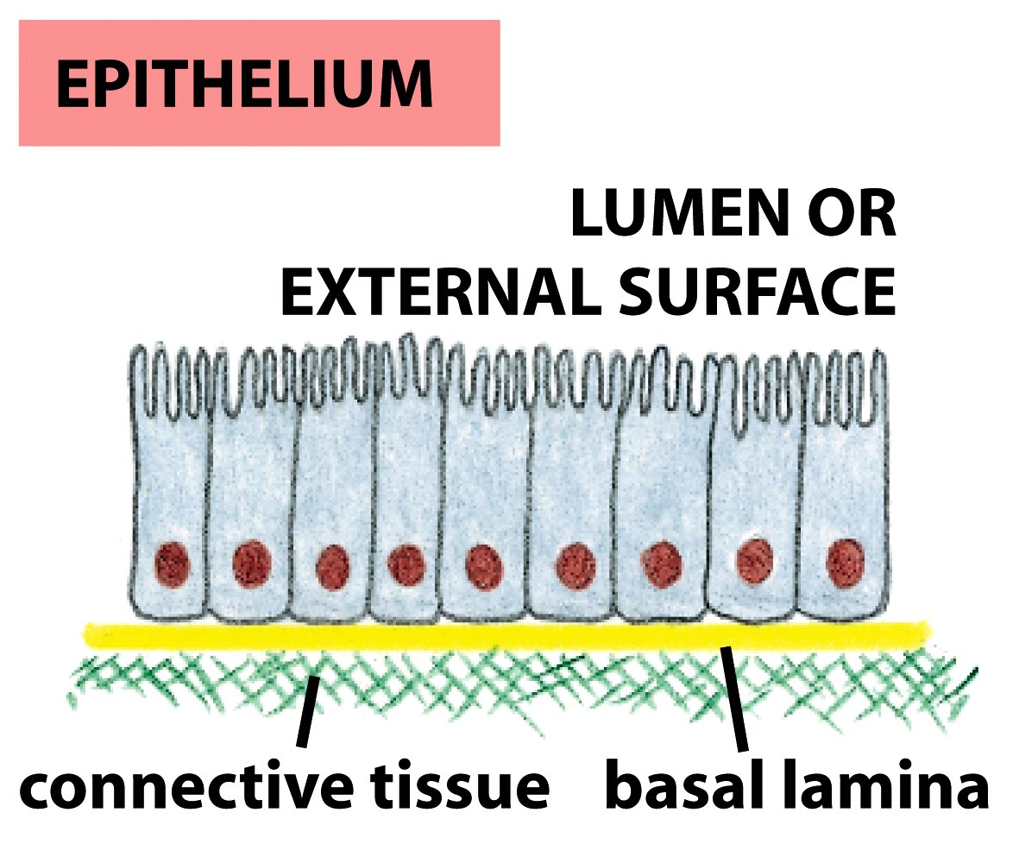
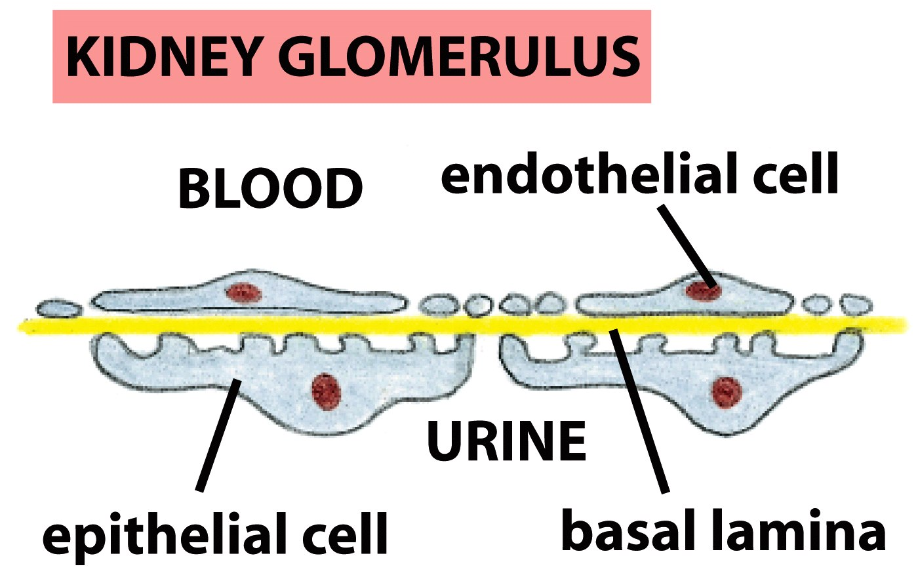
The Basal Lamina: architecture of all epithelia

Slide 10
Cells have many different types of receptors

Slide 11
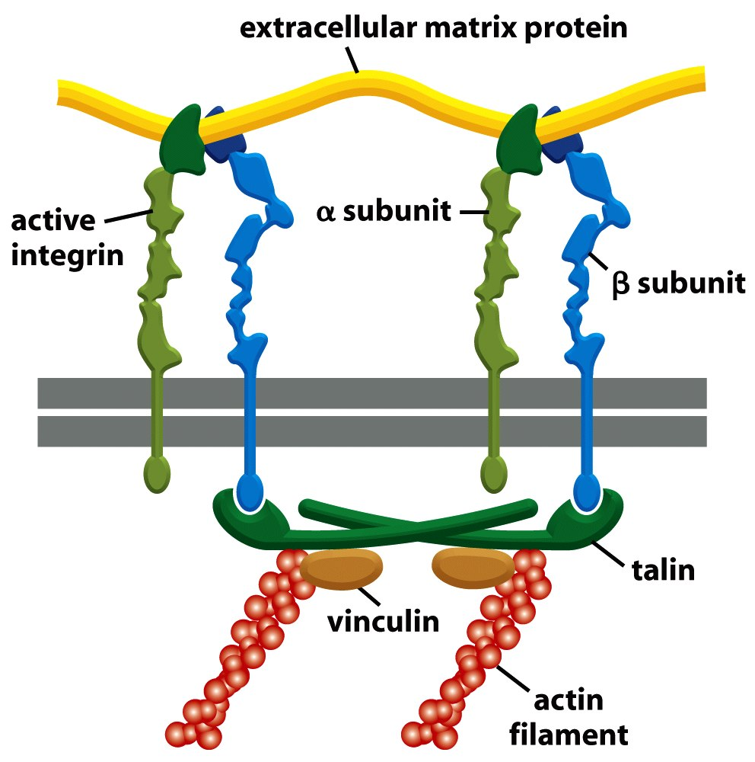
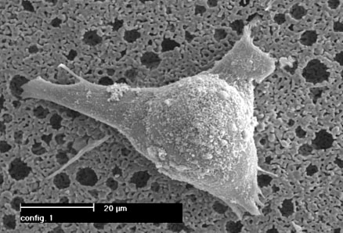
Integrin Structure
Integrins are one type of anchoring junction: anchor the cells to the matrix

Slide 12
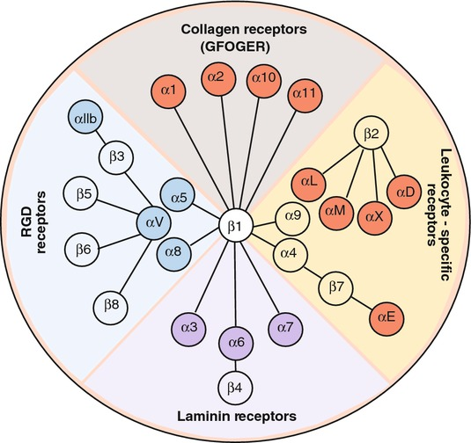
Many different heterodimers of integrins
Heterodimers are specific to the ECM proteins in tissue: matching cell type to tissue
8 betas, 18 alphas = 24 combinations (even though 8x18 = 144)

Slide 13
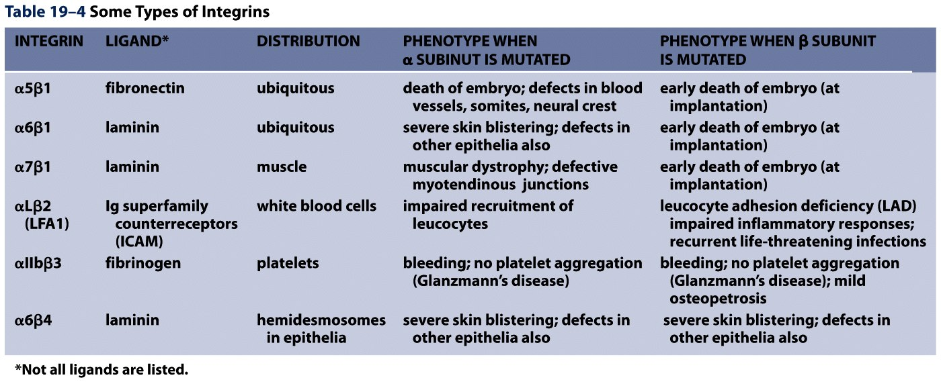
Not all cells express all integrin pairs!
Differential expression of integrins helps isolate cell types to different tissue areas
Epithelia: attach to laminin.
Carcinoma (epithelial cancer) cells: begin to express fibronectin and collagen-binding integrins, so they can invade the surrounding tissue and metastasize.
Tissue engineered material: coat these with proteins that will ONLY BIND the cells you want there!

Slide 14
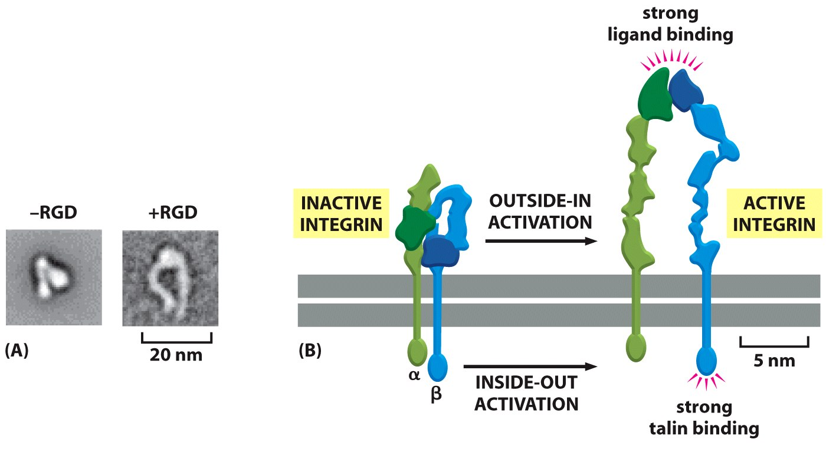
Integrins undergo conformation changes upon binding
RGD: short amino acid sequence that is part of Fibronectin, Vitronectin, Collagen
Focal Adhesion Formation
Signal!!! Survive, migrate, etc.

Slide 15
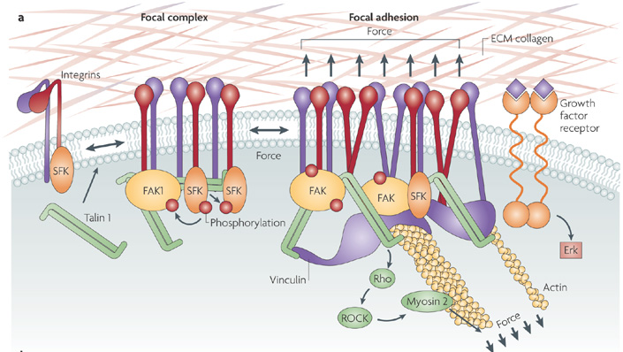
Stable bond, survival signals: minimum of 3-5 integrins clustered

Slide 16
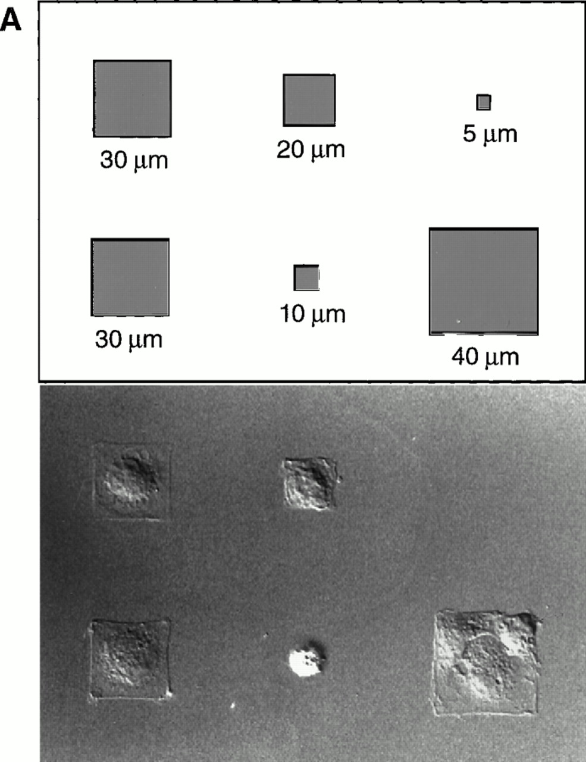
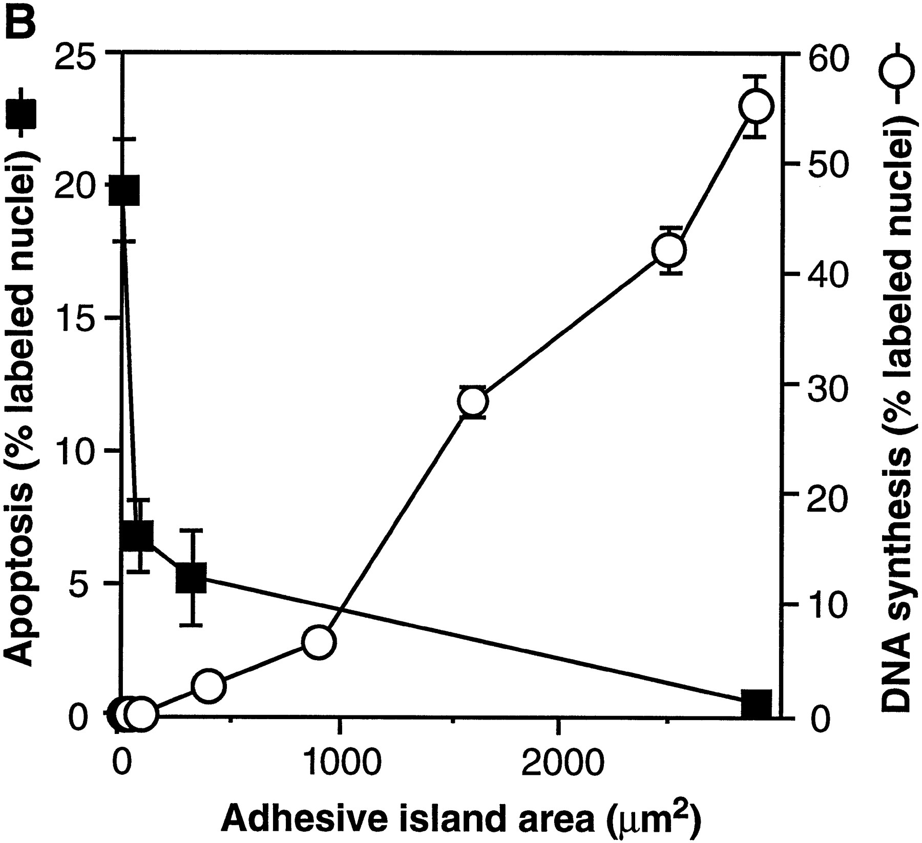
Most Cells Need to Adhere and Spread to Survive
Geometric Control of Cell Life and Death
Christopher S. Chen, et al.
Science 276, 1425 (1997);

Slide 17
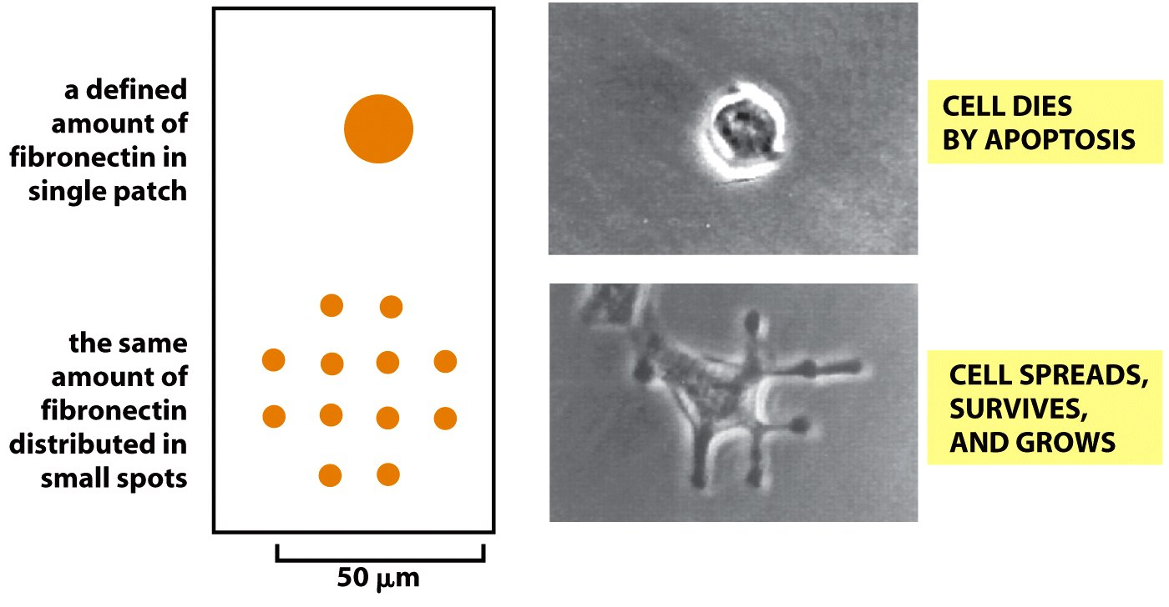
This effect not from “# of integrin bonds”
“anoikis”

Slide 18
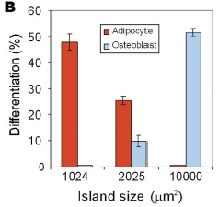
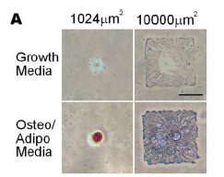
Stem Cell Differentiation by controlling size of adhesion sites
McBeath et al., Dev Cell, 2004

